Slide 1
What’s so special about Dewey translation?
1

Slide 2
2
Notes:
In 2011 (year of my first EDUG meeting and first EDUG presentation), focus was on enhancing the DDC translation software and WebDewey language versions. Soon after 2011, WebDewey became the standard application for DDC classifiers in DDC-using countries, the Pansoft translation software became the standard translation environment for Dewey translations. Full translations of DDC 23 as well as for Abridged 15 were underway in many languages.
Today, most translation teams see themselves in a “normal” updating process, meaning that the initial translation, be it for print or web or both, is finished and the job is to translate new and changed content that is coming in regularly by the US Dewey editors.
I would like in a way to follow up my presentation from 2011, according to the maxim: Now that the shop is running so well, let us finally take a closer look on what we're actually doing here!

Slide 3
3
Me, the translator
Me, the terminologist
Tina Mengel
Tina Mengel
Notes:
Intro: From my profession, I am a translator and a terminologist.
As a translator, I want to produce an accurate target text that corresponds to the source language text, content A corresponds to content B, as a whole. I like it when the shop is running, when the things go fast and easy: Look up an unknown word, build a correct sentence, move on to the next sentence. I like it when a text is correct and readable in the end. As a translator, I like to get things done.
As a terminologist, I look at the concepts and how they are named. I want to give things their proper names. I like to do some research and see how a concept belongs to other concepts. Yes, I also like correct sentences, but more than that I like correct names. And once decided on a good name, I want to have it correct anywhere. As a terminologist, I am a consistency fanatic.

Slide 4
Synergies
4
Translation +
Terminology management/
work
Sphere of special languages, communication, linguistics
computational linguistics -> KOS
mapping of same-type or different types of KOS -> terminology work
translation of KOS
terminology work in KOS
Classification systems, thesauri, taxonomies,
ontologies
Sphere of KOS, meta data, semantic web
Notes:
Why is the translation of Knowledge Organization Systems (KOS) so little discussed in research?
Different disciplines coming from different educational backgrounds, actors are living in their spheres (or „bubbles”).
There are so many synergies between the two worlds, so many connecting points! (And a high need for collaboration.)
Before this background, I’d like to share an experiment with you today. Let us, for a moment, take on the role of a professional translator and a professional terminologist, and let’s try to approach Dewey translation from their perspective.

Slide 5
Translation volume
5
Over 41.000 schedule numbers
Over 11.000 table and internal table numbers
Over 105.000 Relative Index terms
…to be translated!
Notes:
The first question a translator would ask:
How much text is it? → DDC translation volume

Slide 6
Translation complexity & text type (1)
6
Text type: Classification system (with numeric notations representing verbal class contents)
Consists of: (potentially) all disciplines and subjects (= topics), instructions and various other notes, hyperlinked Dewey numbers, interrelated terms, index terms that follow a special structure, …
Notes:
What kind of text is it and how much specialized is the text?
Main differences to text types specialized translators are normally dealing with:
- no continuous text (Exceptions here: Introduction, Theory and Practice, DDC manual)
- (potentially) all disciplines and subjects (= topics)
- data format information as part of the translation content

Slide 7
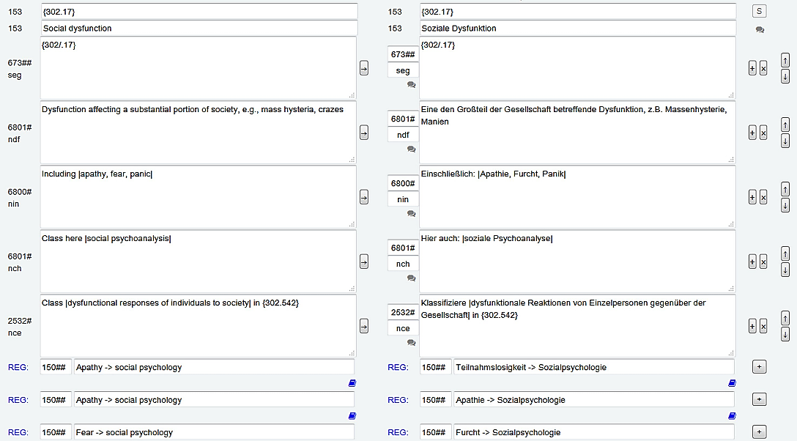
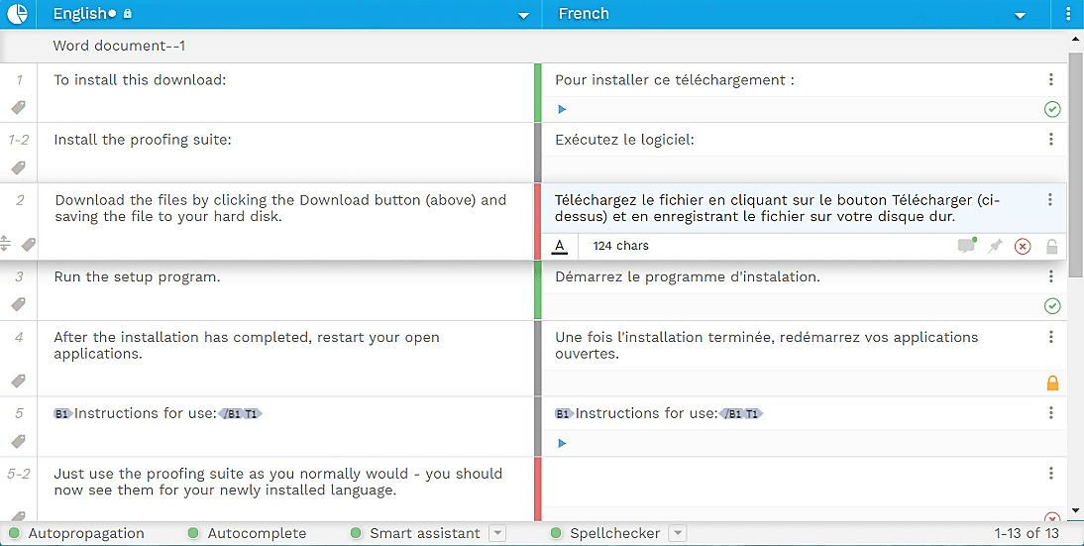
Translation work environment
7
TS DDCger (Pansoft)
TMS (www.wordbee.com)
Notes:
Screenshots: Pansoft Translation Software DDCger 23
Translation Memory System (TMS) example: Wordbee https://www.wordbee.com/
The DDC translation software is similar to a translation memory software (TMS), the normal work environment of modern translators. But of course, there are some differences, too. For example, the DDC TS has no “memory”.
The “memory” in the name “Translation Memory Software (or System)” is coming from the core functionality of these systems: A TMS remembers any text that you have translated before and based on that gives you auto-suggestions for the text you start you type in.

Slide 8
Terminology issues
8
YEP
Q: Are there any terms or phrases in the text that have a specialized meaning, and which I cannot look up in a dictionary?
Q: Is there repeating text that should be handled the same in certain areas, or throughout the text?
Q: Will there be any issues with synonyms and ambiguity?
Q: Are there any regulations regarding grammar and style?
YEP
YEP
YEP
Notes:
Questions a terminologist may ask about Dewey translation.
You can say YEP, if any of it sounds familiar to you!

Slide 9
DDC translation skills
9
Translation
Terminology work
DDC classification knowledge
Notes:
Before we move on, we can already make the observation that DDC translation doesn’t sound trivial, and we can determine this even without having looked at one concrete DDC example.
We can already guess that translating is not the only skill that is demanded here...
How do the different skills interact together? What are the main challenges?
At first, we need to distinguish between the individual linguistic elements of the text:

Slide 10
Linguistic elements in DDC
10
Meta-terminology
Phrases and notes
Topics

Slide 11
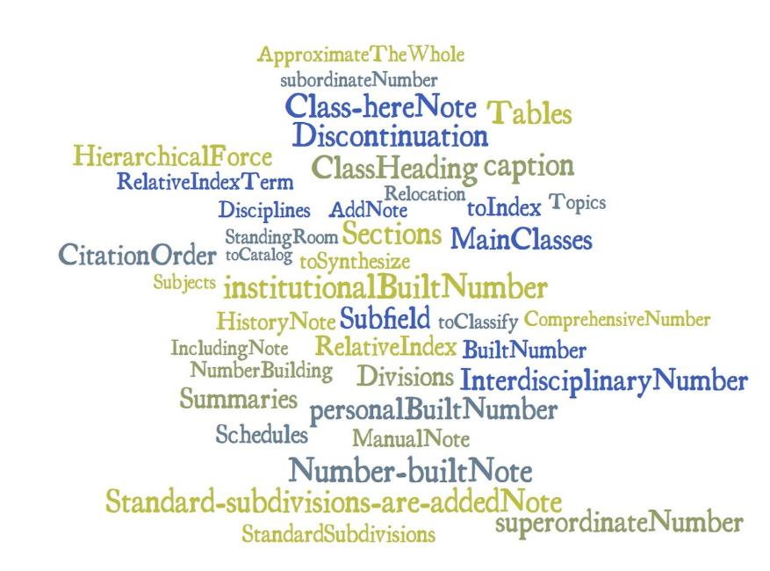
Linguistic elements in DDC (1) – Meta-terminology
11
Introduction, Glossary, Manual, Theory and Practice, other secondary text (articles, project reports, presentations), WebDewey, MARC etc.
Image generated with worditout.com
Notes:
Word cloud generated with: https://worditout.com/word-cloud/ (free)
Starting with the meta-terminology, or meta-language of DDC. The meta-language contains all the terms and formulations that are used to describe the classification system, to speak about it, or to make research with it. It is highly recommended to start a DDC translation by translating as much meta-language as you can find!
However, caution is needed also for early-determined meta-terminology, simply because it can change over time. Only recently, there have been new terms added to the glossary regarding the history aspects of a class, for example “deprecation”.
DDC research projects, new technologies, new functionalities in Dewey applications – all this can have an influence on our DDC meta-language as well. To better keep up with these changes, we would need to have the DDC glossary and the introduction integrated in the translation software.

Slide 12
Linguistic elements in DDC (2) – Notes and phrases (1)
12
Class here |folk remedies, home remedies|
Class |a specific kind of traditional remedy| with the kind, e.g., |medicinal herbs| {$e 615.321}
|Gene therapy| continued from
Standard subdivisions are added for |sound and related vibrations| together, for |sound| alone
|$g*| Use notation {T1—$x 019} from Table 1 as modified at {004.019}
Number built according to instructions
under {006.2483}
Notes:
What Dewey numbers are for the hierarchical structure, the DDC notes and phrases are for the verbal content in the DDC. They build the frame for the topics, they include, they exclude, they interrelate, and classifiers always follow their instructions ;-). Notes and phrases can be very short and clear or can be complex and nebulous, the latter sometimes to the sorrow of the translator and the classifier.
After removing the topics, we can state that the notes and phrases can actually make up a large part of a class content!

Slide 13
Linguistic elements in DDC (2) – Notes and phrases (2)
13
Class |effects of poisons on a specific system or organ| with the system or organ, plus notation {int:616.1-.9;071} from table under {616.1-616.9}, notation {int:617;071} from table under {617}, or notation {int:618.1-.8;071} from table under {618.1-618.8}, e.g., |effect of poisons on the liver| {$e 616.362071}
Add to base number {$b 909.04} notation {T5—$d 1-9} from Table 5 for the group only, e.g., |world history of Jews| {$e 909.04924}; then add {$f 0} |$g*| and to the result add the numbers following {$r 909} in {$d 909.1-909.8}, e.g., |world history of Jews in 18th century| {$e 909.0492407}
Notes:
Two further examples for more complex phrases.
What characterizes the phrases and notes most, is consistency. Only a consistent translation of the phrases and notes can guarantee that search operations yield precise and complete results, and what’s even more important, that the classification rules are being understood and used the way it is intended by the system.

Slide 14
Linguistic elements in DDC (2) – Notes and phrases (3) – Captions
14
Auxiliary techniques and procedures; apparatus, equipment, materials
Computer applications
Groups of people
Serial publications
Synopses and outlines
Historical periods
Education, research, related topics
History, geographic treatment,
biography
Areas, regions, places in general
Specific continents, countries, localities
Notes:
This refers not only to the phrases and notes in a class, but also to the phrases used in class headings, because they can contain expressions from the tables or use captions that are to be translated consistently throughout the system or within a certain subject area. For an initial DDC translation, it is therefore advisable to start with the tables, because those phrases are coming up all the time!
The return of a carefully executed initial translation becomes clear in the ongoing translation of updates: For example, the translator needs less search time to find all the classes affected by the change, since they were previously translated in a consistent way. (Not all the updates are displayed in the update list! There can be target-language-specific treatment, or target-language-only classes, which however need to be adapted to the updated version!)

Slide 15
Linguistic elements in DDC (3) – Topics (1)
15
Including |Accra, Kumasi; British Togoland|
Class here |folk remedies, home remedies|
Class |a specific kind of traditional remedy| with the kind, e.g., |medicinal herbs| {$e 615.321}
|Gene therapy| continued from
Standard subdivisions are added for |sound and related vibrations| together, for |sound| alone
|$g*| Use notation {T1—$x 019} from Table 1 as modified at {004.019}
Number built according to instructions
under {006.2483}
Notes:
Topics are the beating heart of the system, and this literally means that they are living, because they are subject to changes all the time! A topic reflects, together with a DDC number, the literary warrant which means, in other words, whenever there is a certain amount of literature about a specific subject or discipline, this will be represented by a respective DDC number and its topics.
The entrance and alteration of topics are thoroughly discussed and decided upon by the DDC Editorial Policy Committee, in close cooperation with national libraries and other library institutions in the world. The Dewey editors are working in the changes in accordance with the DDC Editorial Rules. The Editorial Rules are the guidelines for the creation of DDC content, and they also contain some extra chapters about grammar, style and wording.

Slide 16
Linguistic elements in DDC (3) – Topics (2) – Translator’s tasks
16
What does the topic mean in the context of the class?
Profound research in specialized dictionaries, terminology databases
Does the topic fit into the formal structure of the note?
Check the consistent wording of the topic in the area/throughout the system
…

Slide 17
Linguistic elements in DDC (3) – Topics in the Relative Index (1)
17
Mensch Personen
Endokrine Krankheiten | 573.439
Endokrine Krankheiten—Menschen | 362.1964
Endokrine Krankheiten—Menschen—Anästhesiologie | 617.96744
Notes:
Discussing the translation of DDC topics can be much more extensive, but I want to leave it with two short remarks about topics in the Relative Index. Because here, the translator needs to take care about some quite critical things:
- First, to translate a multi-level Relative Index term without violating the structure of the Relative Index in case the topic is also treated in other subject areas.
If, like shown here, “Menschen” would be translated differently on the second or third RI term level, this would tear apart the structure of the Relative Index entry. The proof-reading process should therefore include regular consistency checks in the Relative Index.

Slide 18
Linguistic elements in DDC (3) – Topics in the Relative Index (2)
18
Adding synonyms in the target language…
…offers a wider range of verbal access points
Notes:
And there are many other issues with the translation of the Relative Index.
- For example, to make a decision whether or not to add a synonym or near synonym, a spelling variant or an abbreviation in the target language for a topic that has only one entry in the source language.
- Or to decide how to deal with a source language term that does not have a target language translation at all.
These things are particularly important for the translation of print editions, where the easiest and fastest access to a class is still via the Relative Index, and this means that there cannot be enough alphabetical access points.
However, today, we also need to consider that most of the editions are also or only available in WebDewey, where we have the possibility to enrich the DDC vocabulary by mapped terminologies. So, in this case, it can also be a strategy to limit target language synonyms to a minimum.

Slide 19
Fundamental pillars for DDC translation (1) – Consistency (1)
19
automated structure alignment for format consistency
phrases tool for consistency of notes and phrases
projects for consistency of topics in larger updates
most-precise search options and filters for consistency of topics and Relative Index terms
search & replace for controlled replacement of text
Notes:
We heard it before: The consistent translation of all the linguistic elements in DDC is of utmost importance.
Good thing is, that in the translation software, there are several ways keep track on consistency and to perform consistency checks.
Since Dewey translators know them by heart, I only want to point out two of them here:

Slide 20
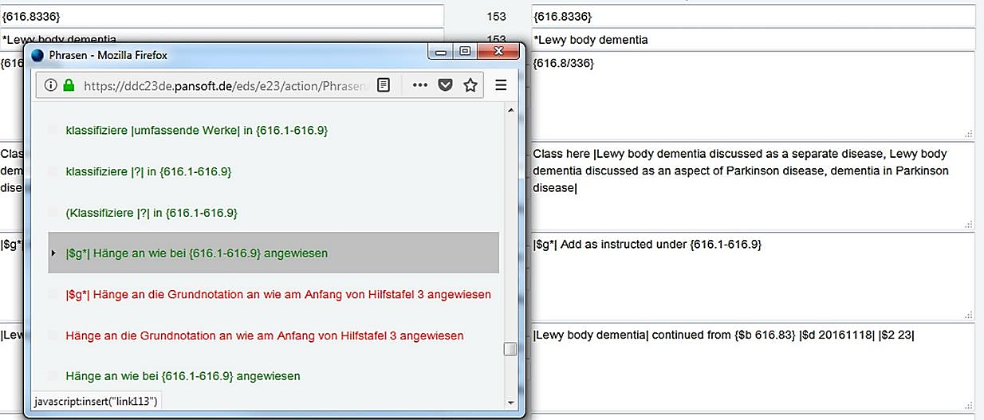
Fundamental pillars for DDC translation (1) – Consistency (2)
20
phrases
tool
Images: TS DDCger
Notes:
Images: Pansoft DDC Translation Software DDCger 23
The phrases tool:
To make sure that we are using the correct formulation of a note or phrase in a class, we can copy a phrase from the phrases tool, which is actually only an XML file where you can maintain your notes and phrases. You can open it in a pop-up-window from where you are translating and copy the phrase into the target language text field.
Currently, this functionality is not as good as it could be. But there is great potential in this tool, because it really can help us translate notes and phrases in a consistent and time-saving (!) way.

Slide 21
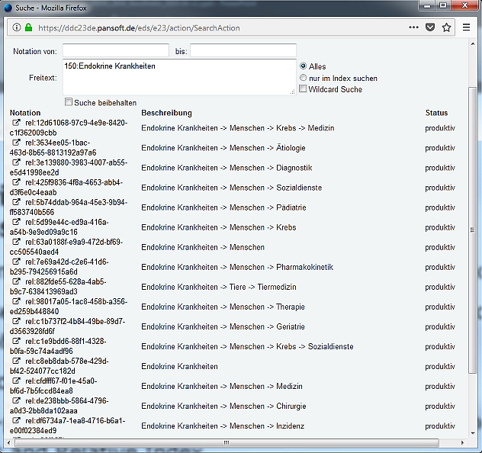
Fundamental pillars for DDC translation (1) – Consistency (3)
21
Simple trick for checking the consistency of Relative Index entries: Search results view in translation software
Images: TS DDCger
Notes:
Images: Pansoft DDC Translation Software DDCger 23
Only a hint, for those who don’t know, or have never tried: To check consistency of translated Relative Index terms, simply use the search results display.

Slide 22
Fundamental pillars for DDC translation (2) – Terminology work (1)
22
The fewer terminology problems, the faster the translation.
The better the terminology quality, the higher the translation quality.

Slide 23
Fundamental pillars for DDC translation (2) – Terminology work (2)
23
documenting the preferred reference works to use
documenting decisions on the adaption of DDC’s text style
following decisions made for the source language regarding spelling, wording, punctuation, dates and abbreviations, capitalization etc.
documenting and maintaining translation of meta-terminology
Notes:
In DDC translation – and this again refers in the same way to other KOS translations – terminology work is an integral part of the translation.
And this means, in a way, that a Dewey translator does two jobs in one. And there’s no need to wonder:
The DDC as a knowledge organization system can be regarded as a concept scheme as well, and therefore, from certain perspectives, can be seen as a terminology itself. The translation of terminology, however, is usually conducted in a terminology database, and this terminology then supports the translator’s work on a text (-> reliable and approved vocabulary at hand, fast look-up, or auto-suggested terms in the text). To translate a whole terminology scheme itself is not so common, and therefore, the idea of having a terminology management for a “translated terminology” may not be the first thing you think about…
However, when taking a look at this list of terminology-related tasks a translator has to deal with…

Slide 24
Fundamental pillars for DDC translation (2) – Terminology work (3)
24
finding target language names for DDC concepts
detecting and documenting terminology questions during translation, documenting solutions found
following decisions made for the treatment of synonyms and term ambiguity
When to add content to the Relative Index? Any limitations (e.g. if DDC mappings are involved)?
Notes:
…we should probably start thinking about how the both skills can best benefit from each other.
Do you remember our little experiment from before? I must admit that I have saved for last two essential questions that the translator would definitely ask:

Slide 25
Are you using a terminology management tool for DDC translation?
25
Terminology databases follow a concept-based system: Concept -> name (source) -> name target 1, name target 2,…
Facilitates discussing translation questions, keeps track of decisions made together
Supports translation quality and semantic interoperability between topics → beneficial for multilingual uses
…
Notes:
Are you using a terminology management tool for DDC translation?
…not yet! But we should starting working on it together. DDC translation is predestinated for terminology sharing and collaborative terminology work: We have all the same (okay, depending on the DDC data version) ONE source language text, which is the perfect starting point for a concept-based and multilingual term translation! Sharing our translation problems, working together on term definitions, finding common strategies to handle difficult or artificial/technical DDC expressions – We’d ALL benefit so much from that!
And to make this clear: This does not mean to transfer ALL the DDC terminology into a terminology management tool! The focus should always be on solving term-related issues that pose a challenge for the translation or that might have an inter-cultural impact on the translation (and the semantic interoperability at the topical level).
What I would have in mind for the future is a multilingual and commonly shared terminology management tool, a more than happy ending would be an integrated solution in the translation software (see example 2 when clicking further). But for sure, this is nothing that comes out of the blue.
A start could be to just collect problematic terms and then see how and where we bring them together and work on them later on. What about having a workshop focusing on terminology work in DDC translation next year?

Slide 26
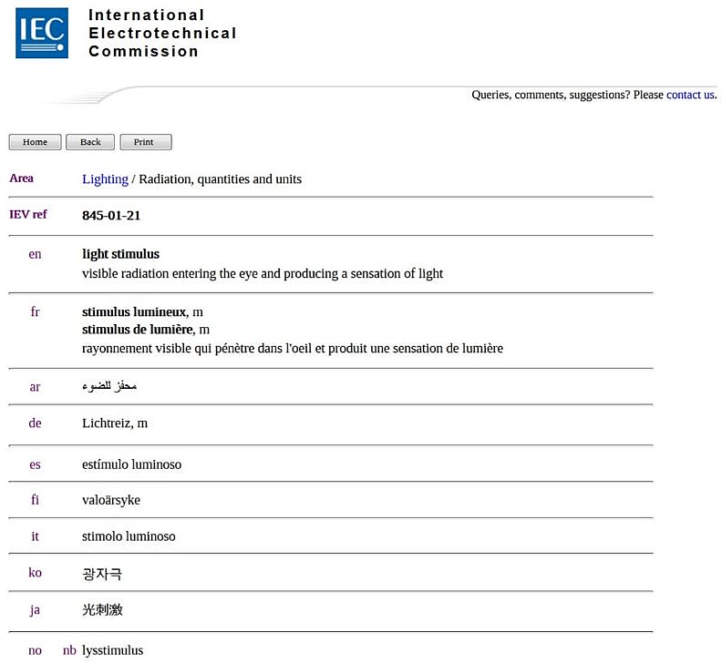
26
Example 1:
Multilingual term entry in a
terminology
database
www.electropedia.org
Notes:
Screenshot: http://www.electropedia.org/iev/iev.nsf/display?openform&ievref=845-01-21
Some randomly taken examples, just to give you an idea of what it might look like.
Let’s say, there would be the source language term for the concept in the DDC. This could also be a phrase or descriptive DDC topic. The entry would have an identifier, and we would give the Dewey number. There could be a definition or a note explaining what the topic is all about in the class, or also what it is all about in the outside world. We could for example say that giving a source for a definition is always required. Dewey translators could add their translation to it, or leave a comment that solves the issue or opens up for another discussion.

Slide 27
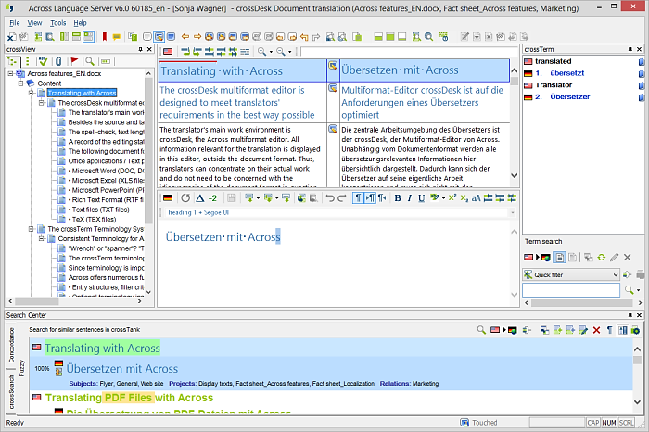
27
Example 2:
terminology
database
integrated in translation memory software
www.across.net
Notes:
Screenshot: https://www.across.net/
Imagine having an integrated multilingual terminology database in the DDC translation software. This would help us translate faster, identify problematic terms earlier, to share them and to solve term-related problems easier together. Plus, it would give us the good feeling that we have a common understanding of the meaning of a topic in DDC, which would in turn be a translation quality assurance for our own translation! ☺

Slide 28
Where are your DDC translation guidelines?
28
DDC Translation Guidelines …are underway! ☺
Finalized version will be sent out to all Dewey translation teams
Miss something in it? Send me your requests!
Fill in specifications for your target language
Easy look-up, everything in one place
Notes:
Where are your DDC translation guidelines?
Every bigger translation project uses translation guidelines or at least terminology guidelines, or a combination of both.
Translation guidelines are THE look-up reference for questions that repeatedly occur while translating. Normally, translation guidelines are set up BEFORE a translation starts. But we all know the problem: Translating a full DDC for the first time means working under enormous time pressure, and usually the first weeks go by with preparing things, get some DDC training, get familiar with the translation software and WebDewey and so on.
There are so many DDC translations out there today, and all the translations are working with the same source text. However, every translation has its particularities, due to different objectives (print only, web only, both, mappings yes or no), divergent syntax or other grammatical specifications for the target language that should be defined once and then be treated accordingly (meaning: consistently) in the translation.
Translation guidelines make the life of a translator easier, and for Dewey translation this means in addition that despite having a customized guideline, we will be able to share and promote a common translation quality standard.

Slide 29
Thank you for your attention!
29
Translation
DDC classification knowledge
Terminology work
Tina Mengel

Slide 30
30
Further reading
Terminology management: Rat für Deutschsprachige Terminologie
http://radt.org/veroeffentlichungen.html (incl. some material in other languages)
Mengel T (2019) Wie viel Terminologiearbeit steckt in der DDC-Übersetzung?. In: Drewer P, Pulitano D (Hrsg) Terminologie : Epochen -- Schwerpunkte -- Umsetzungen. 1. Aufl. Springer Vieweg (to be published in German Oct 2019)
Contact: Tina Mengel, German DDC translation, t.mengel@dnb.de

