Slide 1
The difficult situation of DDC in Austria
by Dr. Kurt Schaefer MSc
Leiter Team Sacherschließung
Universitätsbibliothek, Bibliotheks- und Archivwesen der Universität Wien
EDUG-Symposium 22.5.2014. Reykjavik, Iceland

Slide 2
Datasets with DDC in the Austrian Union Catalogue
February 2013
424.933
Published by Dr. Oberhauser
Mitteilungen der VÖB
2008
2009
2013
„Half-life of information“

Slide 3
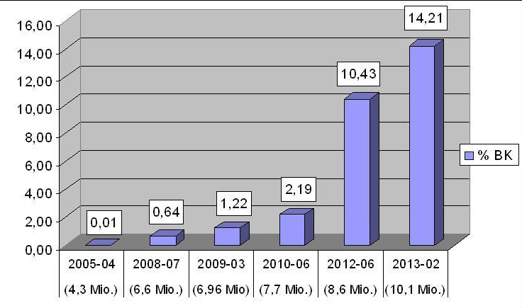
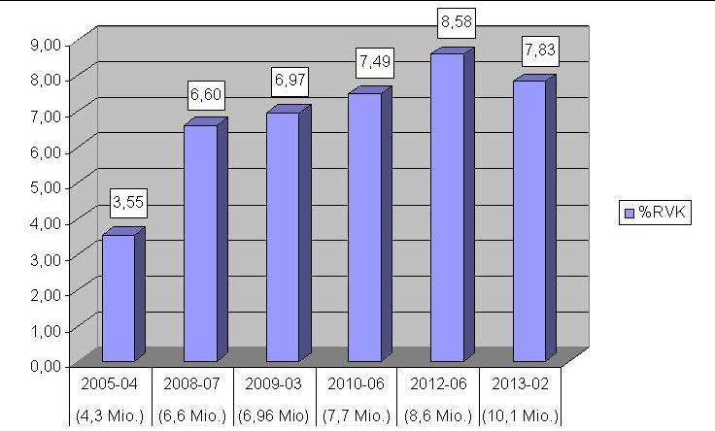
Classification systems within the Austrian Union Catalogue
Figures from
Oberhauser, O. Consortial Subject Indexing and Classification: The present Situation in Austria.
Mitteilungen der VÖB 66 (2013) Nr. 2

Slide 4
OBVSG – Austrian Library Union and Service Co. Ldt.
Catalogue enrichment for RVK and BK. None for DDC
DDC data from
External data transfer
DNB since 2005
Loss of Data caused by „checks“ in ALEPH
Formally wrong data from SWB and BVB
Known since 2008 (Oberhauser 2009)
Solution since summer 2013
No projects for DDC data correction
Correct DDC in wrong MAB field

Slide 5
DDC in the University Library, University of Vienna
No resources for DDC working group
External data transfer is the only use of DDC left
Shelving in the main reading room
200 Religion
September 2013
Possibly other fields follow

Slide 7
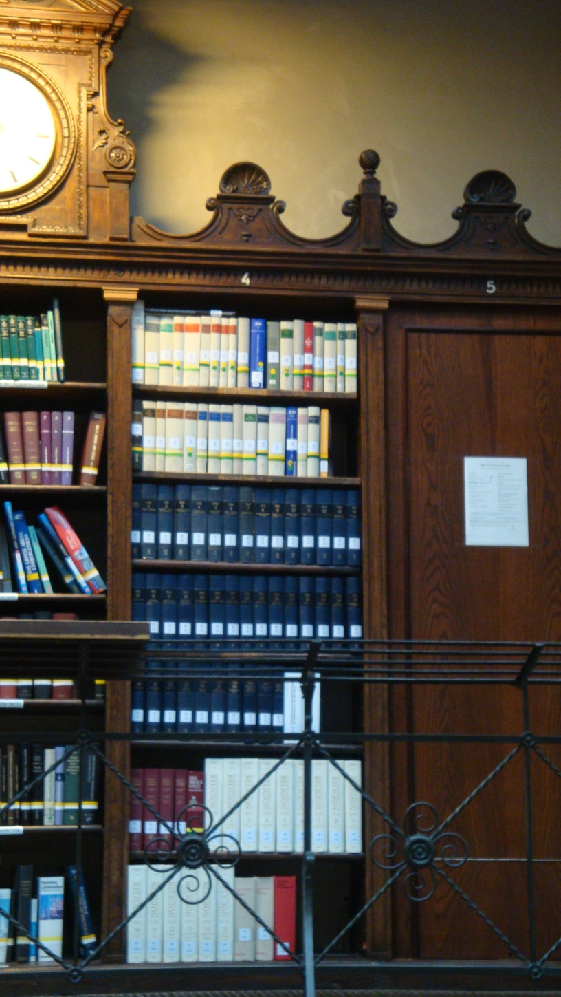
Main reading Room University Library, University of Vienna
200 Religion
43m shelves
Special library: „Catholic and Protestant Theology Library“
450.000m shelves

Slide 9
Bad mood in Austria
DDC too complicated
Rösch 2014; Ethics
Christianity 201-289, 230-289
Oberhauser 2013
Repeating of old or solved problems
E.g. Notation and name of class higher than level three. In DDC 22ger free since 2010
Waldhör 2012
Master Thesis: „Erstellung einer Konkordanz zwischen BK und RVK für den Fachbereich Recht“
Chapter 4
Die Dewey-Dezimalklassifikation – Bereich Recht

Slide 10
Waldhör 2012
ST 505 H249 W7-1(10)+2
Long notations
Difficult to learn (number building)
Problems
Europan law is missing
Subsumption of different fields of law
Important terms are missing
Problem of Common law vs. Civil law
Knudsen 1998
„Brauchen wir die Dewey-Dezimalklassifikation“
Bibliotheksdienst 32 (12): 2120-2131.

Slide 11
Knudsen 1998
Discussion paper before the translation project: DDC deutsch
Extremly polemic
„Deterrent examples“

Slide 12
Knudsen 1998
Discussion paper before the translation project: DDC deutsch
Extremly polemic
„Deterrent examples“

Slide 14
Bild
341.2422
In the field of law DDC is „admittedly out of the question“.
Orman 1941. Law library classification
Library Quaterly 11 (2): 210-217

Slide 15
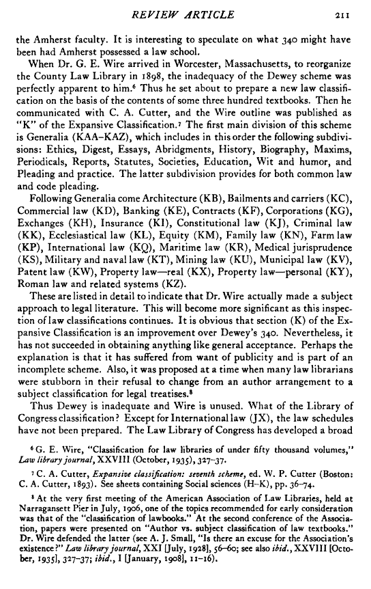
Orman 1941
Bild

Slide 16
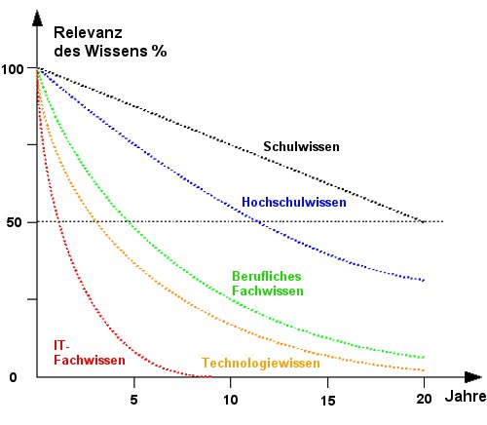
Half-life of Information

Slide 17
Thank you for your attention
Acknowledgement:
Thanks to Dr. Heidrun Alex , Dr. Alfred Friedl
and Dr. Rudolf Lindpointner

Slide 18
Rösch Hermann. Ethische Konflikte und Dilemmata im bibliothekariwchen Alltag. Mitteilungen der VÖB 2014, 67(1):15-32
Umstätter Walther. DDC in Europa. Hat der Einsatz in der Deutschen Nationalbibliothek unsere Zunft weitergebracht? Hat unsere Klientel etwas davon? Bibliotheksdienst 2008, 42(11): 1194-1221
Thieleman Andreas. Sacherschließung für Kunstgeschichte: Möglichkeiten und Grenzen der DDC 700: The Arts. Berliner Handreichngen zur Bibliotheks- und Informationswissenschaft 2007, 202:1-78

