Slide 1
EDUG the European Dewey community
Karin Kleiber

Slide 2
It‘s about
the story of EDUG,
its structure,
all the members,
their activities,
and what will be …

Slide 3
EDUG history
Around 2000
French, Italian, German translations of DDC 21 and 22 existed, many other translations of other versions were in use in Europe
more and more Europen libraries adopted the DDC
need to share experience and to cooperate

Slide 4
The beginning
In 2007 the European Dewey Users Group (EDUG) was established to
promote professional interests of European DDC users
encourage the development of techniques, applications and documentation of translations
coordinate proposals of the DDC according to European interests

Slide 5
025.431094
025.431094 is the DDC notation for the use of the Dewey Decimal Classification in Europe
(025.431=Dewey Decimal Classification) + (09=standard subdivision for places) + (4=Europe)
This is our common interest!

Slide 6
Operational structures
EDUG is governed by a cooperation agreement (Bylaws)
The General Meeting of members, held at least once a year
The Executive Committee, elected every other year
The Working Groups

Slide 7
EDUG membership
Membership is free
Three categories of members:
Institutional members
Affiliated members
Individual members

Slide 8
Institutional members 2014
Biblioteca nazionale centrale di Firenze
Bibliothque nationale de France
British Library
Deutsche Nationalbibliothek
Kunglika Biblioteket
Landsbókasafn Íslands – Háskólabókasafn
Nasjonalbiblioteket
Oesterreichische Nationalbibliothek
Schweizerische Nationalbibliothek

Slide 9
Affiliated members 2014
Bibliotheks- und Archivwesen der Universität Wien (Austria)
KHT Library (Sweden)
Linköping University Library (Sweden)
Menntaskolinn vid Sund Library, Reykjavik (Iceland)
Oberoesterreichische Landesbibliothek (Austria)
OCLC EMEA B.V (Netherlands)

Slide 10
Affiliated members 2014 (continued)
Scottish Library and Information Council (Great Britain)
Stockholm University Library (Sweden)
Umea University Library (Sweden)
Université de la Méditerranée (France)
University of Oslo Library (Norway)
Verbundzentrale des GBV, Göttingen (Germany)

Slide 11
Indivudual members 2014
Peter Werling (PANSOFT GmbH)

Slide 12
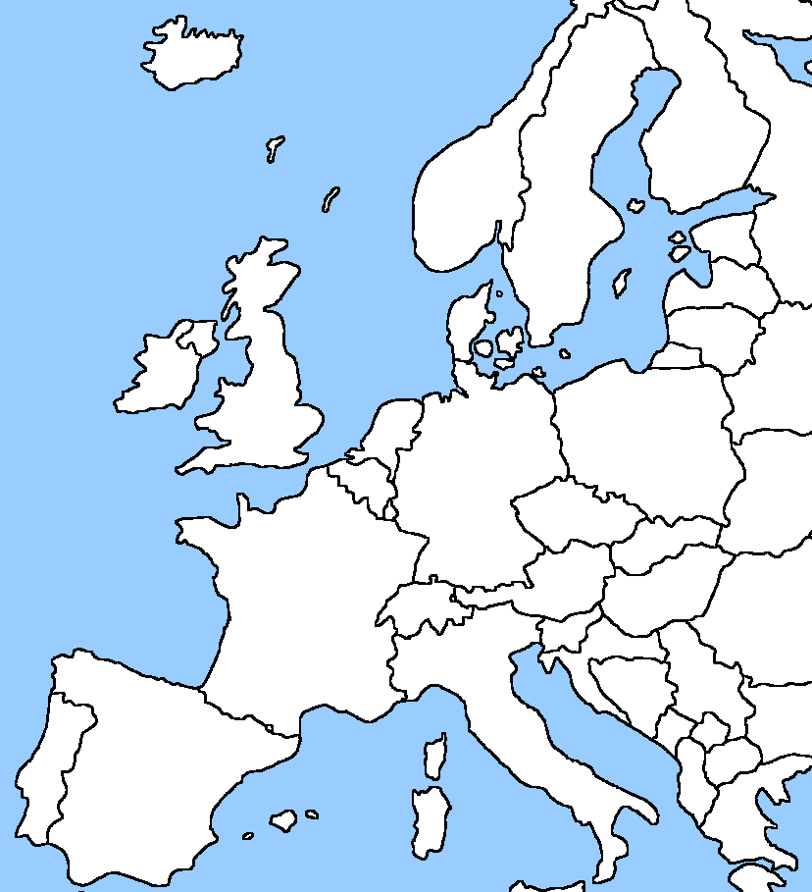
EDUG map

Slide 13
Annual meetings and symposia
2007 Bern
2008 Frankfurt
2009 Vienna
2010 Alexandria
2011 Stockholm
2012 Boston Spa
2013 Oslo
2014 Reykjavik

Slide 14
Working groups 340
Active from 2007 to 2012
to improve the 340 Law provision for legal systems in Europe rooted in civil law
In November 2008 the EPC discussed selected proposals at their EPC 130 meeting
Last discussions and proposals concerned 346 Marriage law
Input in DDC 23: updates for European Union, criminal courts, juristic acts
Notes:
realistic expansions, relocations, add notes or entries on the basis of existing classes according to the literary warrant in Europe
Chair: Yvonne Jahns from the beginning, member: Federica Paradisi who retired

Slide 15
Working groups 370
Active from 2008 to 2014
to improve the 370 Education provision for works in the discipline education in Europe
Issues were besides others primary school curriculum, comparative education, and lately 374 Adult education
Input in DDC 23: improved framework for levels of education, kinds of schools, policy issues and primary education
Notes:
realistic expansions, relocations, add notes or entries on the basis of existing classes according to the literary warrant in Europe
Chair: Yvonne Jahns from the beginning, member: Federica Paradisi who retired

Slide 16
Working groups 930
Active from 2008 to 2013
to improve the 930 Archaeology provision for works in the discipline archaeology in Europe and works on European antiquities
Main topics were proposals for geographic expansions in 931-939 and Table 2-3 as well as time periods in 930
Input in DDC 23: expansion of geographic areas and historical periods
Notes:
realistic expansions, relocations, add notes or entries on the basis of existing classes according to the literary warrant in Europe
Chair: Yvonne Jahns from the beginning, member: Federica Paradisi who retired

Slide 17
Working groups IT
Active from 2007 on
to monitor projects and develop use cases for the application of DDC to online information services in Europe
In 2010 the WG launched an online survey of applications of the DDC to help EDUG to plan its activities
The focus of interest in recent years is on Dewey as linked data
Notes:
realistic expansions, relocations, add notes or entries on the basis of existing classes according to the literary warrant in Europe
Chair: Yvonne Jahns from the beginning, member: Federica Paradisi who retired

Slide 18
EDUG homepage http://www.slainte.org.uk/edug/index.htm

Slide 19
Plans for 2014-2015
Support for the national DDC communities
Communication, promotion, development of DDC in Europe
Annual Meeting and symposium 2015
Establishment of new working groups

Slide 20
Mapping working group
To provide a platform to share knowledge, experience and expertise gained in projects mapping different subject headings and local classification systems to Dewey, and to provide support to similar initiatives in Europe
The 1st meeting will include reports on the completed projects CrissCross and SAB-DDC mapping as well as on ongoing projects "Realfagstermer" to Dewey in Norway and "coli-conc“, a DDC-RVK mapping project in Germany
Notes:
I would like to promote the new working group

Slide 21
Thank you
for your attention!
karin.kleiber@onb.ac.at

