Slide 1
BnF Bibliothèque nationale de France
Use of DDC at the BnF, display of authority Data
EDUG, Paris, 2017 jean.maury@bnf.fr

Slide 2
Overview
History of DDC at the BnF
In 2000, authority data creation
Teaching DDC
Diverse work tools made available of the cataloguers
Statistics in the general catalogue
Dewey at the French digital library Gallica

Slide 3
H istory of DDC at the BnF
In 1992, DDC was chosen by BnF
First for open stack, as indexing and as a shelf number
For the French national bibliography – books – serials - series

Slide 4
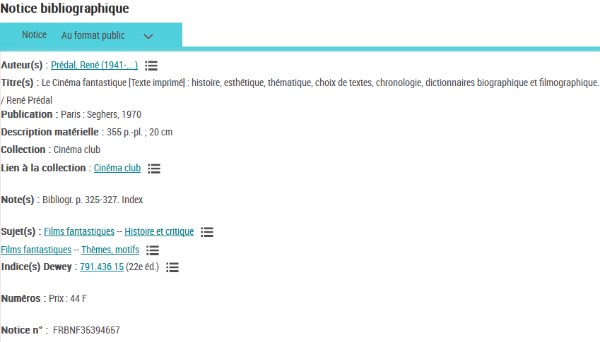
Open stack notice

Slide 5
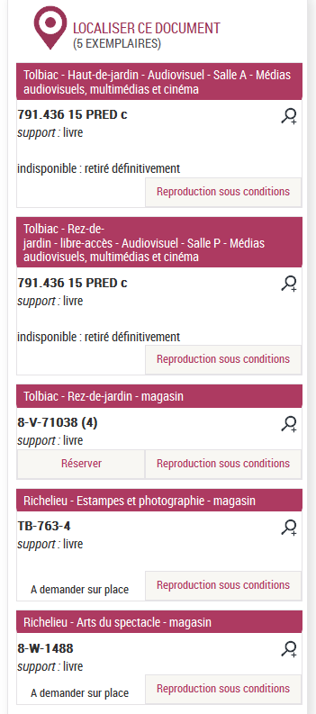

Slide 6
Serials and Series
Are not indexing with subject heading record of the RAMEAU vocabulary, but only with Dewey indexation
Can contain up to 3 Dewey numbers
Before 2001, serials used a closed file Pirana

Slide 7
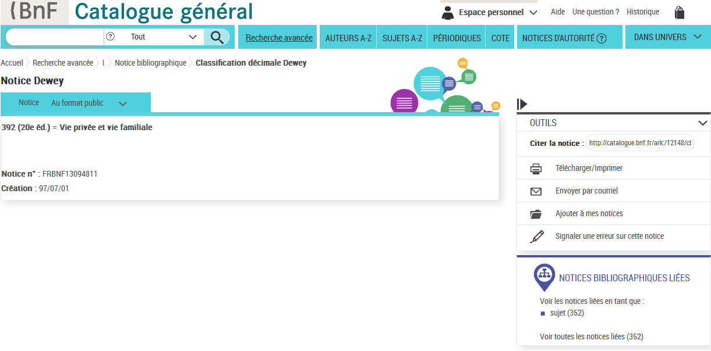
P irana

Slide 8
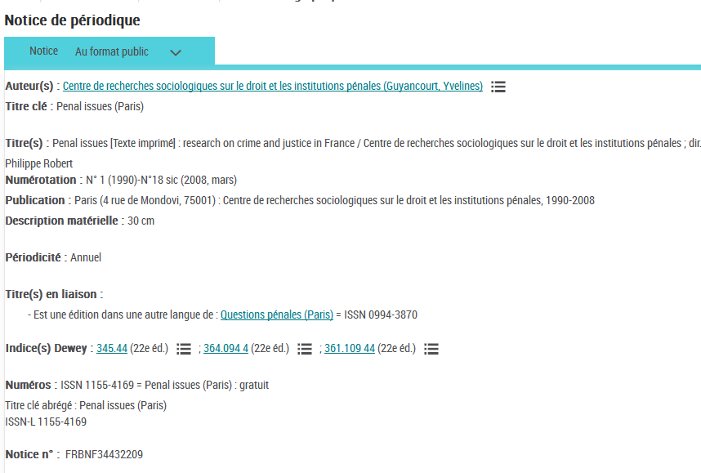
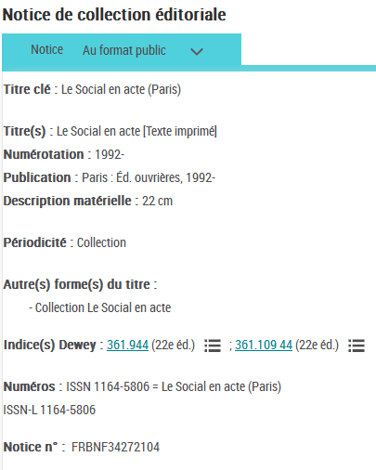
Serials
Series

Slide 9
Legal deposit : books – series - serials
Since 2001, DDC serve as a tool :
to facilitate the publication of the French national bibliography library
to index Legal deposit books, serials and series
Only one number Dewey (as an exception two different classes)
Dewey is used for indexing and not for shelf number

Slide 10
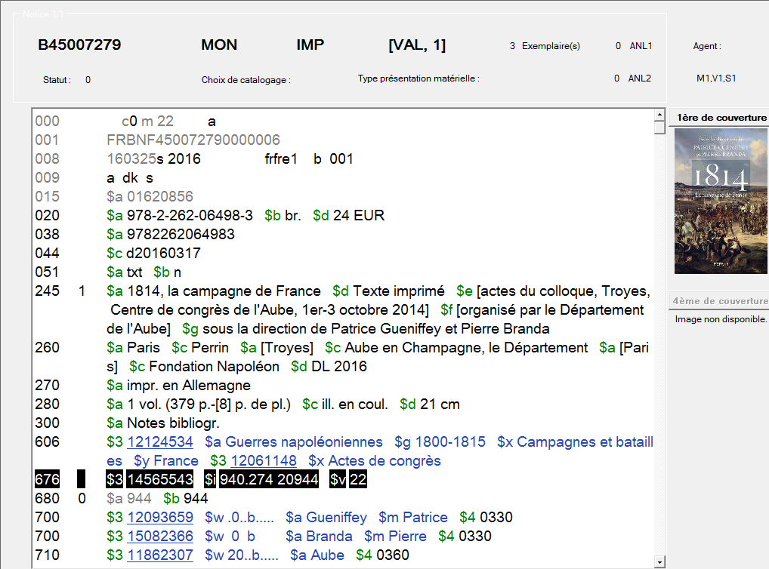
A-DCAT-02

Slide 11
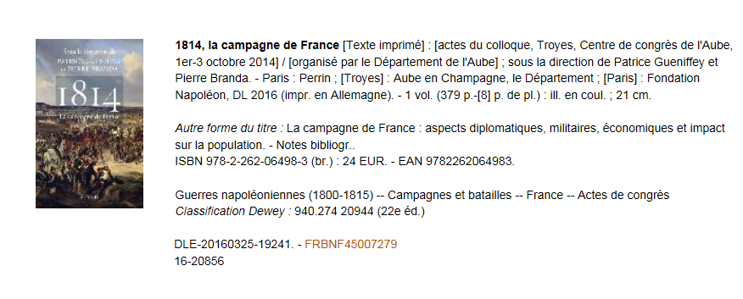
French national bibliography - Books

Slide 12
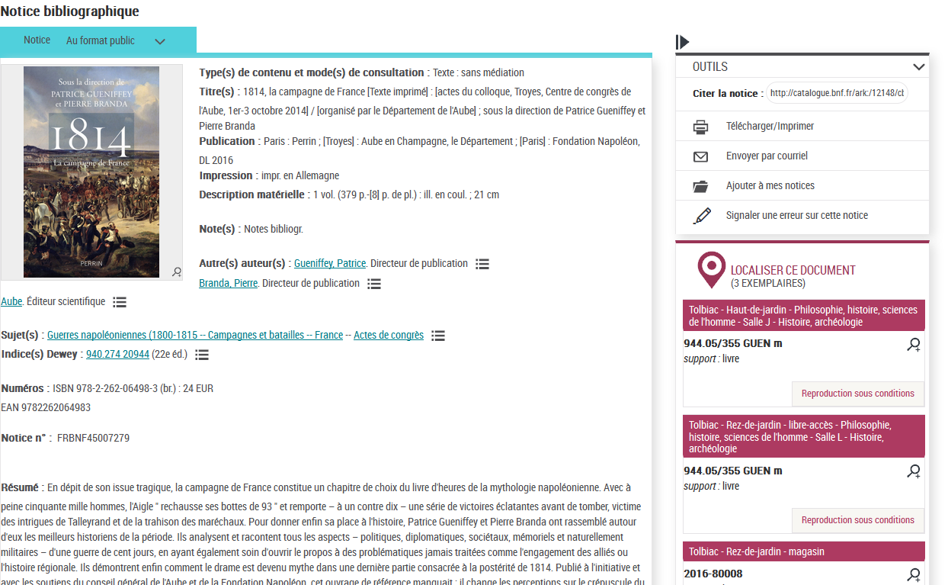
Webcca - General catalogue

Slide 13
Authority data
2001 is also the creation of the authority data
Which contain :
Caption
Other form
Other access
Notes

Slide 14
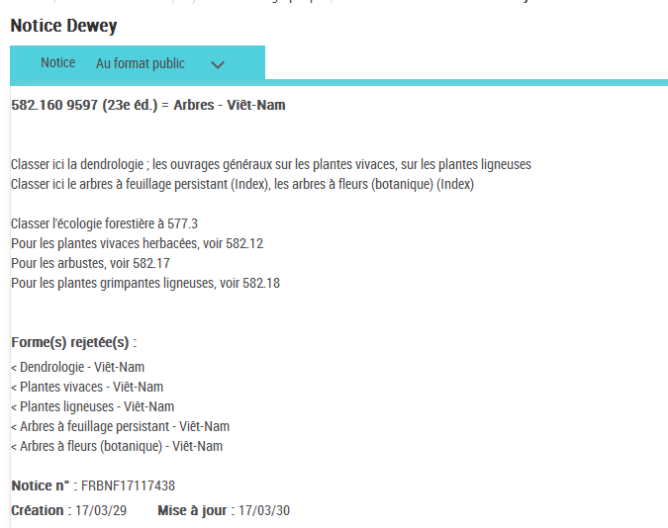
Notice Webcca avec forme, rejetée de l’index

Slide 15
Teaching DDC
Three and a half days Common-core : -history -general principles -constructions : -inside general tables
-with the auxiliary tables
-how to look for Dewey in catalogs (professional and public) -Authorities : various zones, caption’s writing (syntax)
For the specialities, the trainee is taken care by the coordinator Dewey of closeness in every department.

Slide 16
Diverse work tools made available of the cataloguers

Slide 20
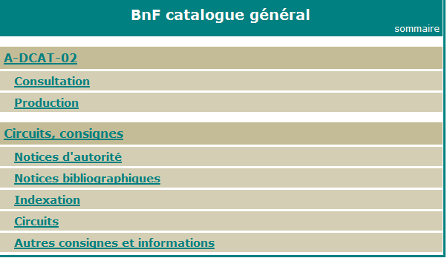

Slide 22
Statistics in the General catalogue
Dewey publishing | With caption | Without caption | Overall total
20 | 12 658 | 319 | 12 977
21 | 119 | 397 | 516
22 | 108 396 | 21 868 | 130 264
23 | 2 374 | 1 | 2 375
Total | 123 547 | 22 585 | 146 132
Total with caption without the 20th edition : 110 889 (only complete files)
Total without caption without the 20th edition : 133 474

Slide 23
French digital library Gallica
DDC was also chosen by the BnF as subject classification for the books digitized in the French digital library Gallica (Gallica.bnf.fr) which corrently holds over (3) million digitized documents

Slide 24
