Slide 1
Translation issues
Dewey in Italy = Amore? EDUG Symposium 2015
Harriet Aagaard, National Library of Sweden
Elise Conradi, National Library of Norway

Slide 2
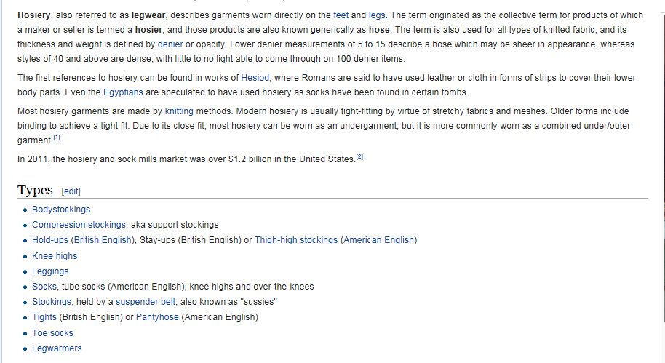
Hosiery
s 1 strumpor, trikåvaror 2 strumpfabrik, trikåfabrik 3 trikå[varu]affär, trikåaffär, trikåvaruaffär ; herrekipering
Wikipedia

Slide 3
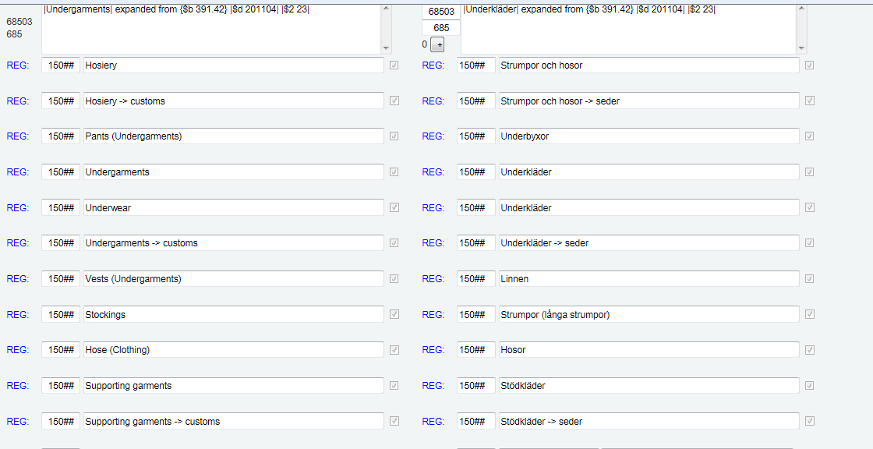
391.42 Undergarments, hosiery, sleepware, loungware
391.423 Hosiery and undergarments

Slide 4
Students
Elev (primary & secondary education)
Student (tertiary education)
371.8019 Elevpsykologi (studentpsykologi)
371.4 Studentvägledning och studentråd
Klassificera här tjänster för elever och studenter
För en särskild tjänst för elever och studenter som inte passar in här se tjänsten, t.ex. arbetsförmedling för studenter 371.225

Slide 5
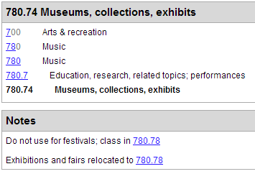
Translation of specific terms (1)
Example 1
Exhibits vs Exhibitions
Would like to translate both to «Utstillinger», but:

Slide 6
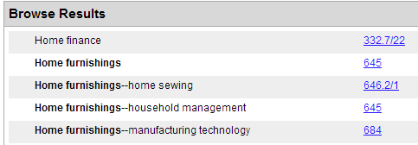
Translation of specific terms (2)
Example 2
Household furnishings vs Home furnishings
Would like to translate both to «Hjeminnredning», but:

Slide 7
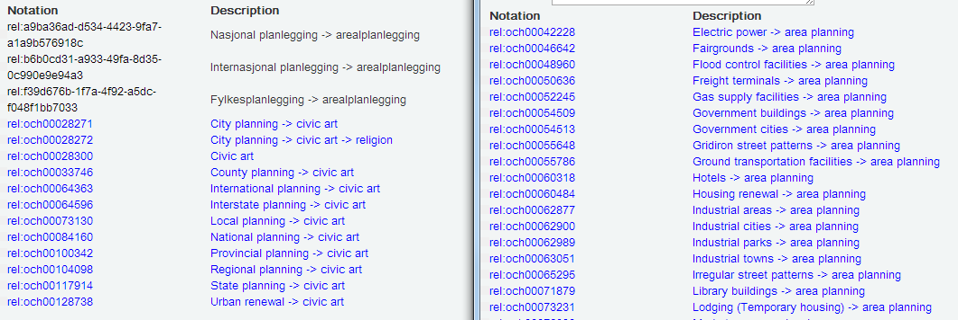
Translation of specific terms (3)
Example 3
Civic art
We don’t have a term for this in Norwegian. Would like to translate it (and Area planning) to «Arealplanlegging», but:

Slide 8
Translation of topical structures
Structure of sports (796)
In particular:
Precollege sports
College sports
Professional sports
We have a totally different structure for sports in Norway, based on participation in clubs - not schools.

Slide 9
Difficult translations
Example in terminology:
Fine and decorative arts
DDK5 translation:
Arkitektur, bildende kunst og kunsthåndverk
(We don’t have an everyday term for «fine arts», so this was a workable solution in the abridged edition. It doesn’t work in the Norwegian WebDewey, where we need a translation of «fine arts».)

Slide 10
Solutions
Translation of specific terms:
Creation of International Dewey translators’ forum in translation software
Translation of topical structures
EDUG (European Dewey Users Group)
Inaccurate translations
Fix as we catch them.
Implementation of Search and replace function in translation software
Inconsistencies due to translation over time
Fix as we catch them.
Implementation of Search and replace function in translation software

Slide 11
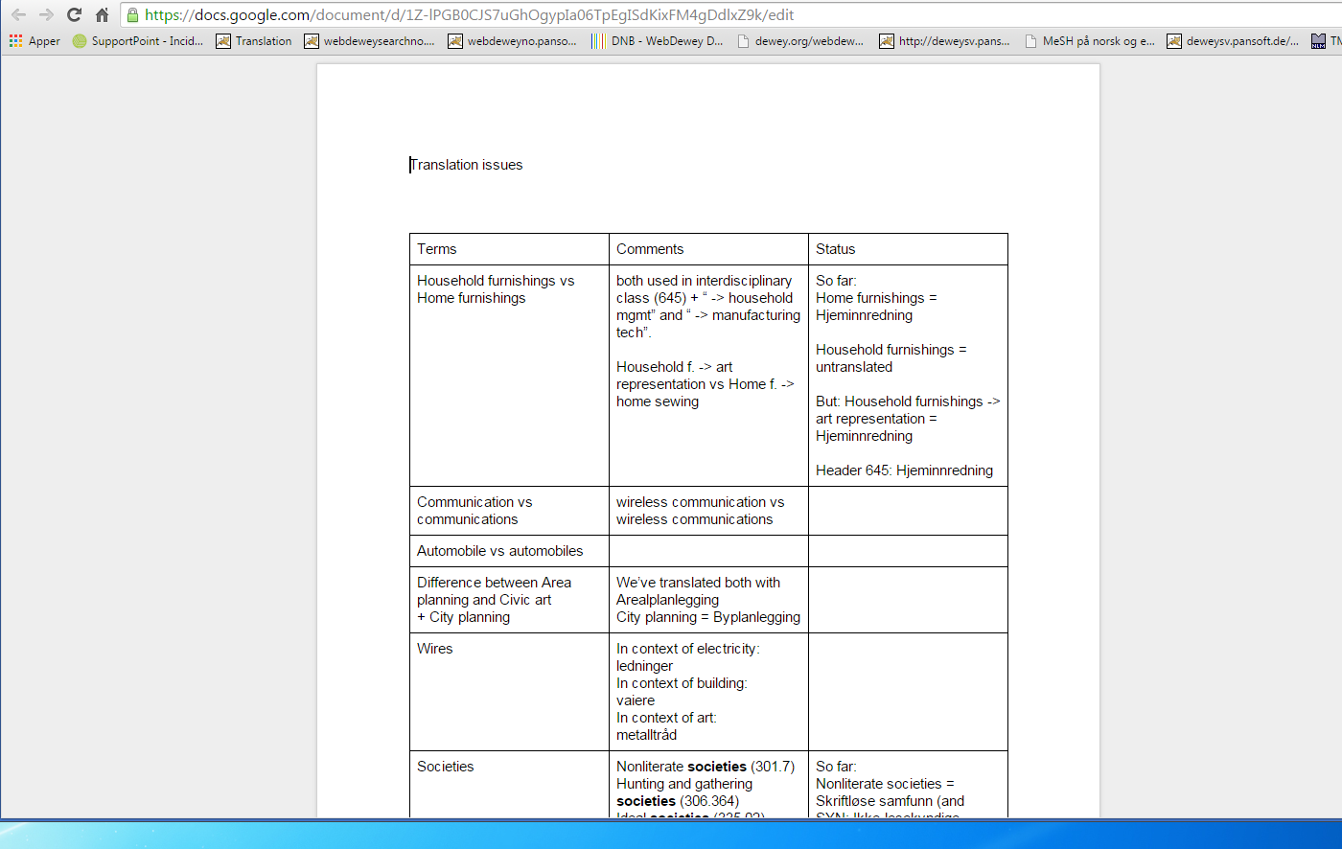
Translation issues in general….

