Slide 1
EDUG – 8 May 2025
Using Dewey linked data
Alex Kyrios
with Jeff Mixter
Senior Editor, DDC
Senior Product Manager

Slide 2
overview

Slide 3
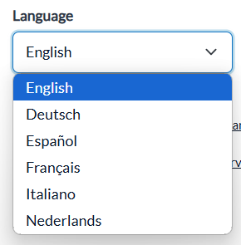
Public linked data service
https://entities.oclc.org/worldcat/ddc/
Launched 2024
All six current languages
Differing access levels

Slide 4
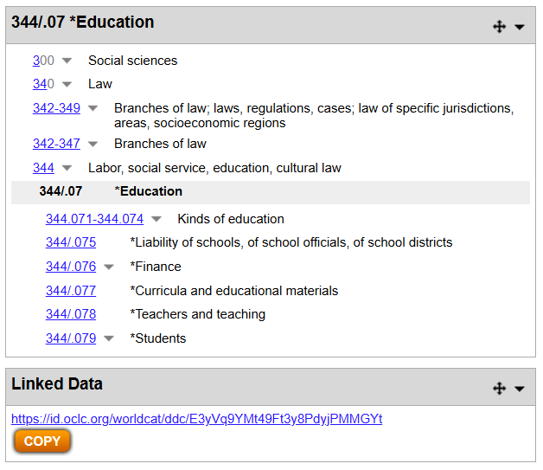
WebDewey integration

Slide 5
Coming features
DDC URIs in WorldCat (082 $1)
DDC to FAST mappings

Slide 6
Dewey linked data APIs

Slide 7
Thank you!
Alex Kyrios
Senior Editor, DDC
kyriosa@oclc.org
Jeff Mixter
Senior Product Manager
mixterj@oclc.org

