Slide 1
End users & Dewey
Can WebDeweySearch & Linked Data make Dewey work harder?
Tina Mengel, Harriet Aagaard, Elise Conradi
EDUG 2016
Göttingen

Slide 2
Outline
WebDeweySearch - German
WebDeweySearch - Swedish
WebDeweySearch - Norwegian

Slide 3
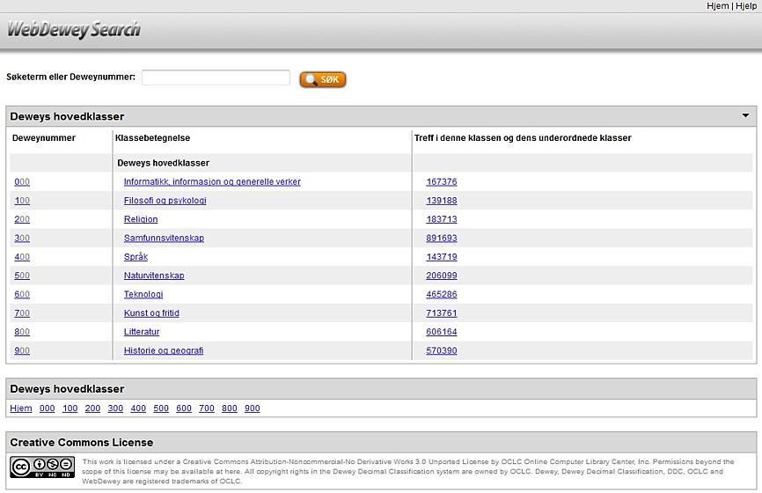
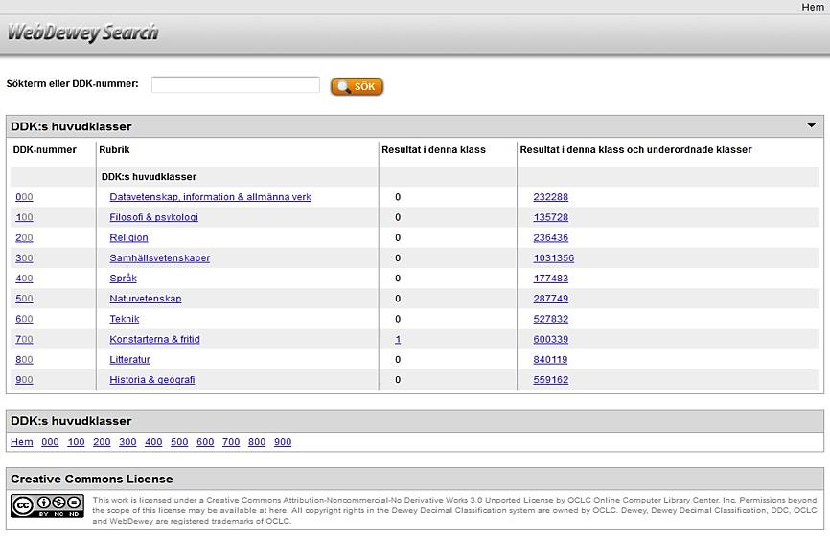
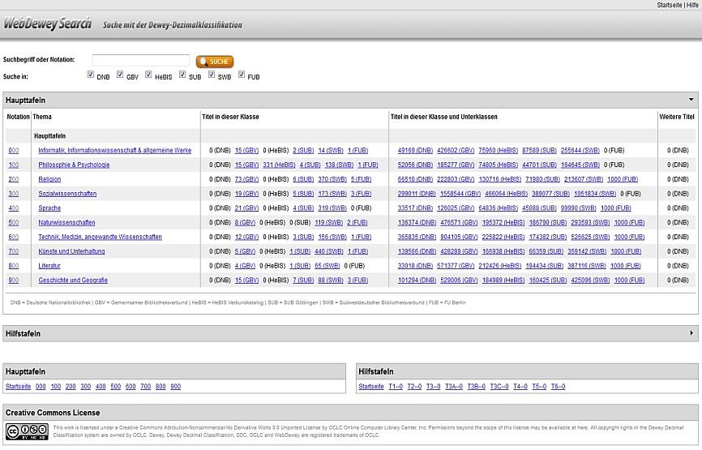
WebDewey Search
3
Notes:
What is WebDewey Search?
It is a web portal for library users to find works they are interested in – with the specification that they approach the title results via the Dewey Decimal Classification. With WebDewey Search they do this either by browsing the DDC hierarchies or by entering a search query. Verbal searching leads to matches based on the DDC‘s Relative Index terms. When they get to a topic that makes them happy enough to see the literature behind, users click on the number stated as hits for a certain class, and are directed to the title results list in a connected library catalog.
I will now go on telling you a little about the history behind WebDewey Search. After that I’ll explain the German use case and in what ways it differs from the WebDewey Search apps of other countries, like the ones of Norway and Sweden. Their use cases will be presented afterwards.

Slide 4
Back in the days… Why did we need an extra access to Dewey-indexed works?
4
Main focus on data exchange and retrieval solutions
German library users don‘t grow up with DDC
→ Making use of both verbal and numerical access points
→ Integration of library catalogs containing foreign DDC data
Notes:
Compared to other countries, Germany’s DDC history is rather young. Application of the DDC in Germany got started only after the translation of DDC 22 (full edition) was completed in 2005, and it was soon clear that its scope of usage would vary from countries having a longtime DDC history built around the DDC as shelving instrument.
The main focus was put on data exchange and retrieval solutions, nevertheless this also involved the large-scale undertaking of contributing DDC numbers for titles of the German National Bibliography. Today, the German National Library supplies an average of over 80.000 works per year with DDC, and that is just the amount of assigned full Dewey numbers, DNB Subject Categories count extra. A considerable amount of it – and that is a first hint – is only partly verbally indexed. This alone backs up the necessity of a more detailed DDC-based access to bibliographic resources. One big advantage of the DDC is that it consists of numerical and verbal content, so why not using both elements also for retrieval?
The other fact is quite simple: German library users don’t grow up with the Dewey Decimal System as a library system that is an integral part of a child’s public education. For our users, Dewey numbers are one among other filters they may use in a catalog to get to the resources of interest. Usually, they don’t care about which instruments have been used to index a document, they want an intuitive and quick way to results.
To meet all the mentioned requirements, an approach had to be found that would include on the one hand the verbal and numerical access points which the DDC luckily provides, and on the other hand could bring together all the DDC-indexed resources we already had and would soon have in the German library landscape. It was intended from the beginning that other libraries or library networks that have Dewey numbers in their bibliographic records, could be integrated in the DDC web portal – so to say, to underline that there is a central access to DDC-indexed documents.

Slide 5
MelvilSearch in the history
5
2006
Launch of MelvilSearch
Notes:
In 2006 MelvilSearch was launched, as part of the Melvil product service by DNB that also included MelvilClass – which was the DNB‘s classification tool for the German DDC at that time – and a few other applications to help dealing with Dewey data in OPACs.
On this screenshot you can see that decision was made to separate the title hits into two matching categories: Titles that have been given the present Dewey number, meaning that these are the exact matches to a class.
The other column subsumes results for the exact number and all assigned Dewey numbers of subordinate classes.
When we are speaking of Dewey numbers here, you may recognize that one relatively important characteristic of the Dewey Decimal Classification is missing here: There are no Dewey numbers displayed!

Slide 6
MelvilSearch in the history
6
2010
Creative Commons License allows representation of numbers and captions
Notes:
That is why 2010 was a milestone: Since then, the Creative Commons License permitted representation of captions and numbers also at any deeper hierarchical level than the first three Summary levels.
This step was very important because MelvilSearch wanted to provide the user with intuitive DDC browsing – and that was simply not given when only captions were displayed! So, it was a great success when OCLC and DNB agreed on that License to allow using full DDC data in own applications for non-commercial use.

Slide 7
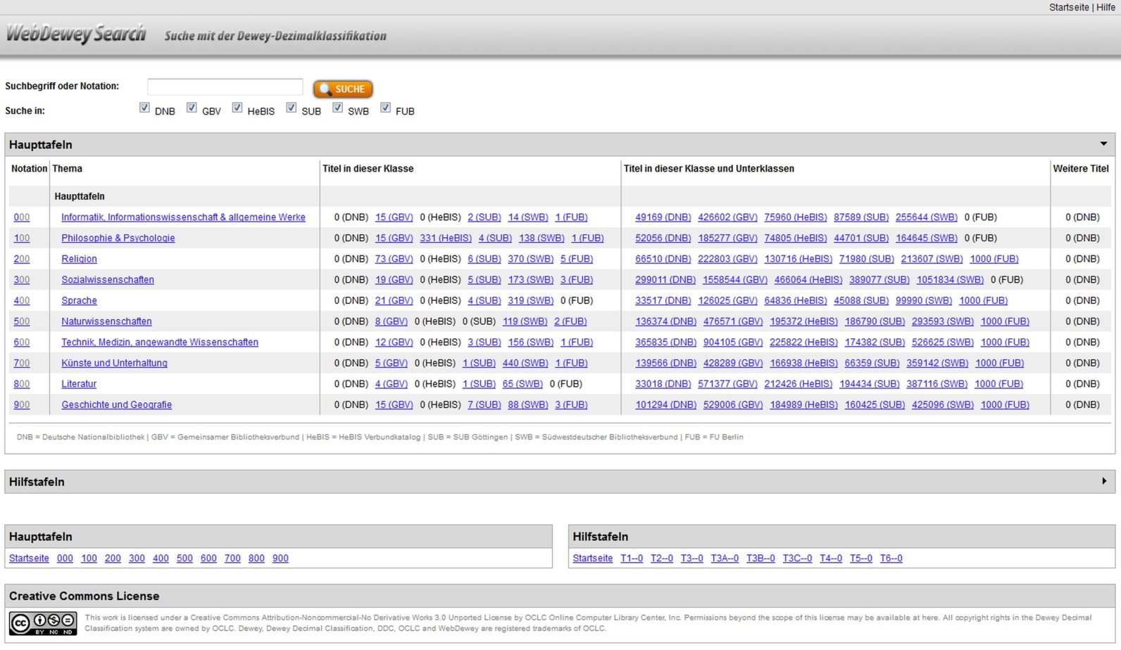
WebDewey Search German
7
2012 –
http://deweysearchde.pansoft.de/webdeweysearch/
Notes:
2012 marks the beginning of the cooperative international work on DDC applications.
MelvilSearch and MelvilClass had been customized for the German use cases. In the meantime, other countries followed in translating the newest DDC full edition, and more and more common uses in the DDC-applying community developed. Hence, the DNB made a decision in favor of the international and cooperative further development of DDC applications, and replaced the Melvil products by the new releases of OCLC‘s WebDewey and WebDewey Search. For WebDewey Search, basic functionalities were defined, with the possibility to adjust and add features if needed.
On this slide you see the German WebDewey Search as it looks today.

Slide 8
WebDewey Search German – Extras
8
One search – Multiple catalogs
DDC Tables – Browsing and Searching
“Further titles” column
Notes:
I will make the start now to show what‘s special in the German use case of WebDewey Search, and afterwards hand on to my colleagues.
Currently, there are three extras:
We have more than one catalog integrated,
the DDC Tables are available for browsing and searching,
and we offer an additional approach to titles by making use of what we call the „Einzelablage“ – that is, the storage of number components for synthesized Dewey numbers.

Slide 9
1. One search – Multiple catalogs
9
Decentralized organization of the German library landscape
Foreign data exchange is common practice → Dewey numbers in many catalogs
→ WebDewey Search offers central access point to DDC-indexed collections
Connected catalogs (today): German National Library (DNB), Common Library Network (GBV), Hessische BibliotheksInformationsSystem (HeBIS), Göttingen State and University Library (SUB), Library Service Centre Baden-Wuerttemberg (SWB), Library System of the Freie Universität Berlin (FUB)
Notes:
Due to the decentralized organization of the German library landscape, specialized collections are found in any of the federal states of Germany. Most research libraries belong to one of the six library network systems, each of them operating own library catalogs with collections containing millions of items. Due to the common practice of foreign data exchanges, a number of libraries and library networks have received Dewey numbers from the Library of Congress, the British National Bibliography, and also from the DNB. This is how title records are permanently enriched not only by verbal indexing data but also by Dewey numbers.
Therefore, it seems only natural to bring the resources together and offer a central access to DDC-indexed works.
The user is free to decide how many of the local catalogs to consider by simply activating or deactivating the respective checkboxes in the “Search in” area. Currently, the catalogs of six libraries or library networks are connected to WebDewey Search German: the German National Library (DNB), the Common Library Network (GBV), the Hessische BibliotheksInformationsSystem (HeBIS), the Göttingen State and University Library (SUB), the Library Service Centre Baden-Wuerttemberg (SWB), and the Library System of the Freie Universität Berlin (FUB).

Slide 10
2. DDC Tables – Browsing and Searching
10
Integrates works classified by built numbers beyond the standard edition repertory, e.g. all numbers to which T2—492352 Amsterdam has been added (→ storage of number components)
Integrates Relative Index terms of Table numbers for verbal searching
Built number
914.9235204
Standard edition
---------
914
Notes:
The integration of the DDC Tables represents a high gain for titles that have been assigned a synthesized number beyond the numbers held in WebDewey. For example, browsing to the Table 2 number (T2—492352) for Amsterdam leads to catalog results gathering all at once everything published about or in the City of Amsterdam in the Netherlands. Approaching those titles via the Schedules would only be successful, if the corresponding built number was part of the standard edition.
The Relative Index terms of Table numbers can also be searched.
The integration of the Table numbers in WebDewey Search is made possible by the storage of number components. You will hear more about that in the context of the “Further titles” column.

Slide 11
3. “Further titles” column
11
Built number
338.76102504
Schedule number
---------
025.04
Integrates works classified by built numbers using digits from 000-999 as added number components
Benefit for assigned built numbers beyond the standard edition repertory
Offers access to different aspects or perspectives of a topic → explorative searching
Notes:
The “Further titles” column:
As mentioned before, German WebDewey Search has two columns regarding the results display in the browse area: “Titles in this class” and “Titles in this class and subordinate classes”. And there is a third column as well, for those titles that have been assigned a built number – with the specification that the Dewey number as present in the hierarchy has been used as a component in the number-building process.
The results in this column represent a different aspect or perspective of the topic, or they represent the main topic that has been added to a certain discipline. DDC disciplines like economics for example wouldn’t work without adding numbers from throughout the Schedules, other areas like medicine in 610 and Social problems and services in the 360s help each other out, in order to represent a specific aspect in the respective field.

Slide 12
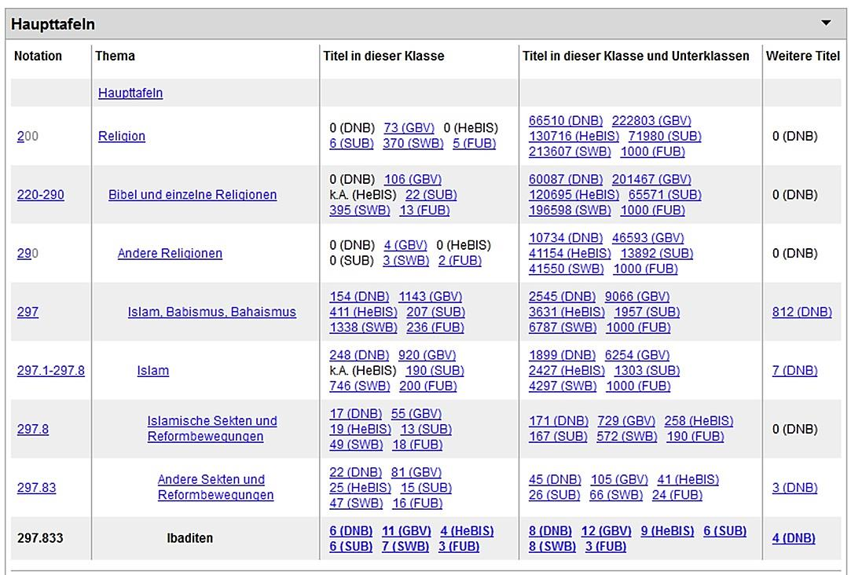
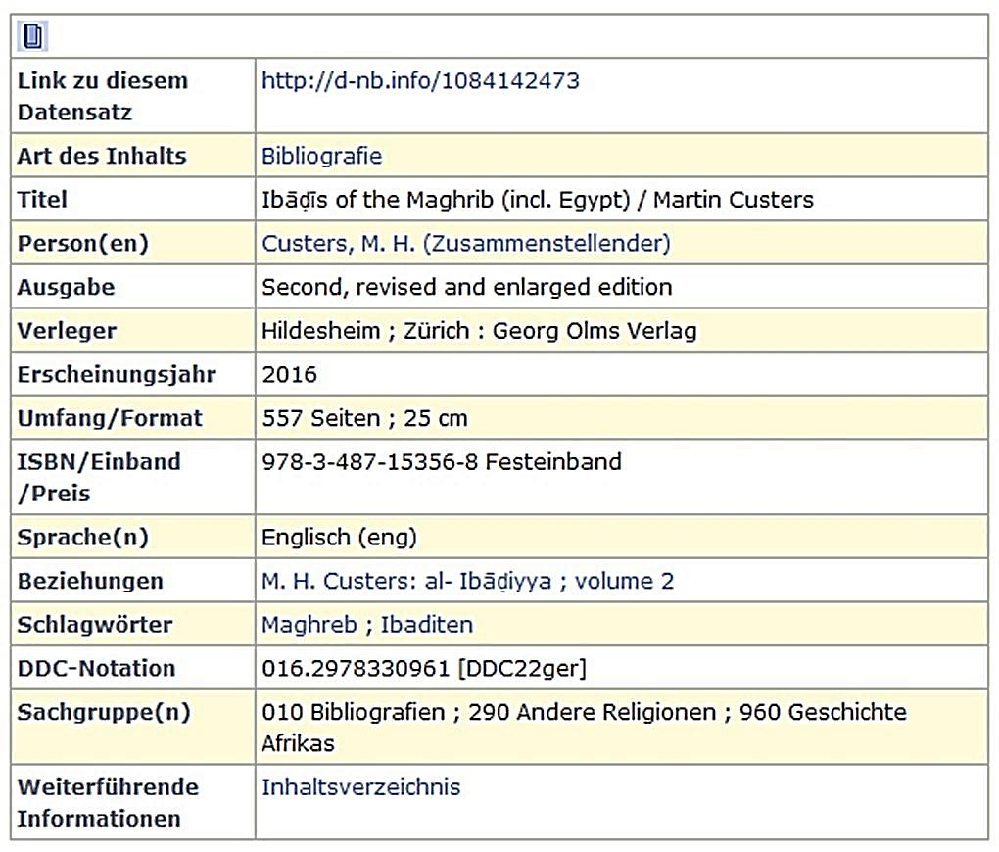
3. DDC number components – “Further titles” column
12
WebDewey Search German
access points:
016.2978330961 [not part of standard edition]
297.833 Ibaditen, Abaditen, Ibadīya
T2—61 Tunesien und Libyen, Maghreb
016 Bibliografien… über einzelne Themen [only via subordinate classes column]
Notes:
One last slide left to demonstrate the benefit of the Further titles column:
Here we have a bibliography of the Ibadites of Maghreb. On the left you can see the elements and the Dewey numbers that have been stored with the title record. In WebDewey Search, you wouldn’t find the assigned Dewey number, as there is no such built number in the standard edition. But you can easily get there by browsing to the respective number in Religion, and also via the Table 2 number for Tunisia and Libya. CLICK. Here you can see where to go in the Schedules to get to the Further titles results.
In addition, you would also find the work in the column “Titles of this class and subordinate classes” for 016 – which is okay for newer titles on top of a list, but as there are thousands of titles in this category, the user would probably prefer the quicker way.
And to recall once again what we have learned in this context: We would NOT find the title in the Further titles column of 016 – because this is the place for built numbers, where 016 itself has been added to another base number.
Thank you so far!

Slide 13
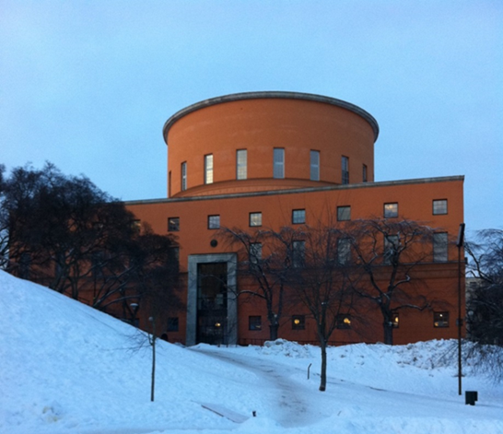
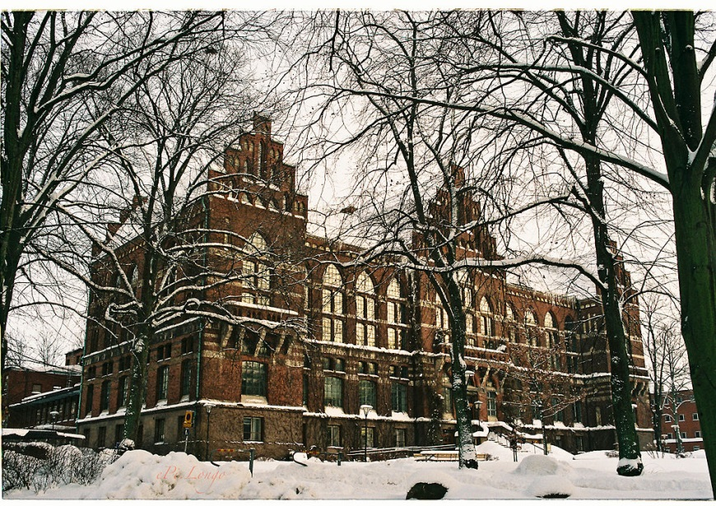
Dewey in Sweden, 2011-
8% of Public libraries
70-80% of University libraries
Mixed translation ~40% translated into Swedish
Full English index, Swedish index ~40% of classes
Notes:
Dewey in Sweden started quite late. In 2011 the National bibliography and most university and research libraries started using Dewey. So far very few public libraries use Dewey, but slowly there will be more.
Sweden decided to translat only parts of Dewey into English – quicker and cheaper! Only approximately 40 % is in Swedish in our mixed translation. As a result we have a full English relative index and a smaller Swedish index

Slide 14
Subject Access in Libris – the National Catalog
Swedish Subject Headings 2002-
SAB Classification 1921- (the National Library 1956- )
Dewey 2011-
(+ other classification systems
+ key words & other subject headings)
Mapppings SAB - Dewey
Classification
Notes:
In Libris, the Swedish national union catalog, subject access by subject headings is only possible for books etc after 2002, when the Swedish Subject Headings started being used.
For older books classification is the only means for searching. The mappping between SAB and Dewey makes this possible, regardless of what classsification system was used in the record.
But, who knows the Dewey Decimal Classification System?

Slide 15
The Swedish WebDeweySearch (not easy to find!)
Notes:
Launching the Swedish WebDeweySearch was part of the Swedish Dewey project. It is very useful for anyone wanting to search by subject – but it is not easy to find in WebLibris! As a result, very few use it. We have no statistics about usage, but our impression is that few use it. Even librarians are lazy!
We have two columns – one for results in the exact class, and one for both the exact class and for subordinate classes. At the first webpage that you see here, there are of course no records with the classification 0, 1 etc, only for subordinate classes.

Slide 16
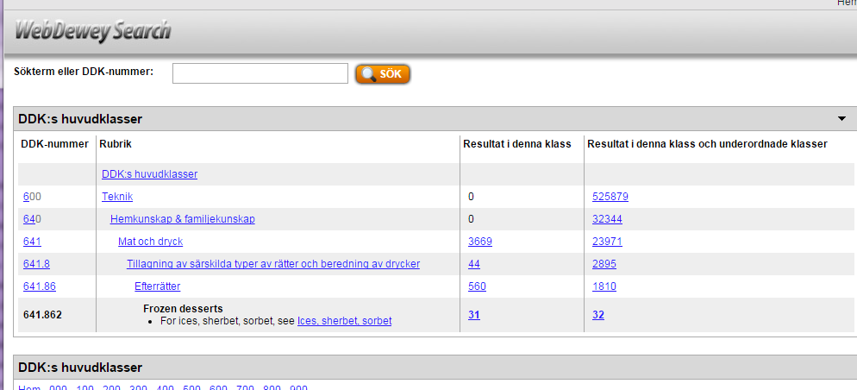
Search for ”Ice cream” (In English)
Not translated => stays in English
Notes:
The mixed translation is a problem. It is very useful to be able to search the full English index, but it is difficult to understand why a search in Swedish for Ice cream do not give you results for Ice cream.
Searching in English renders a search list in English with different aspects of Ice cream, but after chosing eg Ice cream in 641.862 you see the Swedish mixed translation – in Swedish when translated, in English if not translated. A bit confusing!

Slide 17
Improvements
Language
”Full” Swedish translation
Index terms should be marked with language tags (Glass@sv = Ice cream@en Glas@sv = Glass@en)
API
There is one!!!
Make things easier for the users
Notes:
To make subject access by Dewey easier for users, we need an almost full Swedish translation (80-90%). One problem is not being able to search for all subjects in Swedish, another problem is not being able to specify language. An example of this problem i searching the ”glass” in Swedish, ie Icecream. You get results for glass in English, but since a lot of the classes are translated, you will get ”Glas” after chosing frpm the search list. A bit confusing! Specifying language for search terms must be possible.
Since most users do not want to search, they want to find with as little effort as possible, we should integrate WebDeweySearch in the search function. Luckily, there is an API!. But, as the Swedish National Library are working on a ”New Libris”, webLibris is waiting for big changes, and still waiting. The API will be used in the new webLibris, not in the present one.

Slide 18
Future with Dewey as linked data
Notes:
Back to the future. We haven´t forgotten Dewey as linked data. We miss Dewey.info (we do dream on) – but do we nead Dewey.info to be able to provide deweydata to our users?
One problem is developers – a lot of them love linked data, expecially linked open data. But if Dewey cannot be freely accessible, is Dewey.info still useful?

Slide 19
Use for the cataloger
http://dewey.info/class/616.994/e23/
Cancer
Notes:
Most catalogers do copy cataloguing. They will find a Dewey code in the record and want to know more about. This can also be done by the API – but not as easily. (Screenshots from alfa version of new Libris cataloguing client)

Slide 20
Use for the cataloger – shorter call number
http://dewey.info/class/616.994/e23/
616.99
Cancer
Notes:
From Dewey.info or an API it would be possible to automatically get a shorter Dewey number suitable for shelving – Swedish librarians do not understand the value of full dewey numbers for browsing!

Slide 21
Use for end users
Library users
Dewey.info
or Dewey API
Web users (everyone!)
Dewey.info
362.1969943470092
Notes:
For end users of the library catalog, technique behind the schene is not important. We at the national library could use an API for Dewey at the new webLibris, and keep withing restrictions of usage set by OCLC. Libraries with their own public catalogs would have to have a licence to use the API. Most libraries use web solutions provided by a commersial supplyer – they would need a licence for use of the API.
For library end users it is important to be able to search by subject – should the national library organize use of an API to make it easier?
For users searching the web – Dewey as linked open data would open up subject data hidden in Dewey codes. Even a shallow Dewey.info would be of use!
Will libraries continue building long Dewey numbers if the parts cannot be used? 362.1969943470092 – Services to patients with specific conditions – Cancer – in the large intestine - biography

Slide 22
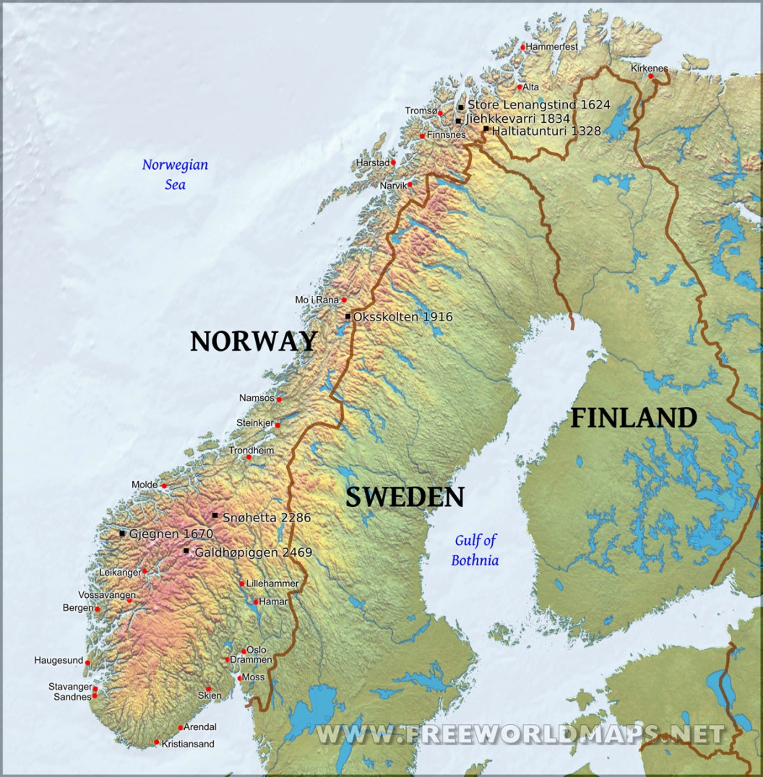
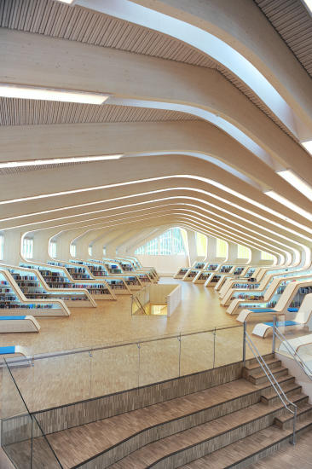
WebDeweySearch in Norway
100+ years using Dewey
National bibliography since 1956
English or abridged /modified translations until 2015
~60 university and research libraries
~430 public libraries
~400 school libraries

Slide 23
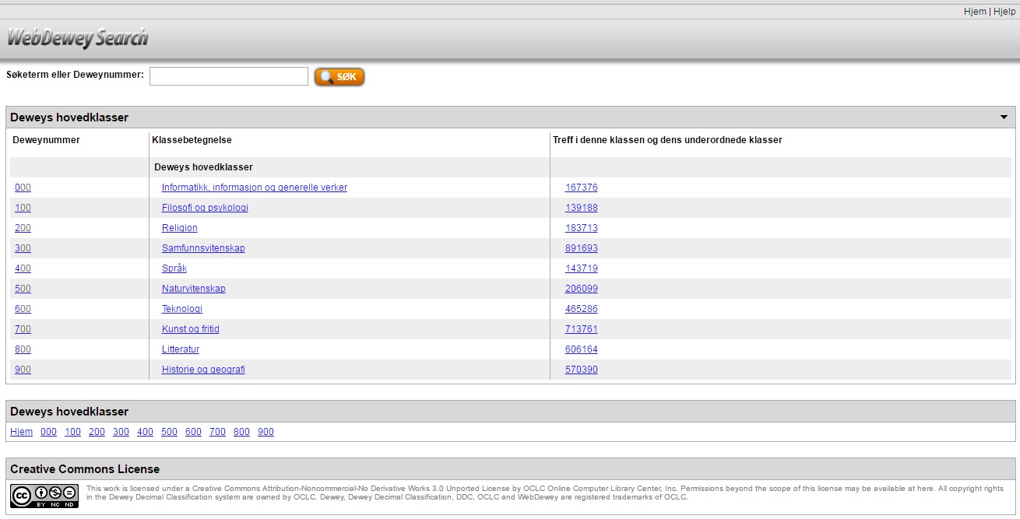
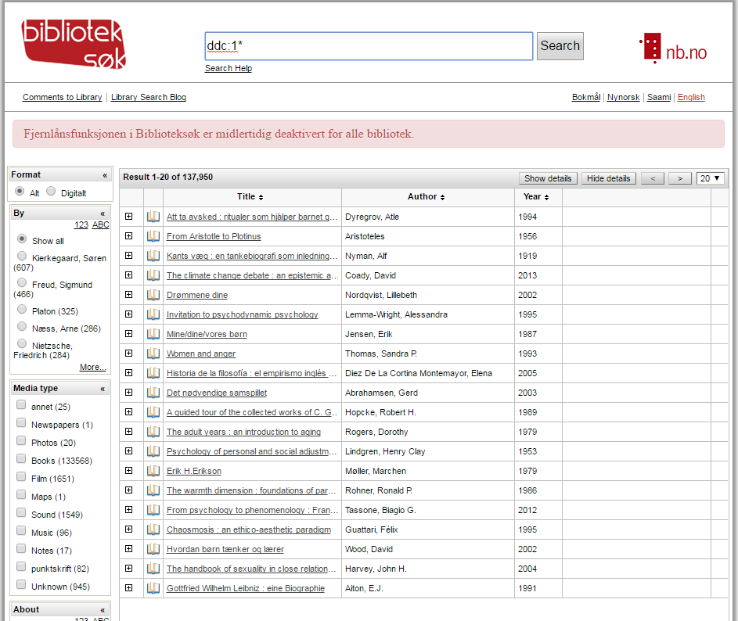
WebDeweySearch -> Union catalog

Slide 24
One-column results

Slide 25
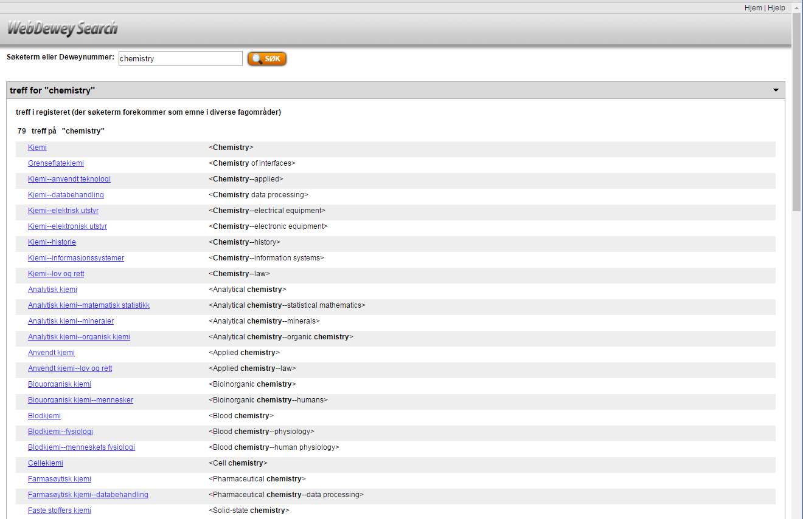
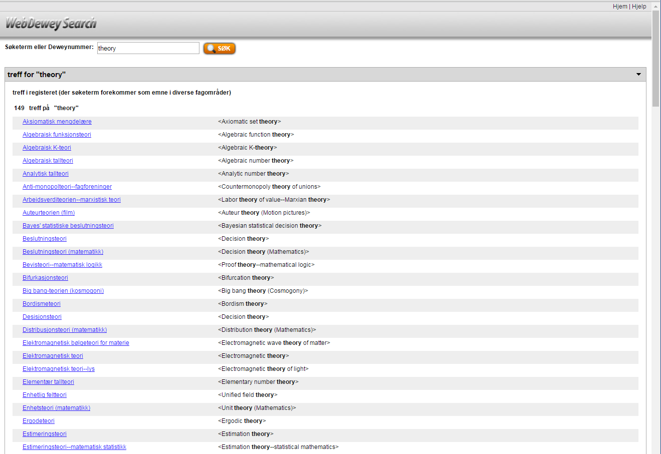
Search in Norwegian and English

Slide 26
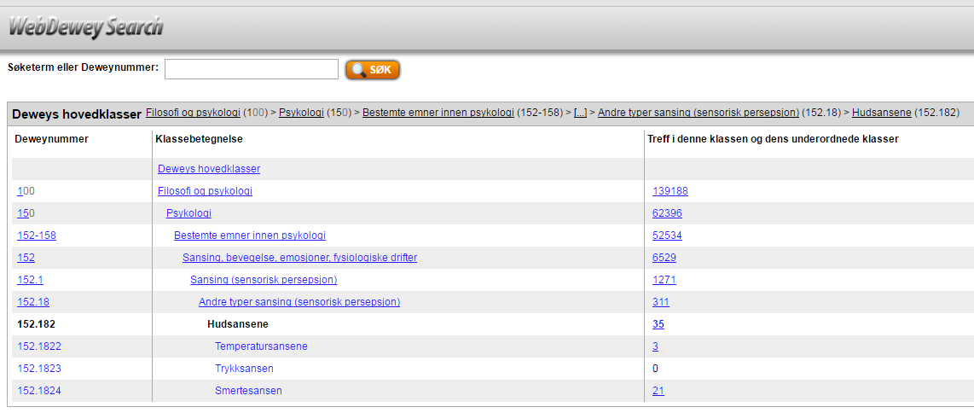
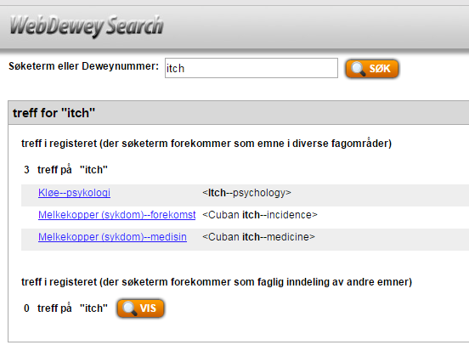
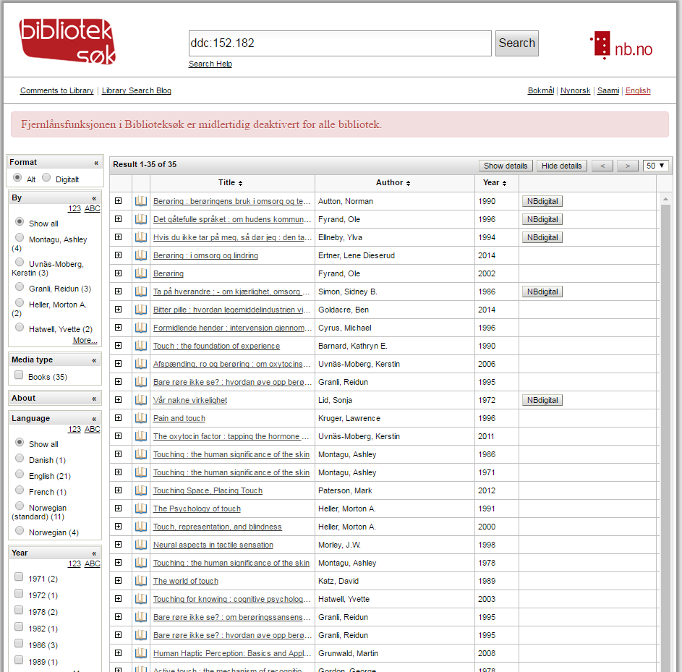
Relative index -> directs to hierarchy
35

Slide 27
Next step: Add mapped vocabularies

Slide 28
API and other end-user solutions in Norway

Slide 29
Danke! Tack! Takk!
http://deweysearchde.pansoft.de/webdeweysearch/
http://deweysearchsv.pansoft.de/webdeweysearch/
http://deweysearchno.pansoft.de/webdeweysearch/
T.Mengel@dnb.de
Harriet.Aagaard@kb.se
Elise.Conradi@nb.no
Peter.Werling@pansoft.de
Questions?

