Slide 1
The Number Building / User Contribution Tool in WebDewey
EDUG 2013 Symposium Oslo 11 April
Julianne Beall, Assistant Editor, DDC
Library of Congress

Slide 2
Outline
What do you gain by using the WebDewey number building tool?
Examples
What works now
What still requires use of Add Local/Edit Local
Questions about desired improvements

Slide 3
What do you gain along the way? (1)
If you follow the process, you get:
Displays that record your progress and show add notes to be followed
Appropriate records that appear in hierarchy box to help you to execute the next step
The ability to go off and search for something, then come back where you were in the number building process

Slide 4
What do you gain along the way? (2)
If you follow the process, you get:
The opportunity to modify proposed user terms to make them fit the Relative Index pattern
The opportunity to add more user terms, either borrowing from the display of Relative Index entries for each number used to build the number, or adding your own terms

Slide 5
What do you gain in the end? (1)
If you follow the process, you get:
Built numbers integrated with other search results and browse results in WebDewey
Built numbers that you can reuse as needed and share with others in your institution
Fields in the MARC classification record that show how the number was built; you can see those fields when you display the MARC format in WebDewey

Slide 6
What do you gain in the end? (2)
If you follow the process, you get:
A user-friendly, visible list of DDC numbers/notation used to build the number—numbers that can be used as additional access points in the MARC 085 Synthesized Classification Number Components field in the bibliographic record
A WebDewey record with information that can help libraries identify logical places to shorten the number

Slide 7
What do you gain in the end? (3)
If you follow the process . . .
Ideally, you would get assurance that the number was correctly built; we are working toward that ideal. . . but for now you still have to be alert and read the add notes that are displayed as part of the process and check the number as it is being built
When the number building tool works correctly, it is very consistent, and can prevent the errors of inconsistency and inattention that humans often make

Slide 8
What do you gain in the end? (4)
If you follow the process, you get:
Built numbers that you can contribute for use in the wider Dewey community (if you don’t use Add Local/Edit Local)

Slide 9
What is user contribution?
Number building assistant submits number into Dewey data flow
via distribution server
as MARC record
back to all users after editorial review
Not unlike “share” button on social networks

Slide 10
Dewey by the numbers: user contribution
108 class records contributed to date
Top contributor: University of Oslo with 28 numbers contributed
Contributed records scattered among 40 divisions; 590s have the most: 12 records
The editorial team still needs to check these numbers and put them in the database if valid

Slide 11
Overall workflow
Find starting number/span with add instruction, else find base number
Click Start/Add
System displays notation specified by add instruction or displays Table 1 (in final step)
No
As needed, user navigates to next number/span with add instruction or base number
Number building complete?
Yes
Verify the number is correct, click Save
User term box appears, select user terms
Edit term, click Update
User term needs to be changed?
Yes
Additional term needed?
No
No
Yes
Create additional term, click Add
Select term to set as caption
Save as institutional or personal visibility
Verify presence in the hierarchy
Contribute to Dewey Editors (optional)
If not contributed to Dewey Editors, new number visible only to institution or person

Slide 12
Process of building 616.99424071 Lung cancer—etiology
Navigate to this number/span | Click | Number built so far | Caption of last number/notation added
616.9942-616.9949 | Start | 616.994 | Cancers of other organs and of regions
611.24 | Add | 616.99424 | Lungs
618.1-618.8:071 | Add | 616.99424071 | Etiology

Slide 13
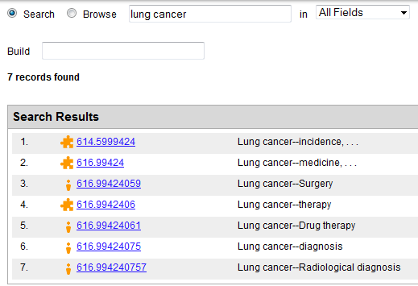
616.99424 Lung cancer--medicine: a built number

Slide 14
Add note at 616.9942-616.9949 Cancers of other organs and of regions
You must start here, where the add instruction is

Slide 15
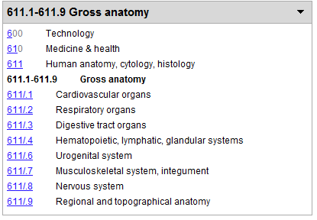
In hierarchy box: 611.1-611.9 Gross anatomy

Slide 16
Number built so far: 616.99424

Slide 17
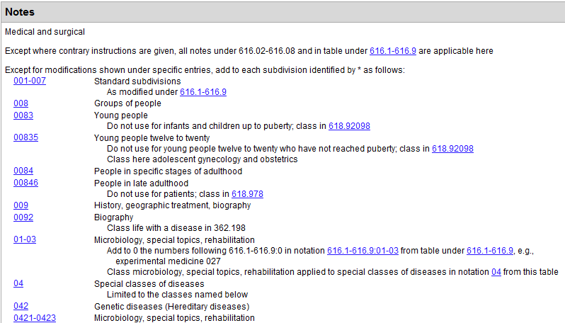
Add table under 618.1-618.8

Slide 18
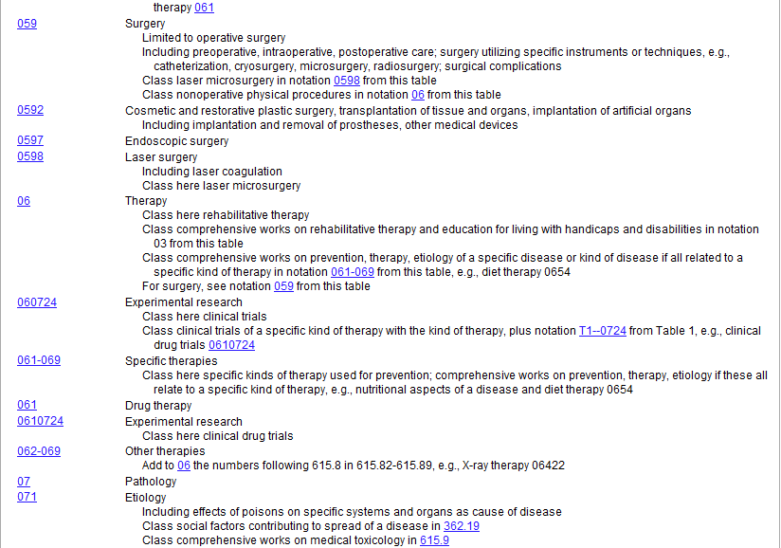
Further down in add table under 618.1-618.8

Slide 19
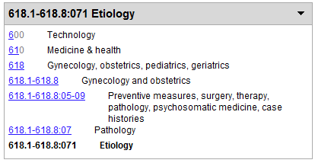
In hierarchy box: 618.1-618.8:071 Etiology
618.1-618.8:071 means notation 071 from the add table under 618.1-618.8

Slide 20
Number building complete
Is this kind of analytic display useful?
Would you like to be able to click at any time and get this
kind of display for all built numbers in WebDewey?

Slide 21
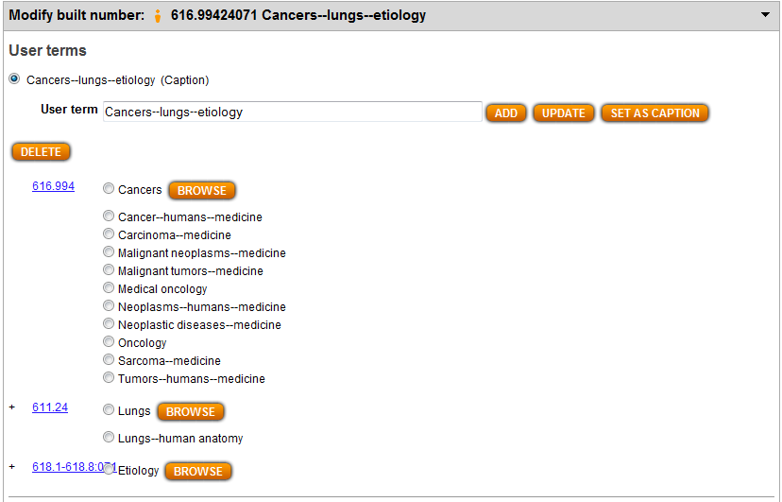
Opportunity to modify user terms

Slide 22
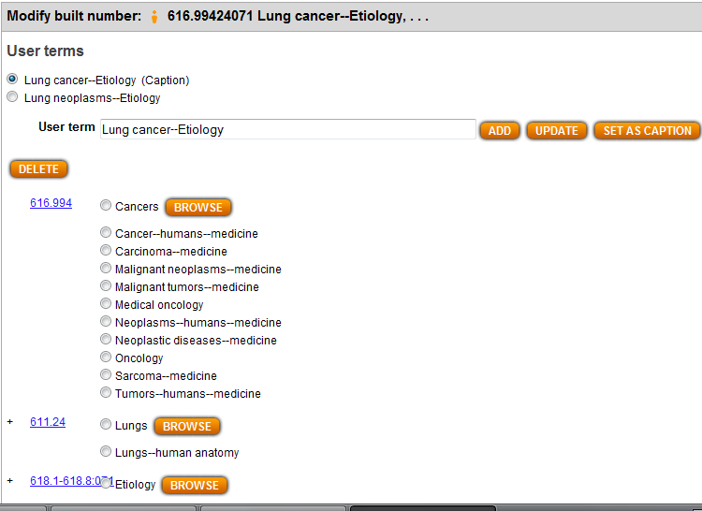
Update for caption, Add for second user term

Slide 23
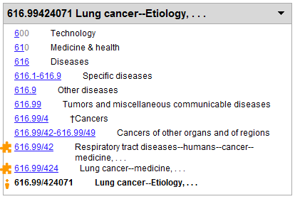
Newly built number in hierarchy box

Slide 24
Visibility box. List of numbers / notation used to build number
Is the list of numbers/notation useful?
Would you like to be able to click at any time
and get this kind of list for all built numbers in WebDewey?
Note: These numbers can be added for access in the 085 field of
bibliographic records.

Slide 25
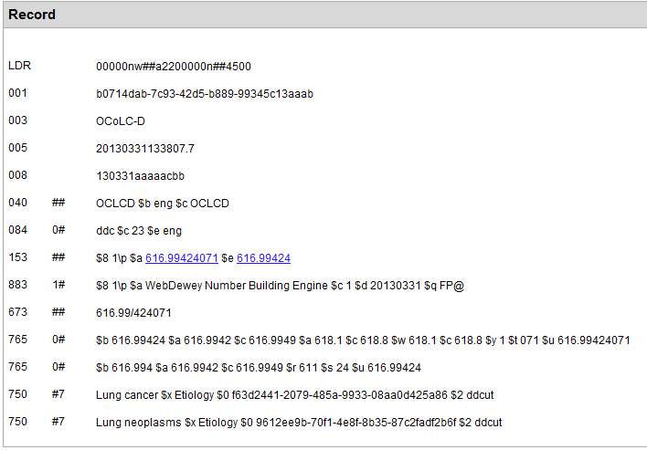
MARC classification record for newly built number

Slide 26
Number, provenance, segmentation

Slide 27
Number components in 765 fields in classification records
From: http://www.loc.gov/marc/classification/cd765.html
Subfield Codes
$a - Number where instructions are found-single number or
beginning number of span (R)
$b - Base number (R)
$c - Classification number--ending number of span (R)
$r - Root number (R)
$s - Digits added from classification number in schedule or
external table (R)
$t - Digits added from internal subarrangement or add table (R)
$u - Number being analyzed (R)
$w - Table identification-Internal subarrangement or add table (R)
$y - Table sequence number for internal subarrangement or
add table (R)

Slide 28
085 field in bibliographic format modeled on 765 field in classification format
Component numbers/notation can be provided in bibliographic records to increase access
From http://www.loc.gov/marc/bibliographic/bd085.html
Subfield Codes most commonly used
$b - Base number $s - Digits added from classification number in schedule or external table (R) $z - Table identification (R)
$8 - Field link and sequence number
From http://experimental.worldcat.org/marcusage/085.html
As of 1 January 2013, 362,718 records in WorldCat had the 085 field.

Slide 29
User terms in DDC classification record

Slide 30
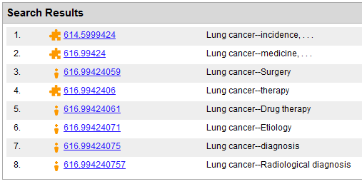
Newly built number integrated with other search results

Slide 31
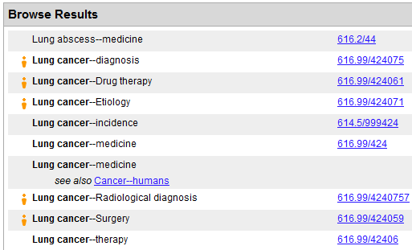
User term integrated with other Relative Index browse results

Slide 32
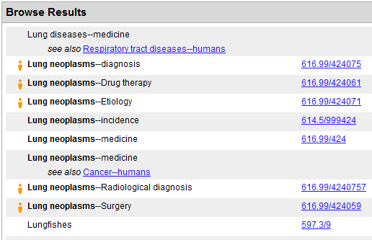
Second user term also integrated in Relative Index browse results

Slide 33
Process of building 305.83982094 Norwegian Australians—social aspects
Navigate to this number/span | Click | Number built so far | Caption of last number/notation added
305.81-305.89 | Start | 305.8 | Specific ethnic and national groups
T5--3982 | Add | 305.83982 | Norwegians
T2--94 | Add | 305.83982094 | Australia

Slide 34
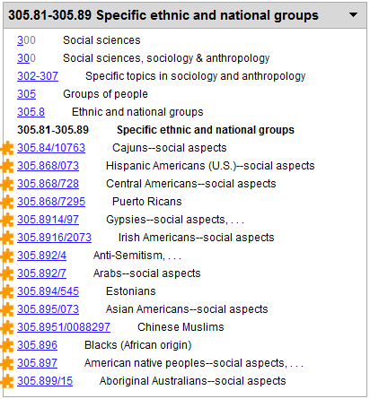
In hierarchy box: 305.81-305.89 Specific ethnic and national groups
Easy to spot
the span with
add notes:
Look at all
the built
numbers!

Slide 35
Add note at 305.81-305.89 Specific ethnic and national groups

Slide 36
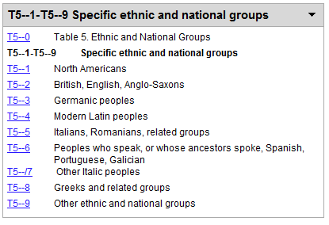
In hierarchy box: T5--1-T5--9 Specific ethnic and national groups
This content appears in hierarchy box when you click Start
at 305.81-305.89 Specific ethnic and national groups

Slide 37
Go to T5--3982 Norwegians and click Add.

Slide 38
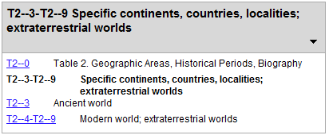
T2--3-T2--9 Specific continents, countries, localities; extraterrestrial worlds
This content appears in hierarchy box—but why?

Slide 39
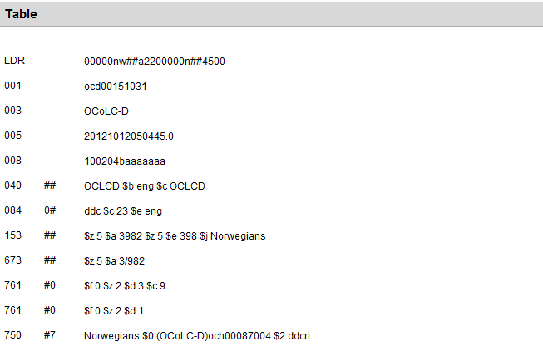
Hidden add instructions reflect part of add instruction at start of Table 5

Slide 40
Abbreviated add instructions (761 fields) help number building tool
From: http://www.loc.gov/marc/classification/cd761.html
Subfield Codes
$c - Classification number-ending number of span (R)
$d - Divided like number (R)
$f - Facet designator (R)
$z - Table identification (R)

Slide 41
T5--0 Table 5. Ethnic and National Groups: add instruction
Number building tool does not understand this part of add instruction at start
of Table 5:
If notation from Table 2 is not added, use 00 for standard subdivisions
We are thinking how to fix that problem.
Should we be thinking about more hidden instructions in each Table 5 record?
Or about visible footnote instructions in each Table 5 record?

Slide 42
Go to T2—94 Australia and click Add. Number building is complete

Slide 43
765 fields show how number was built using the hidden add instruction
765 field shows where the hidden instruction for adding 094 is found:
$z5 $a 3982
It does not show where the visible add instruction is found—at the start of
Table 5

Slide 44
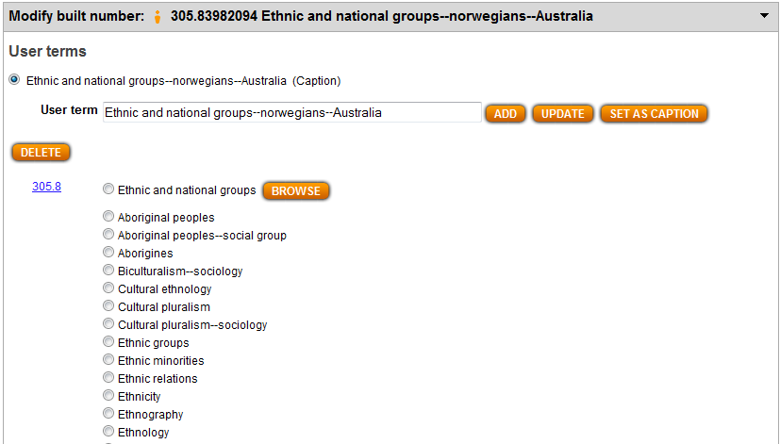
Opportunity to modify proposed user term (caption)

Slide 45
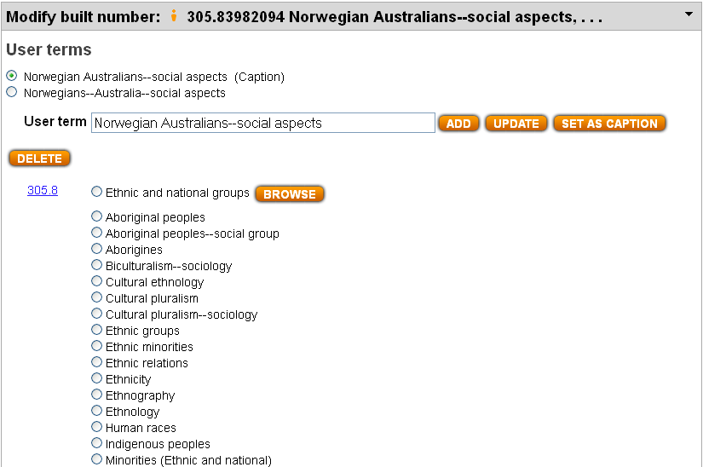
Revised user terms fit Relative Index patterns (Which is better for caption?)

Slide 46
Visibility box. List of numbers/notation used to build number

Slide 47
Process of building 305.8951005 Chinese—social aspects—serials
Navigate to this number/span | Click | Number built so far | Caption of last number/notation added
305.81-305.89 | Start | 305.8 | Specific ethnic and national groups
T5--951 | Add | 305.8951 | Chinese
T1--05 | Add | 305.895105 | Serial publications
 | Edit Local | 305.8951005

Slide 48
Incorrectly built number: needs double zero

Slide 49
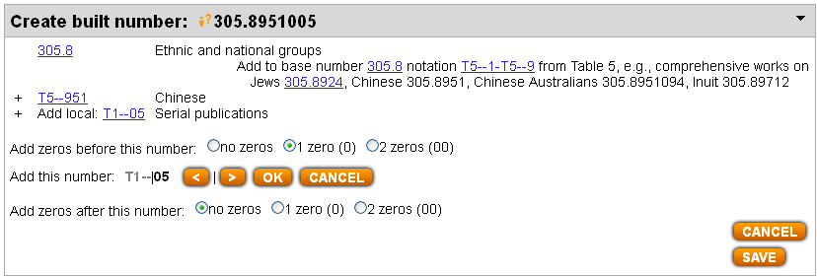
Using Edit Local (Add Local) to insert second zero

Slide 50
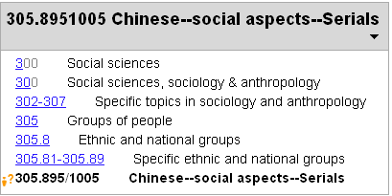
In hierarchy box: number newly built using Edit Local

Slide 51
List of component numbers / notation is correct. Cannot contribute

Slide 52
765 fields in MARC record
We don’t give location of add instruction for standard subdivisions when the
only thing we could cite is the start of Table 1 ($z 1 $a 0). Technically, the
the 765 field showing the addition of 005 should show where the add
instruction is found that specifies the extra zero—at the start of Table 5
($z 5 $ a 0) —though we often have not done that. Otherwise the
765 fields are correct.

Slide 53
Process of building 616.24005 Lung diseases—medicine—serials
Navigate to this number/span | Click | Number built so far | Caption of last number/notation added
616.24 | Start | 616.24 | Diseases of lungs
616.1-616.9 |  | 616.24 | Specific diseases
T1—05 | Add | 616.24005 | Serial publications
Note: You may just look at the add table under 616.1-616.9, or you may select
616.1-616.9:003-006 Standard subdivisions and click Add

Slide 54
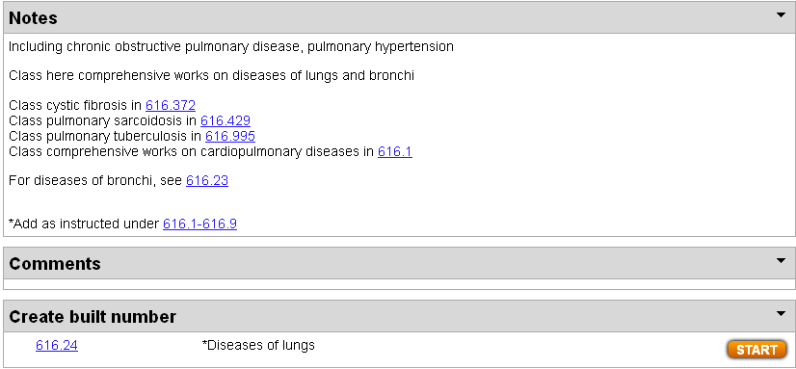
616.24 Diseases of lungs has add footnote

Slide 55
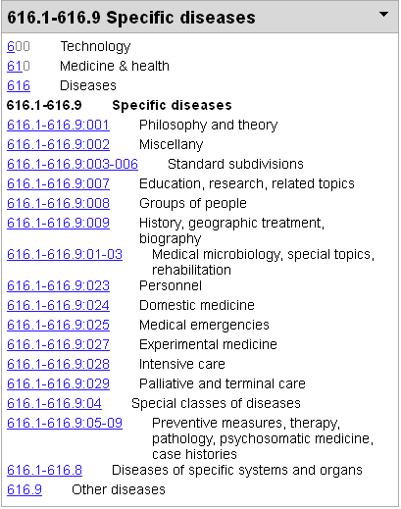
In hierarchy box: summary of add table under 616.1-616.9

Slide 56
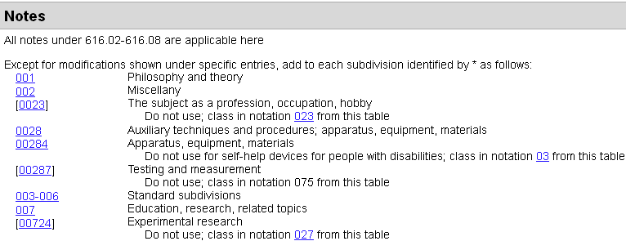
Standard subdivisions have double zero. T1—05 hidden in span 003-006
If you click 003-006, then that line will appear in the analytic display; otherwise not—
but the resulting number will be the same, either way

Slide 57
Find and select T1—05 Serial publications

Slide 58
Extra zero inserted automatically when you click Add
Even if you don’t click on 616.1-616.9:003-006 Standard subdivisions, the number
building tool knows to insert the second zero.
At first it was necessary to use Add Local to insert the extra zero in these cases,
but that problem has been fixed.

Slide 59
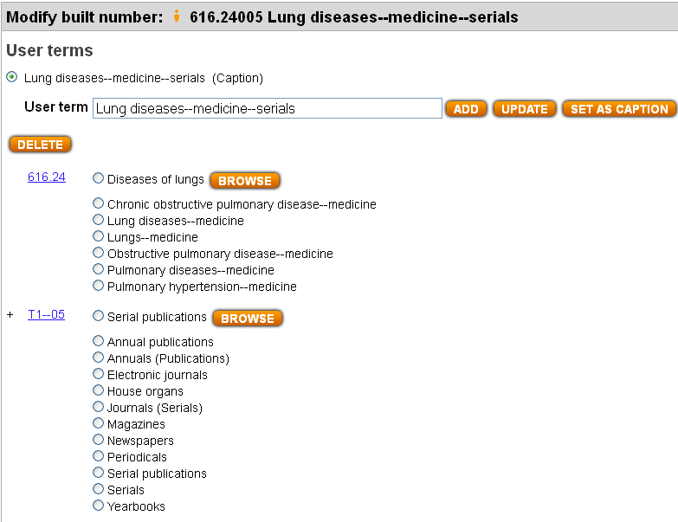
Select from Relative Index entries to update user term set as caption

Slide 60
List of component numbers/notation is correct. Can contribute

Slide 61
Process of building 943.1550875 Berlin (Germany)—1949-1971
Navigate to this number/span | Click | Number built so far | Caption of last number/notation added
930-990 | Start | 9 | History of specific continents, countries, localities; extraterrestrial worlds
T2--43155 | Add | 943.155 | Berlin
930-990:01-09 | Add | 943.1550 | Historical periods
943.10875 | Add | 943.1550875 | Administration of Walter Ulbricht, 1949-1971

Slide 62
930-990:01-09 Historical periods
The number building tool does not understand these instructions!

Slide 63
Last number in list of component numbers not correct!
This illustrates one of the problems with building history numbers using the
notation for historical periods in the add table under 930-990. Here the meaning
of the number 943.10875 Administration of Walter Ulbricht, 1949-1971,
from which the period notation 0875 was taken, has been
lost.

Slide 64
In MARC record, 765 field for historical period not correct!

Slide 65
How to fix the problem? (1)
We do not yet have the answer!
We have been considering various potential solutions—and we welcome other suggestions!
One possibility might be to provide more explicit (and visible) add instructions for historical periods in 930-990, e.g., more instructions under 943.1 Northeastern Germany and 943.2 Saxony and Thuringia

Slide 66
How to fix the problem? (2)
Another possibility might be hidden add notes in T2—3-9 records
We would need to tell the number building tool to use the hidden add note as an extension of the instructions for historical periods in the table under 930-990
The add instructions for historical periods in the table under T1—093-099 are different!

Slide 67
How to fix the problem? (3)
The hidden add notes for T2—43155 Berlin and T2—432122 Leipzig might specify that the numbers following 943.10 in 943.101-943.108 be used
The hidden add note for T2—43364 Munich might specify that the numbers following 943.0 in 943.01-943.08 be used
Or maybe the hidden add notes could be given only at T2—431, T2—432, T2—433, etc.

Slide 68
Questions? Thank you!
Julianne Beall
jbea@loc.gov

Slide 69
Useful links
WebDewey 2.0
http://dewey.org/webdewey/
Dewey training courses
http://www.oclc.org/dewey/resources/teachingsite/courses.en.html
WebDewey Number Building FAQ
http://www.oclc.org/content/dam/oclc/dewey/resources/teachingsite/courses/WebDewey_Number_Building_FAQ.pdf
025.431: The Dewey Blog
http://ddc.typepad.com
MARC Usage in WorldCat
http://experimental.worldcat.org/marcusage/

