Slide 1
Dewey Basics for Mapping \\ Bringing Dewey Mappings onto the Semantic Web
1
Tina Mengel, Lars G. Svensson

Slide 2
2
What it is about to map Dewey
Things to talk about (early!) in the mapping project
Things to consider when you want to share your mappings with someone else

Slide 3
What is it about to map Dewey
3
Advantages of the DDC
universal
numeric and verbal
used worldwide
number building
ongoing updates
WebDewey US and family WebDeweys used around the world to classify with
DDC
Built numbers
Number building tool
Application adapted to local requirements
Additional terminology (Mappings!)

Slide 4
What is it about to map Dewey
4
Advantages of the DDC
universal
numeric and verbal
used worldwide
number building
ongoing updates
WebDewey US and family WebDeweys used around the world to classify with DDC
Built numbers
Number building tool
Application adapted to local requirements
Additional terminology (Mappings!)
Advantages of the DDC
universal
numeric and verbal
used worldwide
number building
ongoing updates
WebDewey US and family WebDeweys used around the world to classify with
DDC
Built numbers
Number building tool
Application adapted to local requirements
Additional terminology (Mappings!)

Slide 5
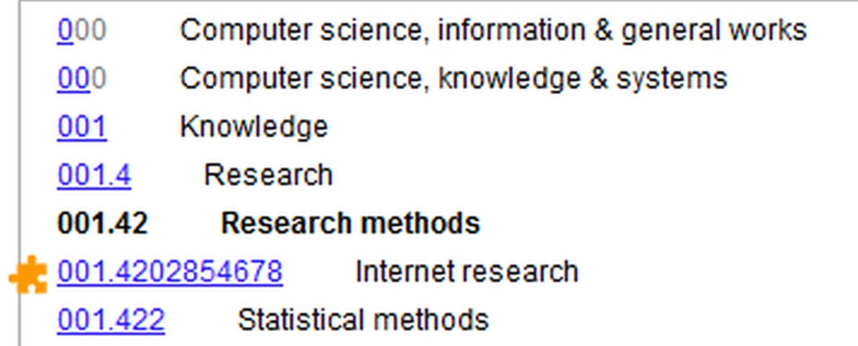
What is it about to map Dewey
5
Typological characteristics
hierarchy
notational
structural
precoordination
built numbers
compound concepts

Slide 6
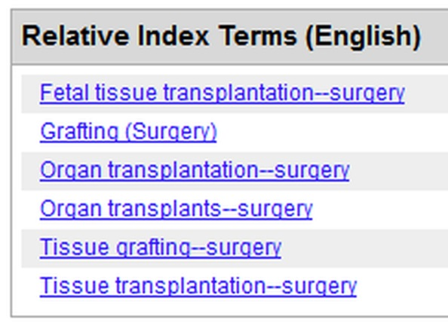
What is it about to map Dewey
6
Typological characteristics (2)
context dependency
1 topic in >1 disciplines
reference notes
Notes
What’s in the class?
What does not belong to the class but elsewhere?
Relative Index
arranged by disciplines
indicator for “What’s in the class” but also for “What else is in the class?”

Slide 7
Things to talk about (early!) in the mapping project
7
Connotation scope (scope of meaning) Unidirectional vs. bidirectional mapping Specificity

Slide 8
Connotation scope
8
What are the elements to be mapped?
System A | System B
Element of - Thesaurus - Classification scheme - Taxonomy - … | Element of DDC - NOTATION
The actual mapping takes place on the subject level.

Slide 9
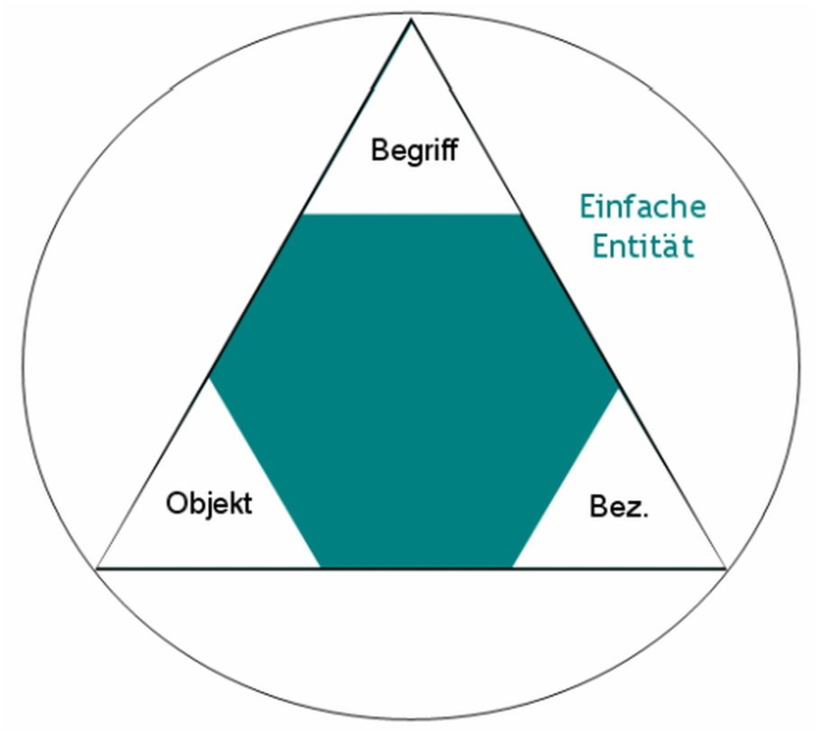
Connotation scope
9
Step 1: Simple entity
Tree
Notes:
Abb. aus: Gödert, Winfried: Semantische Wissensrepräsentation und Interoperabilität. In: Information Wissenschaft & Praxis 61 (2010) 1, S. 5-28

Slide 10
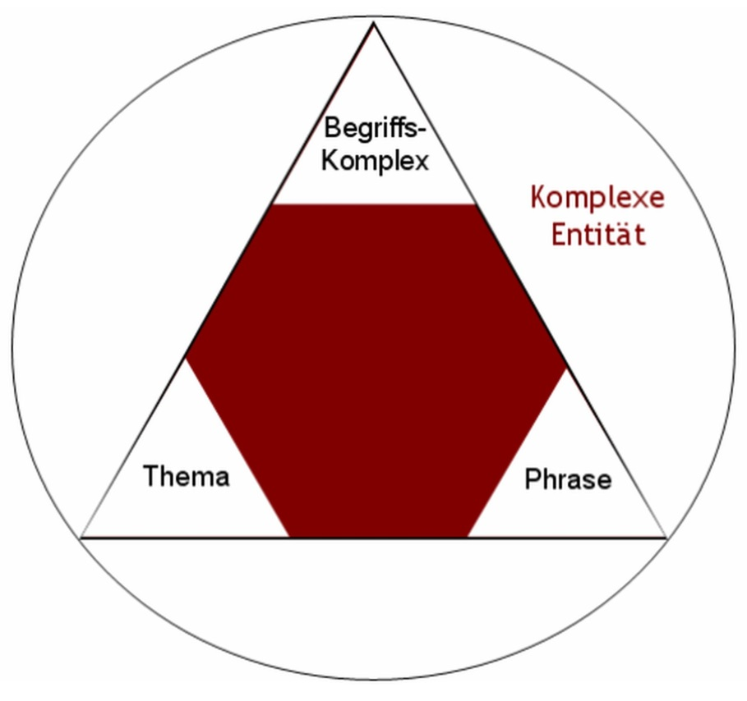
Connotation scope
10
Step 2: Complex entity
pre-combined
predefined
limited for certain use
part of a discipline
positioned in a hierarchy
...
Notes:
Abb. aus: Gödert, Winfried: Semantische Wissensrepräsentation und Interoperabilität. In: Information Wissenschaft & Praxis 61 (2010) 1, S. 5-28

Slide 11
Connotation scope
11
Step 3: Complex entity A MATCHES Complex entity B
Complex entity
A
Complex entity
B

Slide 12
Connotation scope
12
Example for: Complex entity A MATCHES Complex entity B
BT Außenpolitik
Diplomatie
P.01 (allg. Politik)
320
Political science
327
International relations
327.2 Diplomacy

Slide 13
Connotation scope
13
DDC: What’s in the class?
Category A
Class heading Definition note Variant-name note Scope note | Expands or limits the scope of meaning of the whole class number (Notes usually refer to class heading)

Slide 14
Connotation scope
14
DDC: What’s in the class?
Category B
Class-here note Principle of “approximate the whole” | Expands or limits the scope of meaning of a topic
Including note Principle of “standing room”

Slide 15
Connotation scope
15
DDC: What’s in the class?
Category C
Relative Index terms | Show one-to-one correspondence to a topic explicitly mentioned in the class notes or heading Expand or limit the scope of meaning of the whole class or of a certain topic that may or may not be explicitly mentioned in the class
Mapped terms

Slide 16
Connotation scope
16
DDC: What else is in the class – but not visible?
Topics that are equivalent in meaning or are logically part of a topic that is mentioned in the class Topics that are logically opposites to each other (e.g., Morality and Immorality in 170) Topics originating in a superordinate number that have hierarchical force Topics originating in a component of a built number that have hierarchical force Topics that are explicitly mentioned only in a see reference, see-also reference or class-elsewhere note and not in the number they direct to Topics from multi-level or compound RI terms that have a specific equivalent in the entity A vocabulary but are not listed as such in the RI Topics that are logically additional examples when an example is given in a note Topics that are implied in descriptive or phrasal topics in the class heading or notes
Topics that are equivalent in meaning or are logically part of a topic that is mentioned in the class Topics that are logically opposites to each other (e.g., Morality and Immorality in 170) Topics originating in a superordinate number that have hierarchical force Topics originating in component of a built number that have hierarchical force Topics that are explicitly mentioned only in a see reference, see-also reference or class-elsewhere note and not in the number they direct to Topics from multi-level or compound RI terms that have a specific equivalent in the entity A vocabulary but are not listed as such in the RI Topics that are logically additional examples when an example is given in a note Topics that are implied in descriptive or phrasal topics in the class heading or notes
Topics that are equivalent in meaning or are logically part of a topic that is mentioned in the class Topics that are logically opposites to each other (e.g., Morality and Immorality in 170) Topics originating in a superordinate number that have hierarchical force Topics originating in component of a built number that have hierarchical force Topics that are explicitly mentioned only in a see reference, see-also reference or class-elsewhere note and not in the number they direct to Topics from multi-level or compound RI terms that have a specific equivalent in the entity A vocabulary but are not listed as such in the RI Topics that are logically additional examples when an example is given in a note Topics that are implied in descriptive or phrasal topics in the class heading or notes
Topics that are equivalent in meaning or are logically part of a topic that is mentioned in the class Topics that are logically opposites to each other (e.g., Morality and Immorality in 170) Topics originating in a superordinate number that have hierarchical force Topics originating in component of a built number that have hierarchical force Topics that are explicitly mentioned only in a see reference, see-also reference or class-elsewhere note and not in the number they direct to Topics from multi-level or compound RI terms that have a specific equivalent in the entity A vocabulary but are not listed as such in the RI Topics that are logically additional examples when an example is given in a note Topics that are implied in descriptive or phrasal topics in the class heading or notes
Topics that are equivalent in meaning or are logically part of a topic that is mentioned in the class Topics that are logically opposites to each other (e.g., Morality and Immorality in 170) Topics originating in a superordinate number that have hierarchical force Topics originating in component of a built number that have hierarchical force Topics that are explicitly mentioned only in a see reference, see-also reference or class-elsewhere note and not in the number they direct to Topics from multi-level or compound RI terms that have a specific equivalent in the entity A vocabulary but are not listed as such in the RI Topics that are logically additional examples when an example is given in a note Topics that are implied in descriptive or phrasal topics in the class heading or notes
Topics that are equivalent in meaning or are logically part of a topic that is mentioned in the class Topics that are logically opposites to each other (e.g., Morality and Immorality in 170) Topics originating in a superordinate number that have hierarchical force Topics originating in component of a built number that have hierarchical force Topics that are explicitly mentioned only in a see reference, see-also reference or class-elsewhere note and not in the number they direct to Topics from multi-level or compound RI terms that have a specific equivalent in the entity A vocabulary but are not listed as such in the RI Topics that are logically additional examples when an example is given in a note Topics that are implied in descriptive or phrasal topics in the class heading or notes
Topics that are equivalent in meaning or are logically part of a topic that is mentioned in the class Topics that are logically opposites to each other (e.g., Morality and Immorality in 170) Topics originating in a superordinate number that have hierarchical force Topics originating in component of a built number that have hierarchical force Topics that are explicitly mentioned only in a see reference, see-also reference or class-elsewhere note and not in the number they direct to Topics from multi-level or compound RI terms that have a specific equivalent in the entity A vocabulary but are not listed as such in the RI Topics that are logically additional examples when an example is given in a note Topics that are implied in descriptive or phrasal topics in the class heading or notes
Topics that are equivalent in meaning or are logically part of a topic that is mentioned in the class Topics that are logically opposites to each other (e.g., Morality and Immorality in 170) Topics originating in a superordinate number that have hierarchical force Topics originating in component of a built number that have hierarchical force Topics that are explicitly mentioned only in a see reference, see-also reference or class-elsewhere note and not in the number they direct to Topics from multi-level or compound RI terms that have a specific equivalent in the entity A vocabulary but are not listed as such in the RI Topics that are logically additional examples when an example is given in a note Topics that are implied in descriptive or phrasal topics in the class heading or notes

Slide 17
Unidirectional vs. bidirectional mapping
17
Complex entity
A
Complex entity
B
Complex entity
A
Complex entity
B

Slide 18
Unidirectional vs. bidirectional mapping
18
Initial system |  | DDC
Tektonik SYN Geotektonik |  | 551.8 Structural geology Class here deformation, diastrophism, epeirogeny, tectonics

Slide 19
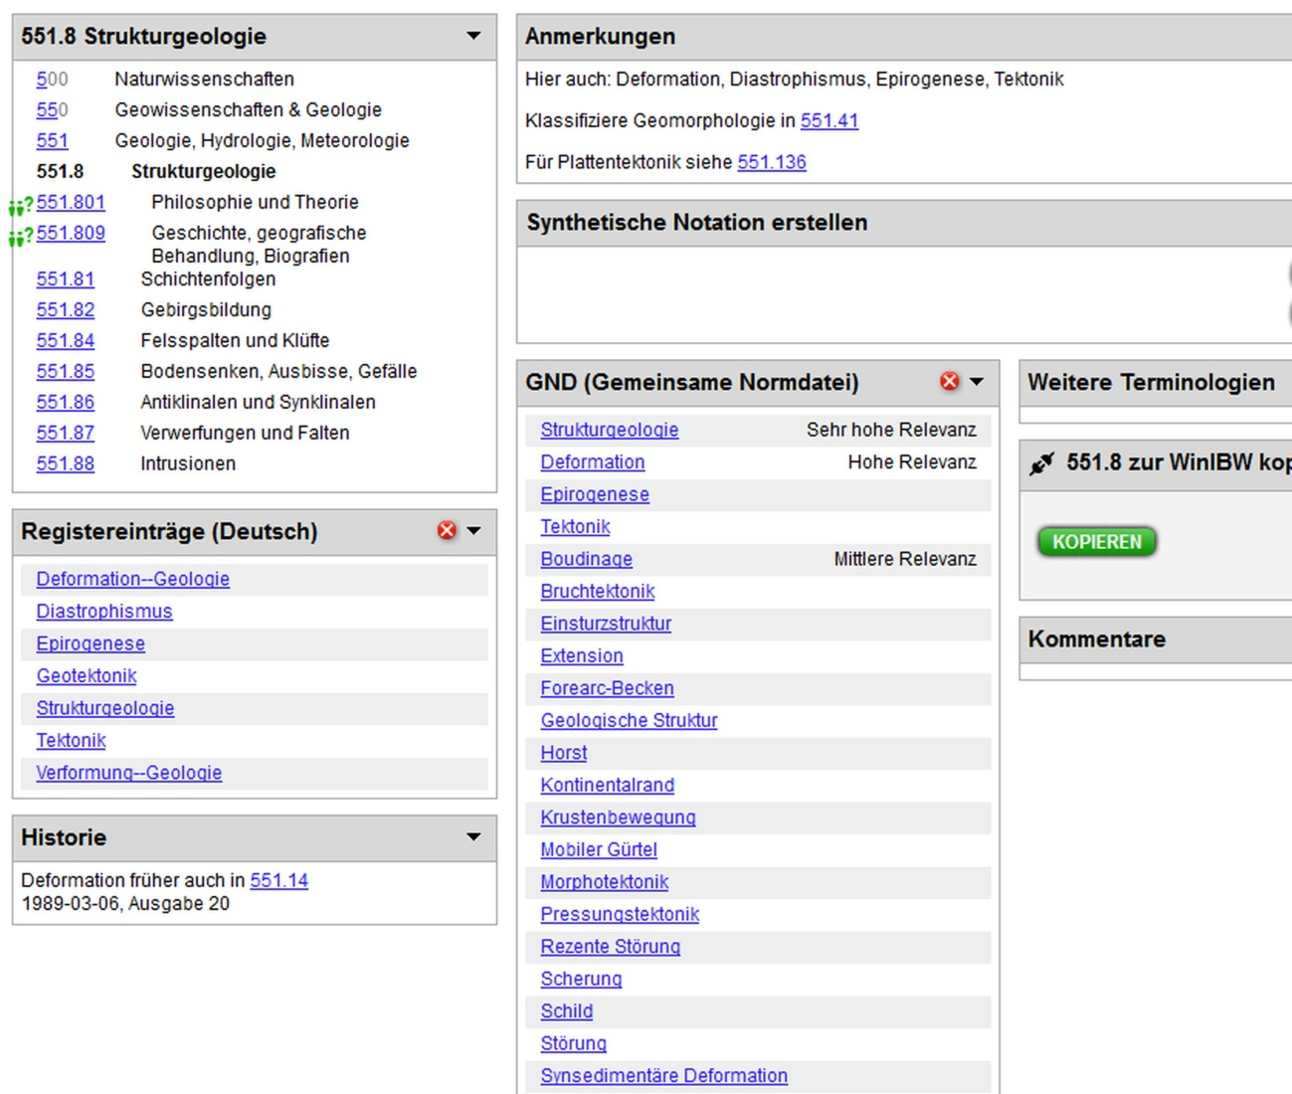
Unidirectional vs. bidirectional mapping
19

Slide 20
Unidirectional vs. bidirectional mapping
20
Degrees of Determinacy
Relationship based on the Connotation scopes of both systems and under consideration of unidirectional mapping
D4 = fully correspondent
D3 = high relevance
D2 = partial relevance
D1 = minor relevance
Complex entity
A
Complex entity
B

Slide 21
Specificity
21
Notational hierarchy

Slide 22
Specificity
22
Number building
Bauhausstil (Architektur) | Deep-level mapping | 720.9 History, geographic treatment, biography [formerly also 721.09] + T2—43 Germany and neighboring central European countries + T1--09042 1920–1929

Slide 23
Specificity
23
Structural hierarchy
Whatever is true of the general topic is also true of subordinate topics
Hierarchical force
Where to find?
Definition notes, Variant-name, former-name notes, Scope notes, Class-here notes, Number-built notes, Class-elsewhere notes, Former heading notes, See references

Slide 24
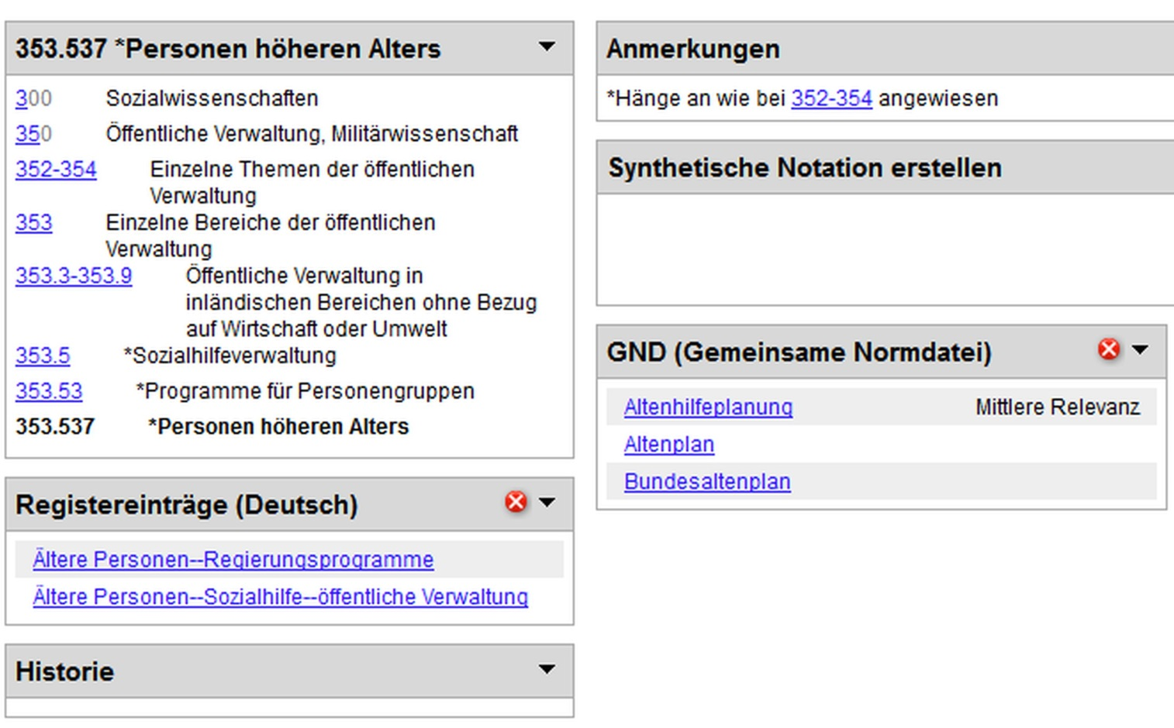
Specificity
24
Structural hierarchy
Single social welfare government programs directed to elder persons

Slide 25
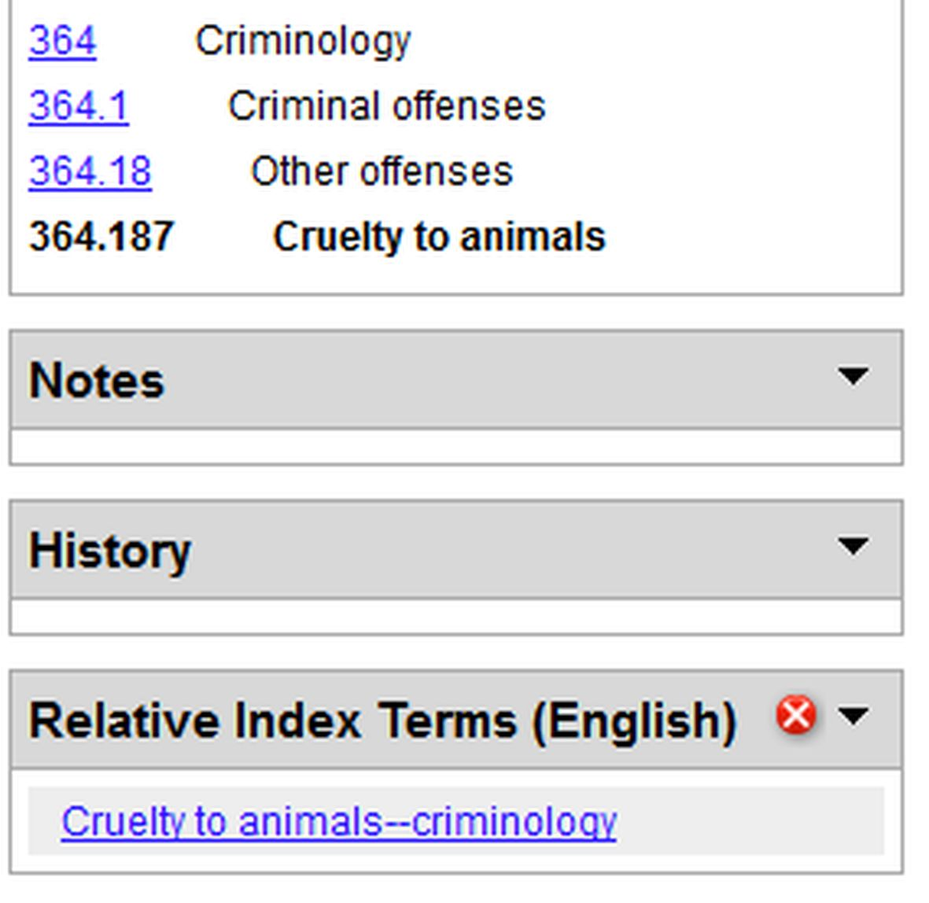
Specificity
25
Structural hierarchy: Hierarchical force: Example:
364 Criminology Definition note: Crime and its alleviation 364.1 Criminal offenses Class-here note: conspiracy to and incitement to commit an offense, individuals identified with a specific offense or type of offense, investigation of specific crimes, crimes without victims | 364.187 Cruelty to animals
Definition note: Crime against animals and its alleviation
Class-here note: conspiracy to and incitement to commit an offense against animals, individuals identified with a specific offense or type of offense against animals, investigation of specific crimes against animals, …

Slide 26
Specificity
26
Structural hierarchy: Hierarchical force: Example:
364 Criminology Definition note: Crime and its alleviation 364.1 Criminal offenses Class-here note: conspiracy to and incitement to commit an offense, individuals identified with a specific offense or type of offense, investigation of specific crimes, crimes without victims | 364.187 Cruelty to animals
Definition note: Crime against animals and its alleviation
Class-here note: conspiracy to and incitement to commit an offense against animals, individuals identified with a specific offense or type of offense against animals, investigation of specific crimes against animals, …

Slide 27
Specificity
27
Context dependency
A topic can occur in more than one discipline – in the DDC, that is in all disciplines in which the topic has literary warrant
Fast Food 641.555 $d2 | One-to-many mapping | 641.555 Timesaving cooking
306.4613 $d2
642.1 $d2
306.4613 *Personal health
642.1 Meals for home, family, individuals

Slide 28
Further things to talk about (early!) in the mapping project
28
Mapping of Tables – Yes or no?
Updating (hence versioning) of mappings according to DDC changes – Yes or no? And if Yes, how?

Slide 29
Mille grazie, ragazzi e ragazze !
29
References:
https://www.oclc.org/content/dam/oclc/dewey/resources/teachingsite/courses/Technical_Introduction.pdf
http://www.oclc.org/support/documentation/glossary/dewey.en.html
Green, R.; Panzer, M.: The Ontological Character of Classes in the Dewey Decimal Classification. In: Paradigms and conceptual systems in KO: proc. Eleventh int. ISKO conference, Rome, 23-26 February 2010.
CrissCross project page: http://ixtrieve.fh-koeln.de/crisscross/index_en.html
Gödert, W., Hubrich, J., Nagelschmidt, M.: Semantic Knowledge Representation for Information Retrieval. De Gruyter Saur, 2014.
Illustrations on slides 9 and 10: Gödert, Winfried: Semantische Wissensrepräsentation und Interoperabilität. In: Information Wissenschaft & Praxis 61 (2010) 1, S. 5-28
WebDewey US: http://dewey.org/webdewey/login/login.html
WebDewey Deutsch: http://deweyde.pansoft.de/

Slide 30
Things to consider when you want to share your mapping with someone else
30
What do they want to do with the information?
What data formats can they consume?
What can you say about your data (ontological commitment)?

Slide 31
What we want to share is knowledge, but the best we can do is to share data
31
Knowledge
Knowledge
Information
Information
Data
Data
Sender
Receiver

Slide 32
With Linked Library Data, Library Information is increasingly used outside of libraries
32
Library data
Some
data
Photo by KIUI Staff (CC BY): http://www.flickr.com/photos/
kiui/3693823005/
Other
data

Slide 33
Until now, library information was mainly transported using MARC (pick your dialect…)
33
[...]
024 7# $a http://d-nb.info/gnd/4129921-8 $2 uri
083 04 $a 720.94309042 $9 d:3 $9 t:2010-03-10 §2 22/ger
150 ## $a Neues Bauen
450 ## $a Bauhaus-Stil $x Architektur
[...]
750 #7 $a Architecture, Modern -- 20th century $0 (DLC)sh 85006834 $0 (uri)http://lccn.loc.gov/sh85006834 $2 lcsh
750 #7 $aArchitecture -- 1900-1945 $0 (FrPBN)FRBNF11943944X $0 (uri)http://data.bnf.fr/11943944 $2 ram
083: Single Dewey classification number or a number span associated with a 1XX heading in an established heading record or a subdivision record.
http://www.loc.gov/marc/authority/ad083.html

Slide 34
Representation of KOS was an early use of RDF technologies
34
“Baustil”@de
“Architektur”@de
skos:prefLabel
gnd:4134057-7
gnd:4002851-3
skos:broader
“Architecture, Modern – 20th century”@en
gnd:4129921-8
“Neues Bauen”@de
“Bauhaus-Stil / Architektur”@de
lcsh:sh85006834
“Architecture – 1900-1945”@fr
“Funktionalismus <Architektur>”@de
skos:closeMatch
skos:relatedTerm
ram:11943944
gnd:4018924-7

Slide 35
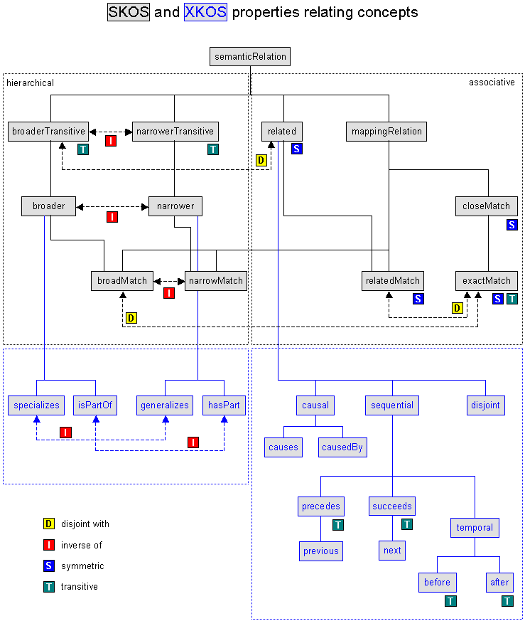
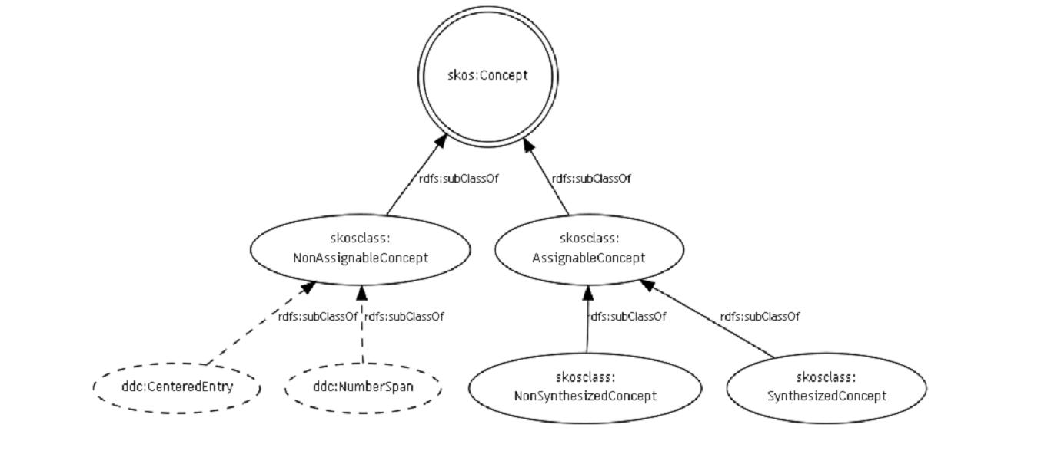
One issue with SKOS: It‘s heavily geared towards thesauri (extension proposals exist)
35
Panzer & Zeng (2009)

Slide 36
Another issue with SKOS: The mapping properties are always bidirectional
36
skos:relatedMatch, skos:closeMatch and skos:exactMatch are each instances of owl:SymmetricProperty.
skos:exactMatch is an instance of owl:TransitiveProperty.
A corollary this is that we at the DNB cannot use those to publish the CrissCross mappings
http://www.w3.org/TR/skos-reference/#L4186

Slide 37
One proposal has been to build complex subjects and map those with SKOS properties
37
327.2 (Diplomacy)
det 3
Diplomatie
341.33 (†Gesandtschaftsrecht )
det 2
Diplomatie
skos:closeMatch
327.2 (Diplomacy)
320 (Politik)
Diplomatie
skos:broadMatch
341.33 (†Gesandtschaftsrecht )
340 (Recht)

Slide 38
Another way is to create specialized relationships instead (e. g. in the GND Ontology)
38
gndo:determinacy3
327.2 (Diplomacy)
Diplomatie
341.33 (†Gesandtschaftsrecht )
gndo:determinacy2
Disadvantage: Requires special business logic to interpret the data correctly…

Slide 39
There has been very little research on how those relations work in real-life settings…
39
“Landhaus <Villa>”
“Villa”
skos:altLabel
skos:prefLabel
http://d-nb.info/040635325
skos:broadMatch
Katholische Kirche: + 32%
Alkaloide: + 629%
Herpesviren: -31%
Abbildung: + 78%
http://dewey.info/728.8
dc:subject
http://d-nb.info/984538100
“Saalbauten auf Pfalzen
und Burgen im Reich
der Staufer”
dc:title

Slide 40
So what is there for us to do?
40
Possible areas:
Develop SKOS extensions for library classifications
Improve possibilities to transport mappings in MARC
Develop SKOS extensions for unidirectional mappings
Figure out if this really works as we think it does…

