Slide 1
Features for the Future: What Might the Dewey Ecosystem Look Like in Ten Years?
1
Lars G. Svensson

Slide 2
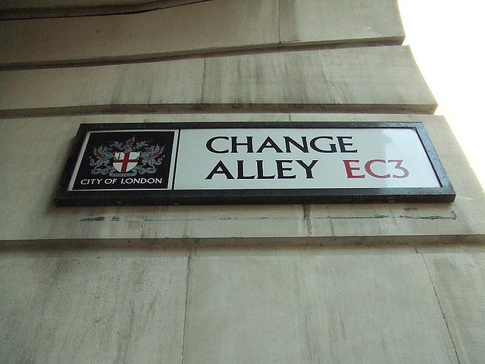
In the last ten years, we have witnessed some large changes in the Dewey world
2
Photo by Matt From London (CC BY): http://www.flickr.com/photos/londonmatt/3163571645/

Slide 3
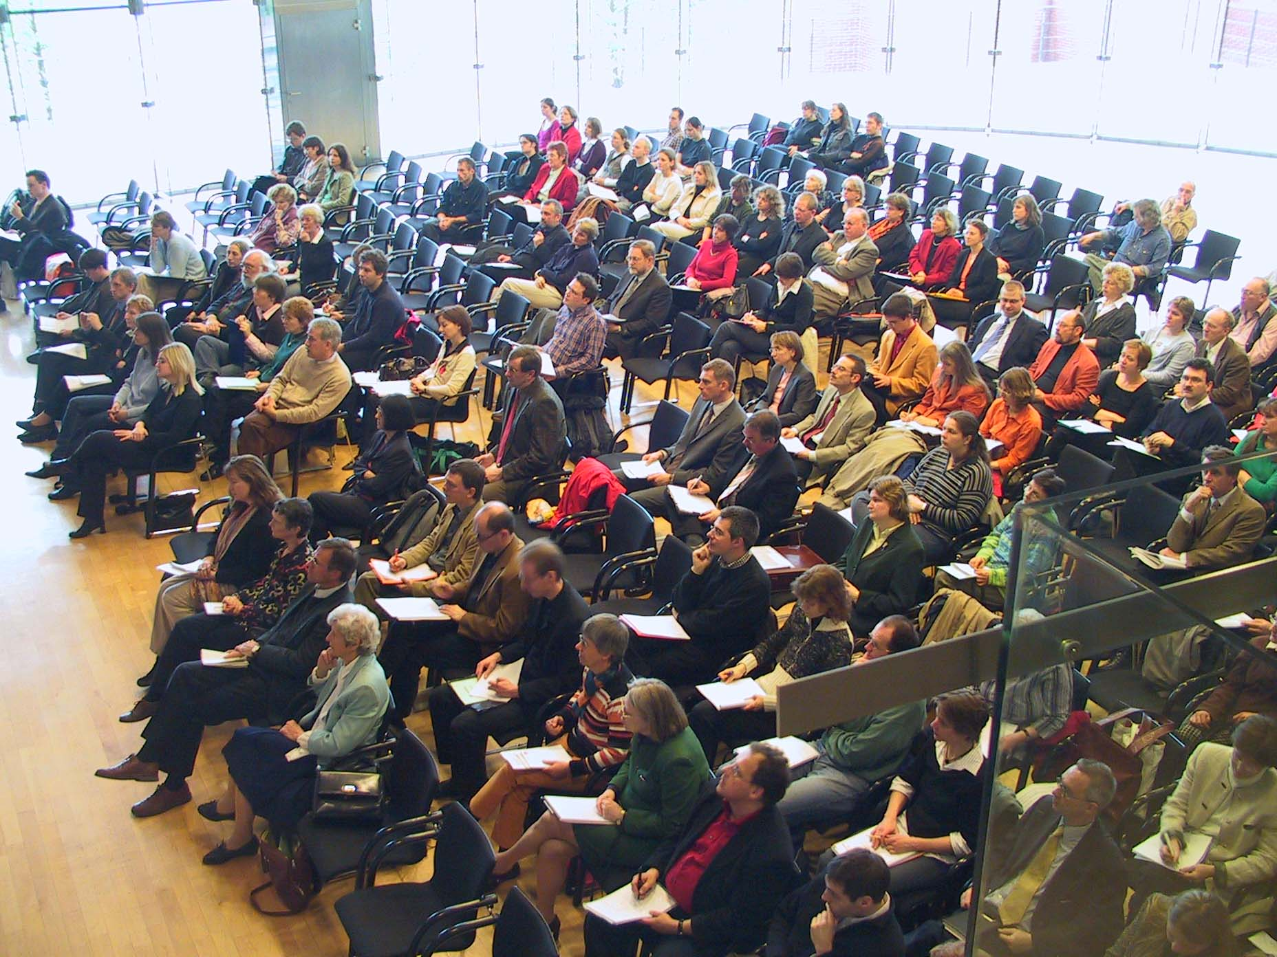
The EDUG community has been a large driver behind some of those changes
3

Slide 4
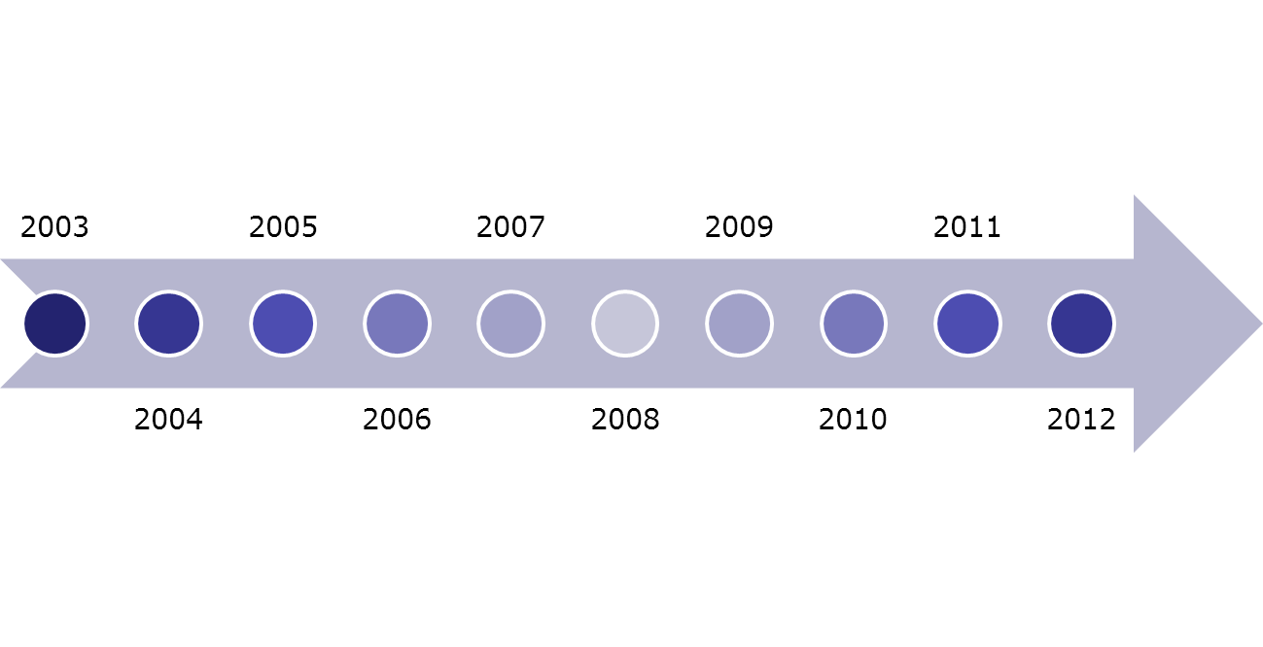
In the previous talks we have heard much about the past …
4

Slide 5
… but we still do not know what will come
5
http://www.gedankenkonsum.de/wp-content/uploads/2011/03/the-future.jpg

Slide 6
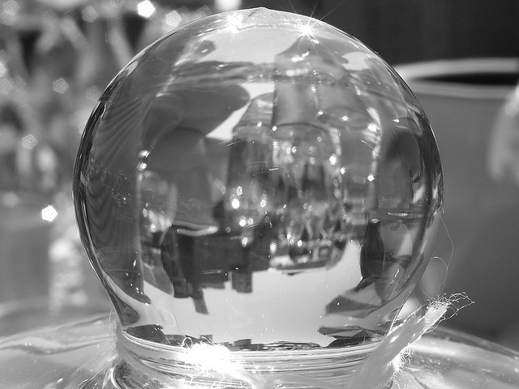
So I had a brief session with my crystal ball and in ten years:
6
Photo by Jason Langheine (CC BY-SA): http://www.flickr.com/photos/yorkjason/612634561/

Slide 7
1. Dewey will have changed some internals
7
Photo by Kake Pugh (CC BY-NC-SA): http://www.flickr.com/photos/kake_pugh/738613004/

Slide 8
Dewey is available under an open license
8
CC BY-NC-ND

Slide 9
There is explicit versioning of DDC classes in place (and we use it for non-editorial purposes)
9
$ curl -H "Accept: application/rdf+xml" http://dewey.info/class/332.45/e23/about

Slide 10
The DDC is a fully faceted classification (and we use those facets!)
10
639.5
(Crustacean fisheries)
595.388
(Natantia (Shrimps))
T2--483
(Sørlandet and Vestlandet)
639.5809483
(Fishing for shellfish in south-west Norway)

Slide 11
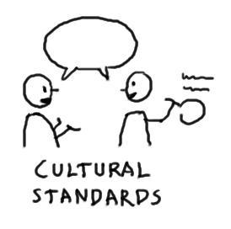
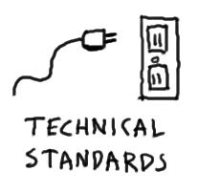
2. DDC is (even) more interoperable
11
Drawings by dgra_xplane (CC BY-ND): http://www.flickr.com/photos/davegray/5630708321/
and http://www.flickr.com/photos/davegray/5630708309/

Slide 12
We have mappings between DDC and other KOS
12
GND
RVK
LCSH
SAB
Dewey
CC
Lots of KOS
I don‘t know
SÄO
RAMEAU

Slide 13
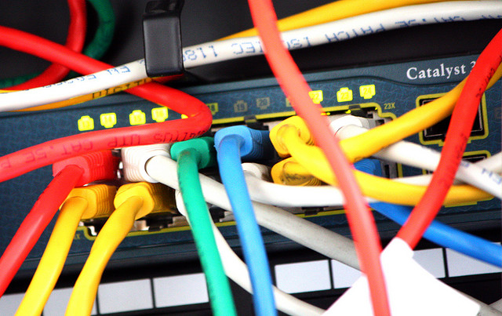
There is an infrastructure in place to distribute those mappings
13
Photo by KIUI Staff (CC BY): http://www.flickr.com/photos/kiui/3693823005/

Slide 14
We have verified that the crosswalks actually make retrieval better…
14
“Landhaus <Villa>”
“Villa”
skos:altLabel
skos:prefLabel
http://d-nb.info/040635325
skos:broadMatch
“Large and elaborate
private dwellings”
http://dewey.info/728.8
skos:prefLabel
dc:subject
http://d-nb.info/984538100
“Saalbauten auf Pfalzen
und Burgen im Reich
der Staufer”
dc:title
Notes:
Suchwort DissOnline Semantisch Differenz davon brauchbar
Abbildung 32 100 +68 +25
Katholische Kirche 23 32 +9 +8
Herpesviren 8 6 -2 -6
Alkaloide 37 274 +237 +233
Berater 3 61 +78 +13

Slide 15
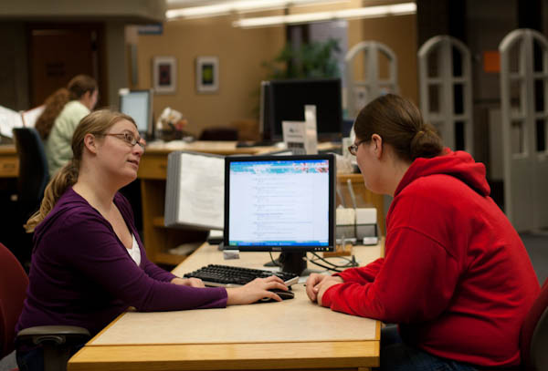
3. The integration of DDC into user interfaces is mainstream
15
… and then you just apply the filter here and you‘ve found everything on Swedish reindeer.
Wow!

Slide 16
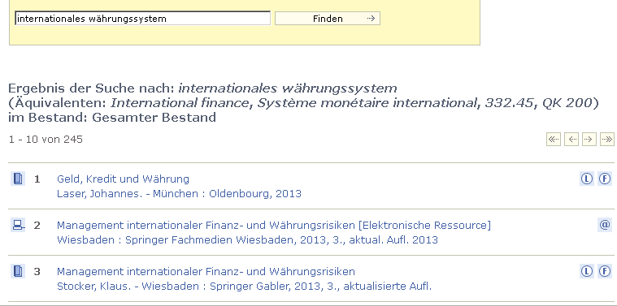
For end users we have a seamless inte-gration into catalogues and library portals
16

Slide 17
Cataloguers’ interfaces evaluate third party information and suggest further access points
17

Slide 18
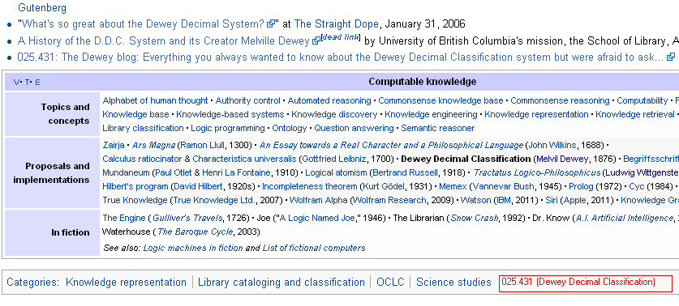
Major websites use Dewey as one way to organize their content
18
http://en.wikipedia.org/wiki/Dewey_Decimal_Classification

Slide 19
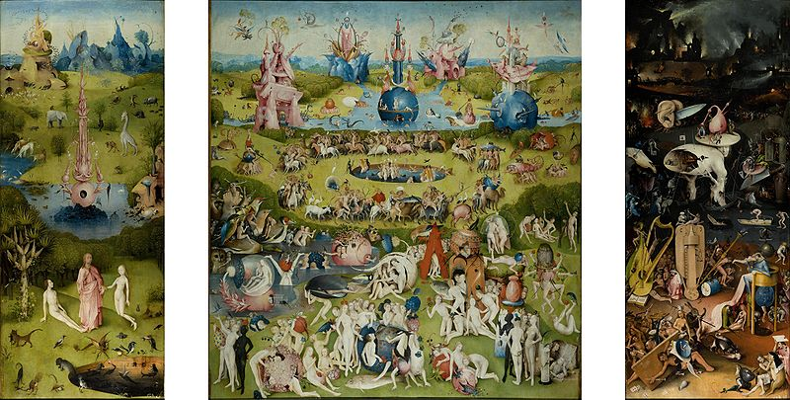
So is this the future or just a dream?
19
Photo in Public Domain: http://en.wikipedia.org/wiki/File:Jheronimus_Bosch_023.jpg

Slide 20
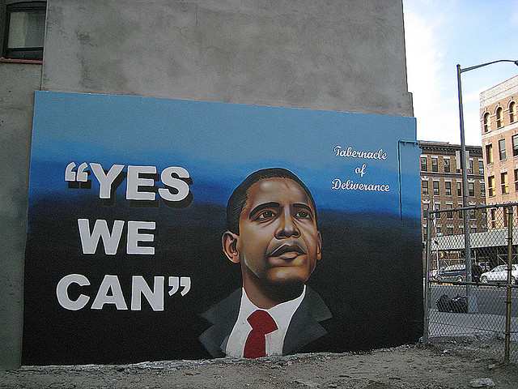
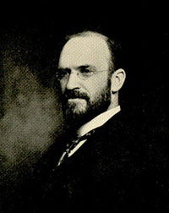
Well, it depends on us! And if we believe it can be true, it will.
20
Photo by H.L.I.T. (CC BY): http://www.flickr.com/photos/29311691@N05/3285706027/
Photo in Public Domain: http://en.wikipedia.org/wiki/File:Melvil_Dewey.jpg

