Slide 1
Who needs Dewey?
A Norwegian perspective

Slide 2
My talk

Slide 3
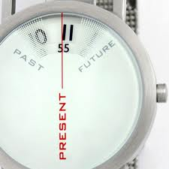
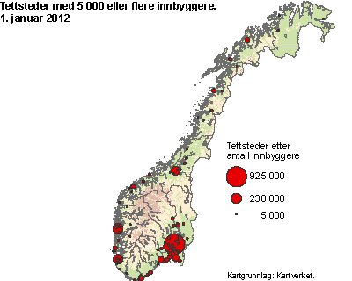
Norway: 5 million people scattered around …
19 counties
428 municipalities, ranging from 201 inhabitants (Utsira) to ca. 600 000 inhabitants (Oslo). (2012)
Public Library Act: Each municipality shall have a public library, which is administered by the municipality alone or in cooperation with other municipalities

Slide 4
Is small beautiful?
Public libraries:
Report to the Storting 23 (2008-2009):
108 public libraries have less staff than one man-year
56 % of the public libraries have less than two man-years
124 municipalities (29 %) have no professionally
qualified head librarian
This shows that there is need to have an efficient bibliographic system which allows for the reuse of (classification) data
Main provider to public and school libraries: Norwegian Library Bureau. DDK5 (latest Norwegian DDC translation used).Subject headings and classifiaction numbers mapped:
*650 1$aBoliger$0husholdning$1643.1$2BS$9nob

Slide 5
Academic and special libraries
Library units in all: 314 (Statistics Norway, 2011)
1 national library
146 academic libraries (universities and university colleges)
36 libraries in health institutions
109 public special/research libraries
22 private special/research libraries
112 libraries in research institutions and higher educational institutions + their subunits participate in the BIBSYS shared cataloguing system. No unified classification and subject data policy

Slide 6
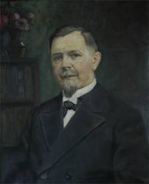
Haakon Nyhuus «imported» Dewey
Newberry Library, Chicago Public Libray
Head of Oslo Public Library in 1897
Library reformer of the century!
Introduced Dewey in the library 1898
Mildly sceptical to Dewey: «… the old carriage with its ten wheels, some of which are a little loose and shaky from wear and tear…»

Slide 7
Arne Arnesen – disseminated Dewey
Head of cataloguing, later head of the library
Published articles/books about cataloguing and classification
Published cataloguing rules and DDC schedules in Norwegian
Initiated courses in librarianship

Slide 8
All editions up to 1983 named after Arnesen
Bøkenes opstilling og nummerering, 1914
(1. ed.)
Klassifikasjon etter Melvil Deweys system, 1920 (2. ed.)
Klassifikasjon etter Melvil Deweys system, 1969 (3. ed.)

Slide 9
Historically: Dewey = public libraries
The national bibliography (University of Oslo Library) started using Dewey in 1956
Academic/special libraries:
«Home grown systems»
UDC
Dewey
No official coordination between the two sectors, Dewey remained «public library property»
1977: National Office for Research Documentation, Academic and Special Libraries (RBT) established the Norwegian General Classification Committee, DDC Section

Slide 10
1970s – Turning point
Surveys/seminars/workshops on the use of classification and indexing systems in Norway
Thorough investigations into general classification systems: Library of Congress Classification, Bibliographic Classification (Bliss), UDC and DDC.
National classification policy published (1977):
Norwegian academic and special libraries are advised to use either UDC or DDC. DDC is recommended for smaller libraries and libraries with a «general» collection profile. UDC is recommended for larger collections where its greater level of specificity is needed

Slide 11
National classification policy (1977)
The long term aim was a national thesaurus which covers all subjects. The database should point from the subject terms to DDC/UDC. The need for Norwegian terms is emphasized since the results will be communicated to «students, pupils and the general public»
Since Norway is a small country we have to refrain from translating the international classification systems in full

Slide 12
National classification policy (1977)
Abbreviated, national editions is an option, but have proved hard to update
Translate terms as an «input vocabulary» to the international classification systems
Centralize classification, reuse data from bibliographic centres (national or international)
Show libraries where they can shorten the number
(DDC: 331´886)

Slide 13
Results …
The use of «home made systems» reduced
Move from UDC to DDC (ca. 60 UDC users remain)
Before developing DDK4 (published 1983) one of the options for updating Dewey in Norway was to translate the relative index of the full edition only
DDK4 a (more or less) «true» subset of DDC which made it easier for libraries to use DDK in combination with full DDC

Slide 14
Intermediary editions (DDK4 and DDK5)
Updating continues to be a problem
Intermediary edition too small for the large or specialized collections, often too detailed for the smallest libraries (and therefore also difficult to use)
Too small: many editions of Dewey still in use, little harmonization of vocabularies
Too detailed:
Example (book on dog massage):
DDK5: 636.7089582
No suggestion as to where to shorten the number

Slide 15
When replacing DDK5
Surveys/seminar/workshops on the use of classification and indexing
Little reuse of DDC numbers (partly due to the number of editions in use, partly that classification numbers are adjusted to the collections)
Pilot project on mixed English/Norwegian (an attempt to create one Dewey edition applicable to all types and sizes of libraries + «quick fix»)

Slide 16
Reasons for choosing a full translation of DDC:
One size fits all
The need for Norwegian vocabulary throughout the system to form subject headings
End user tools need to be in Norwegian
Updating of mixed edition time consuming and costly
The university libraries prefer a full translation
One source
Easier to reuse classification
Improve consistency in OPACs
Facilitate federated searches

Slide 17
Cultural diversity … BIBSYS
Title: | At home : a short history of private life / Bill Bryson
 | DDC= all editions
Keyword | privatliv | boliger | historie | sosial | utvikling
Local subject heading | privatliv | rom boliger | Boliger | Privatliv | Rom Arkitektur | Hjemmet | Hjeminnredning | Husholdning | Innbo | Møbler | Inventar | Gjenstander | Hygiene | Dagligliv
HUMORD: | Boligforhold | Historisk framstilling | Kultur | Hjem
TEK subject heading | Rom Arkitektur | Boliger | Boliginnredning
UDC classification | 728:392 | 72:159.937.52(09) | 643(091) | 316.7 | 643 | 728.1 | 72.011 | 930.85
DDC classification | 306.09, 810, 390.094, 392.3, DDC-23 392.3, 392.36, 643, 643.1, Dewey NB: 643.1

Slide 18
Classification issues which need attention
Acceptance for reuse of classification from centralized sources
Convince libraries that Dewey is more than a shelving system!
Experiment with, develop and implement end-user browsing tools
Support the mapping of vocabularies to WebDewey
Many libraries find DDK5 too detailed, show where to abbreviate
Affordable licence

Slide 19
Hanna Lund, University of Oslo Library, 1943
«Life is too short to allow the neglect of classification»

