Slide 1
DDC Updates & Notification functionality in WebDewey
1
Tina Mengel

Slide 2
Outline
2
Dewey updates now and then (Theory first)
DDC Updates & Notification – Brief introduction to main features

Slide 3
Back in 2008…
3
MelvilClass (developed by DNB, launch in 2006) used to classify with DDC
No regular updates in MelvilClass since first release in 2006 → Thousands of changes to be translated
Start of “DDC Deutsch Update” : external and descriptive documentation of changes
Notes:
I would like to make a short step back in history, because at least from the German National Library’s point of view, DDC updating already has a story to tell.
In 2006, the German National Library had introduced MelvilClass, the customized application for the electronic version of the then freshly translated DDC 22, which soon became the central working tool for classifying with the DDC.
Due to several reasons, the workup of the continuously increasing amount of regular changes that was coming in from OCLC could not be taken up until November 2008 – and that was three years after the appearance of the German DDC 22 – resulting in thousands of changes waiting to be translated and published to the German edition.
In 2008, the DNB and the Cologne University of Applied Sciences could manage a part-time employment for me to start working up the long queue of DDC updates. So, I split my work time for the CrissCross project and started off translating in the translation software – an application I knew quite well from the time I worked on the initial translation of DDC 22.
Let’s go on to see why “external” and “descriptive” is bold-faced here.

Slide 4
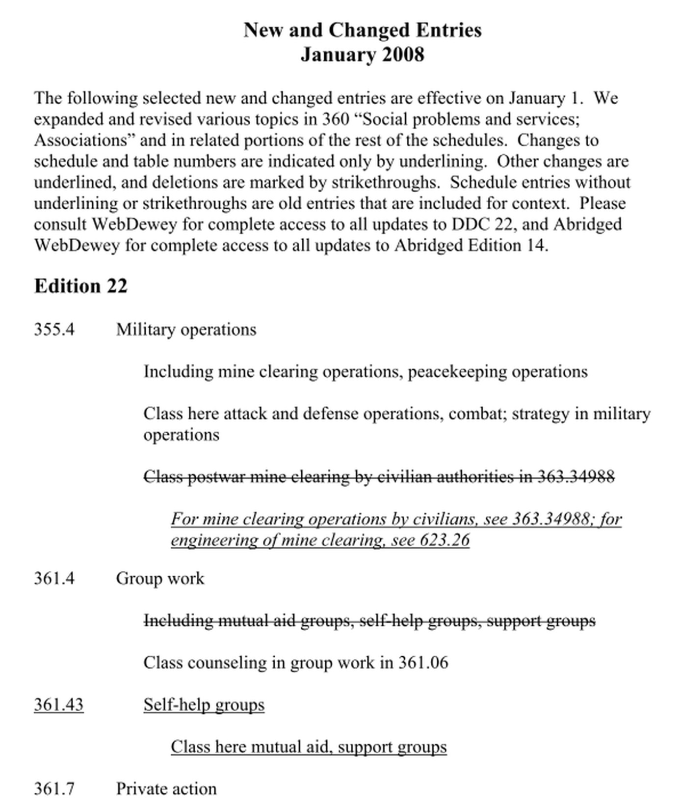
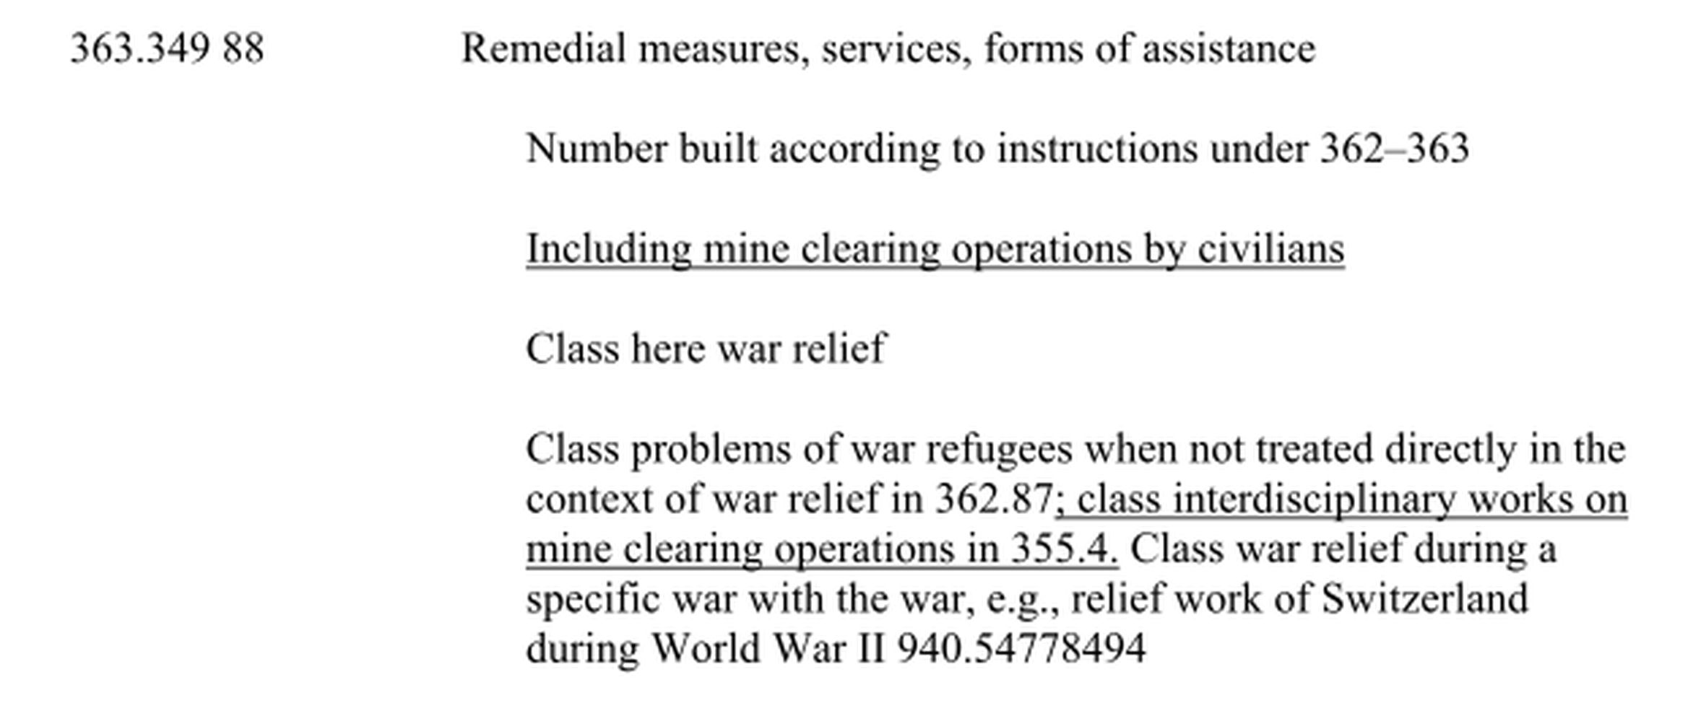
Back in 2008…
4
Notes:
On this slide, you see the first workflow for DDC Deutsch Update, which was created by my own resources and was meant to be an interim solution for the time the decision-making went on regarding the further development of MelvilClass.
What we actually wanted was a solution that was included in MelvilClass, with the updates information coming in directly from the translation software. What I mean is, you could already upload classes from the translation software to MelvilClass, but there was no hint at all in MelvilClass to see that there was any change in the DDC content. I know, the interim workflow was (and still is, for some days left) inconvenient and far too time-consuming, but at least it has been serving with regard to the kinds of information we wanted to provide.
In that time, there wasn’t any history information for a class integrated in the electronic versions, neither in OCLC’s WebDewey nor in MelvilClass. The printed edition provided several listings of changes like the table of Relocations and Discontinuations, and some other comparative tables where also the main topics were given that were subject to a bigger change. Besides that, OCLC published on their website on a regular basis hand-made PDFs for relevant changes – which was the most valuable source of information to follow updates resulting form EPC decisions, and in general, for updates that took place in more than one discipline. CLICK. EXPLAIN. CLICK.
Therefore, for me, it seemed only logic to translate updates according to their topical coherency and to publish those updates together - a concept that I gave the name “strings of changes”, and which will be found in the new Update feature under the name “projects” respectively “project numbers”.

Slide 5
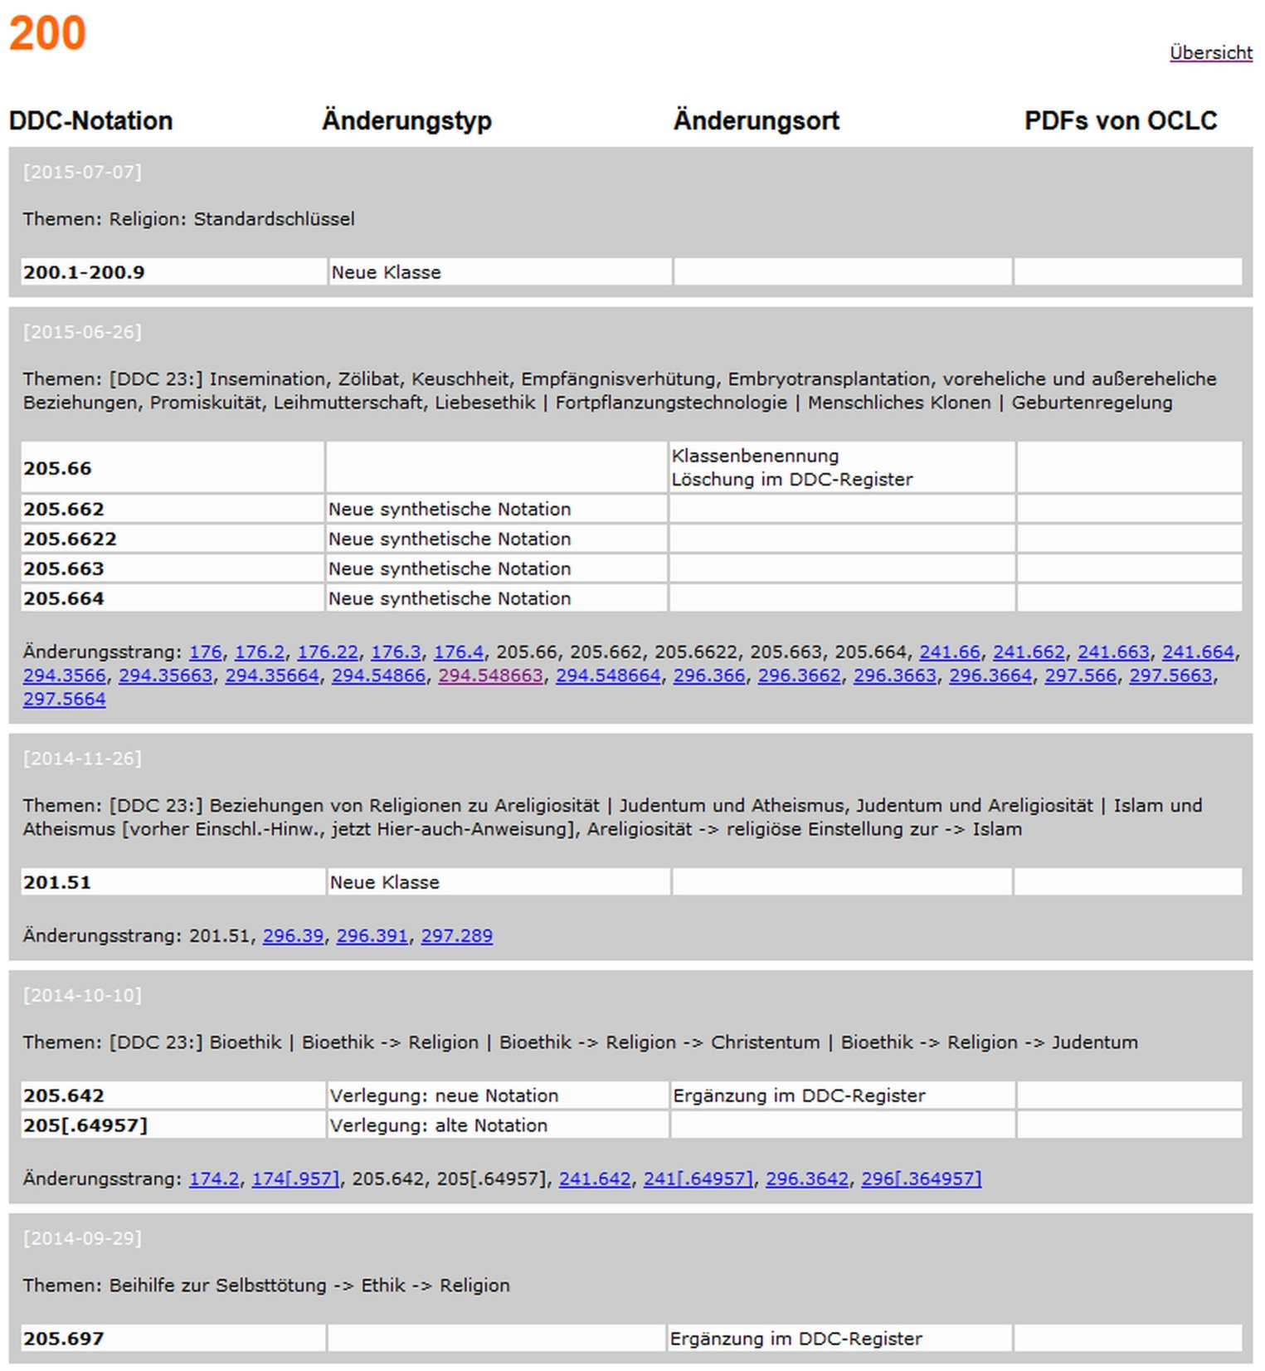
How to guarantee up-to-dateness of mapped terminology?
5
Basic set of documented types of changes essential for the updates tracking when DDC-mapped terminology is involved:
relocations and discontinuations (full and partial)
new and deleted classes
new and deleted built numbers
changes in the Relative Index (new, deleted, changes from one class to another, changes in meaning)
changes in the class heading (if changes in meaning)
changes in class-here notes and in including notes, new and deleted class-here and including notes
changes in number building instructions
changes in class-elsewhere notes (if a certain context that has been in the class before is now to be found elsewhere)
Notes:
And also for another reason it became clear, that we would even need more history information beyond what was given by OCLC’s New and changed entries documentation.
What happens to a GND-DDC mapping if the number used for a mapping has been deleted in WebDewey? What happens to a mapping if a Relative Index term moves from one class to another? When we do a mapping that is bound to the scope of meaning of a topic based on DDC criteria like “approximate the whole” and “including” – Does it have any impact on the mapping, if a topic moves from a Class-here note to an Including note?
Well, we soon found out: IT DOES!
CLICK. This being told, you may understand why I decided in favor of the inconvenient way of documenting the translated updates for the German DDC users; I wanted to provide them with the same detailed information on “WHAT has happened WHEN and WHERE in a class and how updates were connected to each other”… This is a cutout of my update documentation website. Here you can see why it is descriptive: As history information for a class was not inside MelvilClass, later WebDewey Deutsch, I had to describe everything, so that the information could be used accompanied with the view in the classification tool to enable the user to follow the updates. Since I am translating and publishing the updates in the form of topically coherent projects, the documented entries are presented as a group of changes that belong together. This group contains a date info, some keywords to name the topic or topics of the update, the Dewey numbers, the main types of changes, like relocations or new classes, and further types of changes when the update there might have an effect on the classification or the mapping process.

Slide 6
Back in 2011 (EDUG, Stockholm)
6
Trend towards sharing the same applications for Dewey
MARC 21: international standard for DDC data
→ paved the way for “realistic” discussions:
- making use of field 685
- develop a common DDC update process
Notes:
Retrospectively, the EDUG meeting in Stockholm in 2011 marked a changing point – or should I say, it had kind of a booster effect for the things we are talking about here.
In that time, the idea to share the same applications for Dewey to give emphasis to a vision of an international Dewey family was turning more and more into reality. Joan Mitchell, former DDC editor in chief, was persistently promoting and pushing this vision into the direction we can today call “a standard solution”; I think we all agree that is a great achievement for the international Dewey community.
The Dewey family has, so to say become a WebDewey family as well – A trend that opened up new and realistic discussions on many DDC issues. Among them were those issues like:
What about other DDC-translating countries – Won’t they be in the same update situation when they have completed their first translation of DDC full edition? How will they process and publish their updates? Wouldn’t it be the best solution to find a common way for the updating process? What about the updating of DDC-mappings? Now, that the DDC data was in MARC 21 format, a field 685 saying “history note” popped up – Why not making use of it for history information of a class? And so on.
After Stockholm, a team of OCLC, DNB and Pansoft started developing the Updates and Notification functionality which will finally be going live in the next few weeks.

Slide 7
DDC Updates & Notification – Brief introduction to main features
7
Notification of updates inside WebDewey
Subscription of area(s) of interest to be notified
WebDewey Updates page: Updates display & search
Notes:
On the following slides, I will give you a very short overview of the main features of the Updates & Notification functionality.
More information can be found soon on the EDUG website.

Slide 8
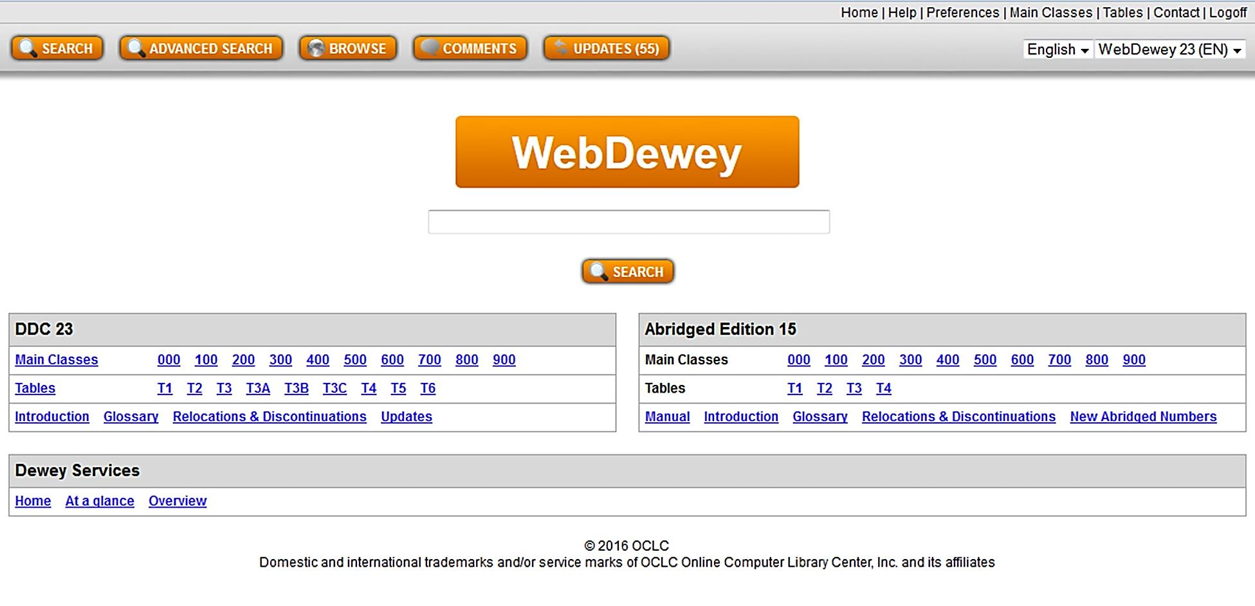
1. Notification of updates inside WebDewey
8
Notes:
From now on, a WebDewey user‘s first sight after the login to WebDewey will certainly be the one at the UPDATES area:
Are there any new Updates for me since my last login?
In the example here we see a number in brackets – that is the number of updates added since your last login – and the number refers to your subscription of areas of interest.

Slide 9
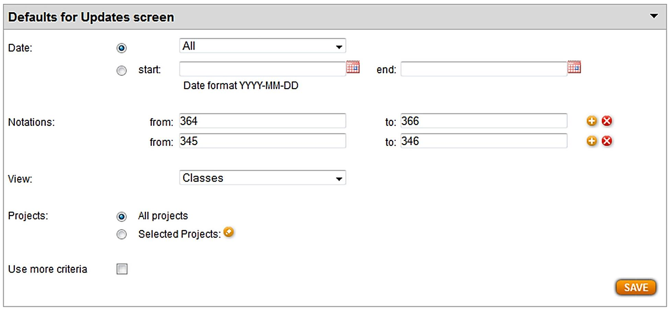
2. Subscription of area(s) of interest to be notified
9
Notes:
WebDewey users know that they can set several defaults for their view of the DDC, for example whether to see segmentation marks or not, or what page to see after the first login.
The preferences page will be extended by another box to set the defaults for the notation areas of interest, plus other selectable search parameters for a combined search query. You can set quite detailed combined queries as default, but I have a feeling that most of the users will start by subscribing for a certain number of notation areas.

Slide 10
3. WebDewey Updates page: Updates display & search
10

Slide 11
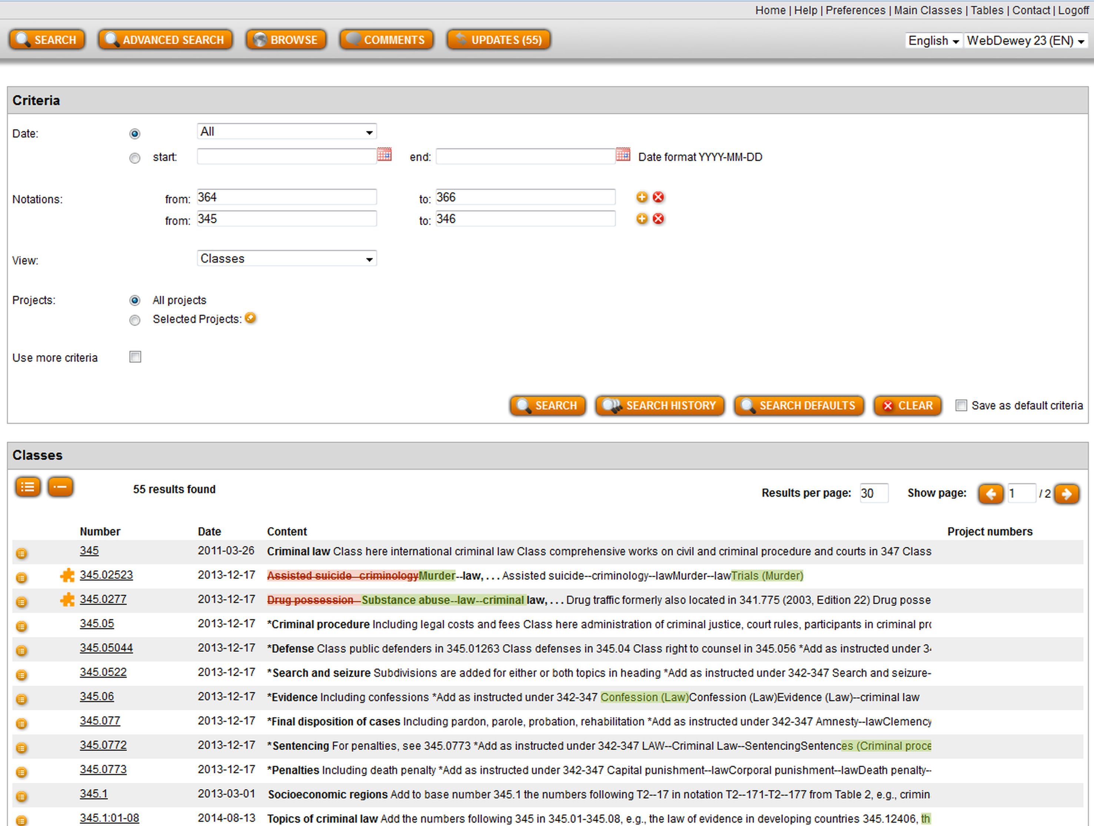
11
Notes:
Let us now go to the Updates page, the heart of the new functionality.
The upper part of the screen is the search area. It looks basically the same than in the Preferences. Peter can show some search queries later, I will now focus on explaining the Results views.
The area beneath can represent the results in two different modes:
The one we see here, is the single-line mode: This is a quick view mode to get an overview of how many results there are, or to check if other numbers are involved in a project, which would be displayed in the Project numbers column.
The single-line display can be turned on and off by clicking on the respective icon.

Slide 12
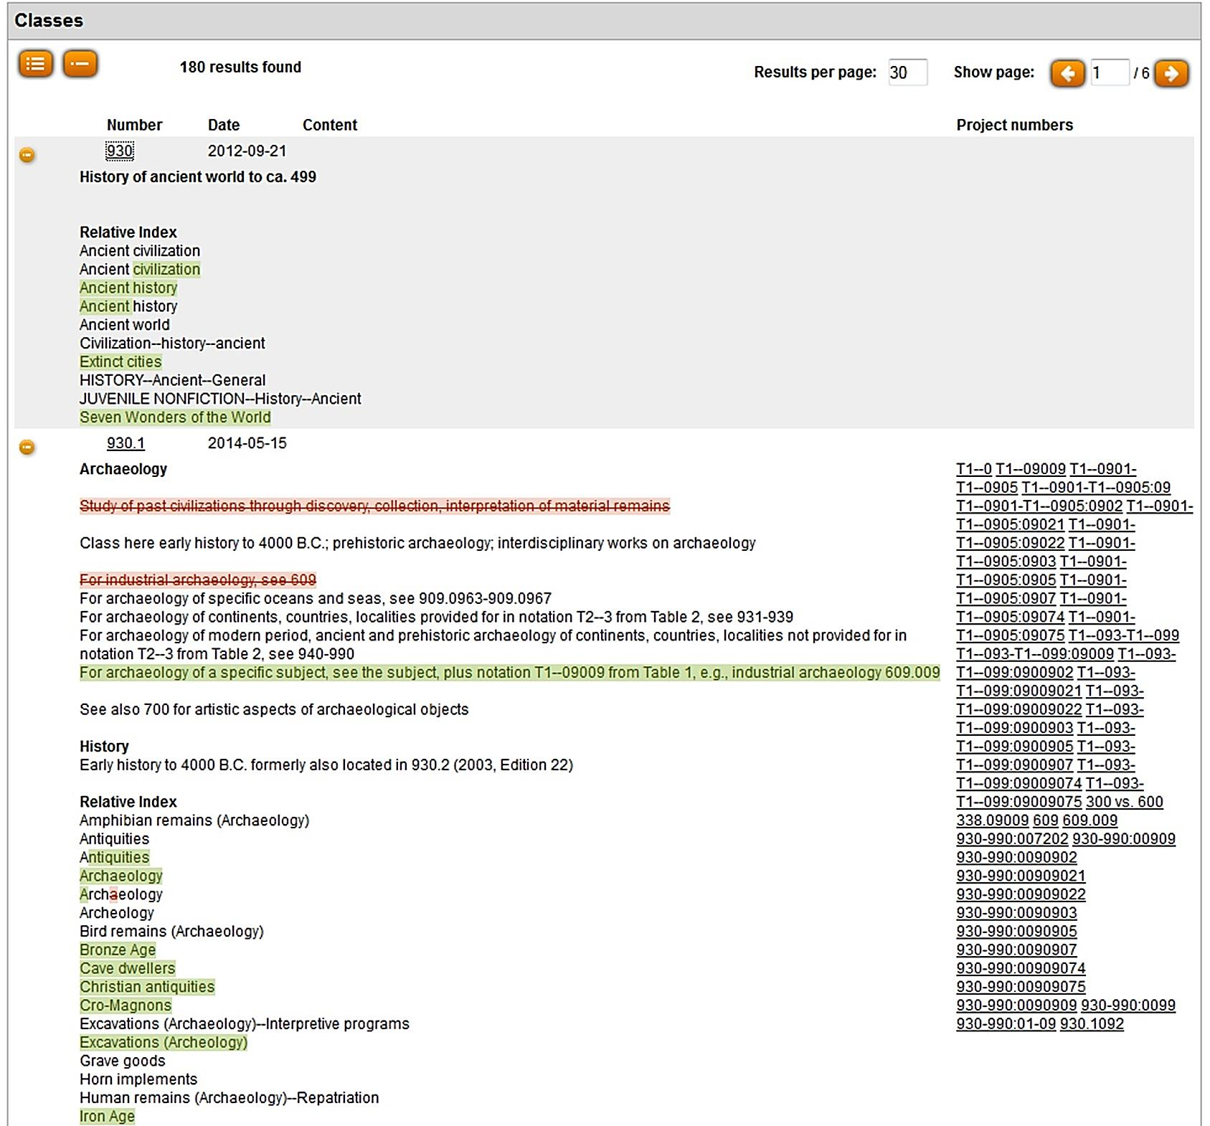
12
Notes:
The other results display mode is the Detailed-view mode.
In this mode, the user is finally able to track changes on every class level - as they appear. What I think is really fantastic is the before/after representation within the class. I don’t think I need to give this info explicitly, because it is quite intuitive, however : GREEN-highlighted means ADDED CONTENT, RED-highlighted and crossed-out means DELETED CONTENT.

Slide 13
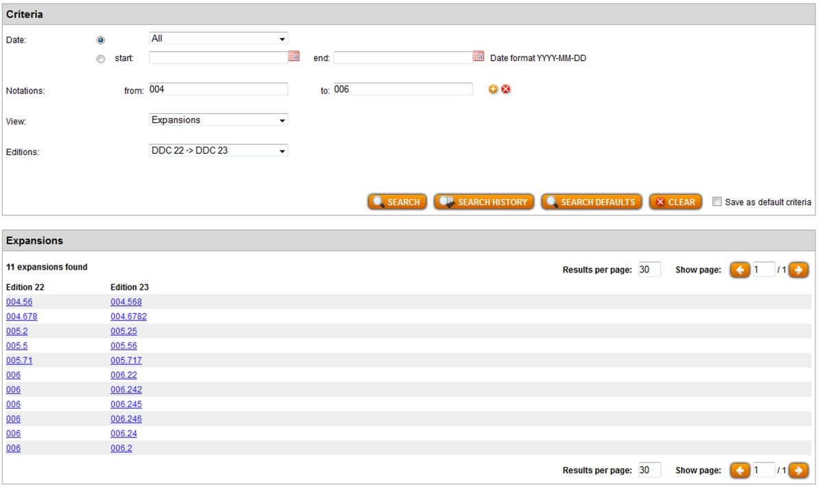
Additional view modes
13
Comparative tables for Relocations, Discontinuations, Expansions → based on printed editions
Notes:
Additional view modes for
Relocations, Discontinuations, Expansions,
based on what we were used to in the printed editions.
I think that is quite self-explaining, too. You select what you want see being compared and select the editions you want to see compared.

Slide 14
Additional view modes : Projects
14
What is a Project?
Groupings of classes that are processed together in the translation software / editorial system and published together in WebDewey. Can be used for:
Updates having an effect on more than one discipline
Very important updates, like changes based on EPC decisions
Formal updates that are irrelevant for the classifier (= silent publish)
Notes:
Soon to come after the implementation of the Updates & Notification functionality, the translation software will be equipped by some new processing modes that enable the translator to create working sets. Working sets will be shown in WebDewey as Projects, and coherent Dewey numbers that were processed as a working set will be shown in the Project Numbers column on the Updates page in WebDewey.
I won’t tell too much of that today, as we are still in the pre-testing phase. But as soon as there is any news to report, information will be found on the EDUG website. I am also going to publish some help documents for both functionalities there.
So, stay tuned for updates on the DDC updates on the EDUG website!
http://edug.pansoft.de/tiki-index.php

