Slide 1
28 June 2017
Searching by Dewey number
Julianne Beall
Consulting Senior Editor, DDC

Slide 2
Overview
Search strategies combining
Subject or keyword terms
Dewey numbers
Truncation symbol to adjust the specificity of the Dewey number
Useful for refining searches
Searches on Dewey number alone may retrieve works in more languages
Searches illustrated using WorldCat.org

Slide 3
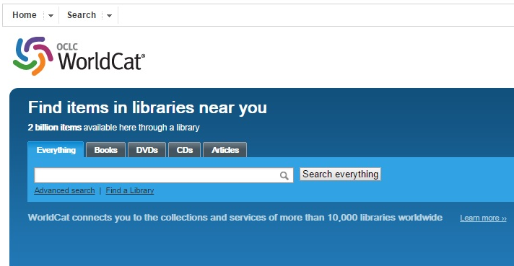
WorldCat.org

Slide 4
Use Advanced search menu?
You may use it if you wish . . .
But the search menu does not include Dewey
You can use the index label “dd:” to override the menu category, and retrieve the correct results

Slide 5
Basic search box with index labels
Search pattern: subject term [su:] DDC [dd:]
Default Boolean connector: AND
Default index: keyword
Use asterisk [*] for truncation
Put the subject term or keyword first; that works best with the “sort by relevance” algorithm of WorldCat.org

Slide 6
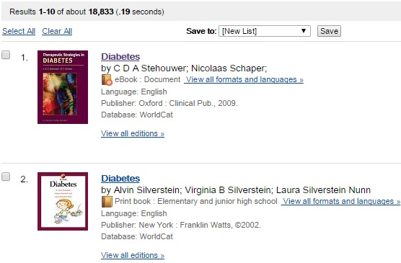
su:diabetes dd:616*

Slide 7
su:diabetes dd:616*
[Results: 18,833] DDC: 616.46206

Slide 8
Scroll down to Linked Data

Slide 9
su:diabetes dd:616.4624*
[Results: 154] DDC: 616.4624

Slide 10
su:diabetes dd:362*
[Results: 1,907] DDC: 362.19646200922

Slide 11
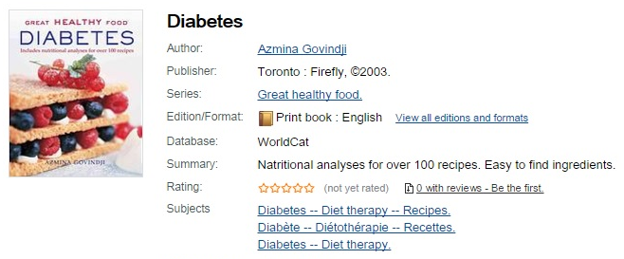
su:diabetes dd:641*
[Results: 1,733] DDC: 641.56314

Slide 12
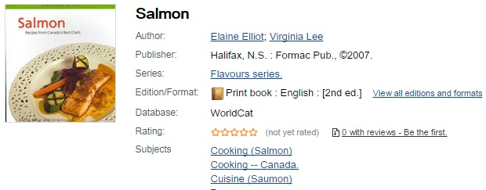
su:salmon dd:641*
[Results: 142] DDC: 641.692

Slide 13
su:salmon dd:597*
[Results: 1,758] DDC: 597.56

Slide 14
Salmon in zoology schedule
597.5 Protacanthopterygii
Class here Salmoniformes
597.55-597.59 Salmoniformes
Class comprehensive works in 597.5
597.5/5 Salmonidae [old number for salmon, before ed. 21]
597.5/6 Salmon
597.5/7 Trout
597.5/9 Esocidae

Slide 15
Various possible searches
su:salmon dd:597.5*
Results: 1,029
su:salmon dd:(597.56* OR 597.55*)
Results: 936
su:salmon dd:597.56*
Results: 245
Note: a few records have more than one DDC number; use of Boolean NOT may exclude desired records

Slide 16
su:salmon dd:799*
[Results: 676] DDC: 799.1756

Slide 17
su:salmon dd:799.1756*
[Results: 70] DDC: 799.1756097112; 799.1755

Slide 18
Salmon in natural resources schedule
333.91 Water and lands adjoining bodies of water
Class here aquatic resources, comprehensive works on the economics of aquatic resources
For a specific aquatic resource, see the resource, e.g., minerals 333.85, fishes 333.956
333.95/6 Fishes
333.95/62-333.95/67 Specific kinds of fishes
Add to base number 333.956 the numbers following 597 in 597.2-597.7, e.g., salmon 333.95656

Slide 19
su:salmon dd:333*
[Results: 1,047] DDC:333.910079 [333.9100979?]

Slide 20
su:salmon dd:333*
[Results: 1047] DDC: 333.956

Slide 21
manga dd:53*
[Results: 81] DDC: 537

Slide 22
Search by Dewey only; refine search by language
dd: 799.1756* [Results: 102]
Language:
English (75)
French (18)
Swedish (4)
German (3)
Norwegian (1)
Northern Sami (1)

Slide 23
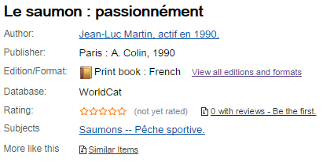
dd:799.1756*
[French] DDC: 799.1756

Slide 24
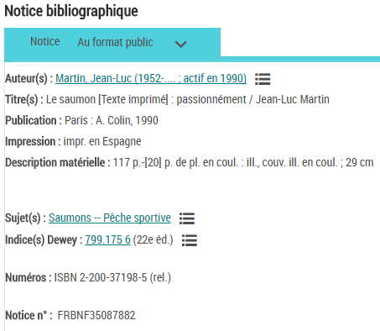
BnF Catalogue Général

Slide 25
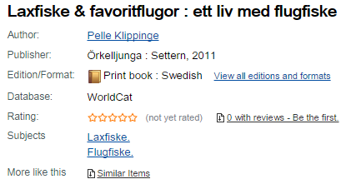
dd:799.1756*
[Swedish] DDC: 799.1756

Slide 26
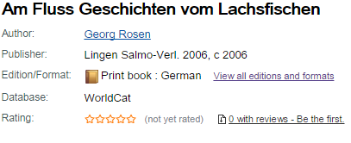
dd:799.1756*
[German] DDC: 799.1756

Slide 27
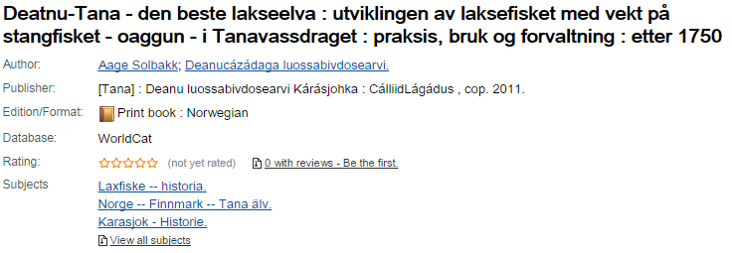
dd:799.1756*
[Norwegian] DDC: 799.1756094846

Slide 28
Sources of help
http://www.oclc.org/support/help/worldcatorg/ApplicationHelp.htm
http://www.oclc.org/support/help/searchingworldcatindexes/Default.htm
Especially useful for index labels, e.g., label for DDC edition: d2:
Example: d2:23

Slide 29
European Dewey Users Group Meeting
Julianne Beall
Consulting Senior Editor, DDC
beallj@oclc.org

