Slide 1
28 June 2017
News from the Dewey Editors
Rebecca Green
Senior Editor, Dewey Decimal Classification
Dewey Editorial Operations Program Manager

Slide 2
Overview
EPC exhibits of greatest interest to EDUG
Enhancements to history notes in WebDewey
Segmentation in WebDewey
What comes after DDC 23?

Slide 3
EPC 140-S93.1
936.3, 936.4, and 936.9
Early history of central
And western Europe to
Roman period

Slide 4
Hallstatt and La Tène periods (1)
The Hallstatt culture: ca. 1200 (late Bronze Age) to ca. 450 B.C. (early Iron Age)
Hallstatt A and B: ca. 1200 to ca. 800 B.C.
Hallstatt C and D: ca. 800 to ca. 450 B.C.
La Tène culture: ca. 450 B.C. to Roman conquest in 1st century B.C.

Slide 5
Hallstatt and La Tène periods (2)
Provisions for Hallstatt and La Tène periods given under:
936.3 Germanic regions to 481
936.4 Celtic regions to 486
936.92 Netherlands to 486
936.93 Belgium to 486
936.935 Luxembourg to 486
936.94 Switzerland to 486

Slide 6
Hallstatt and La Tène periods (3)
936.3 *Germanic regions to 481 and Pannonia
936.3012–.3015 Early history to ca. 800 B.C.
Add to base number 936.301 the numbers following 930.1 in 930.12–930.15, e.g., Bronze Age 936.30156
936.3016 Ca. 800–113 B.C.
936.30163 Ca. 800–ca. 450 B.C.
Class here Hallstatt period, Hallstatt C, Hallstatt D
For Hallstatt A, Hallstatt B, see 936.30156
936.30166 Ca. 450–113 B.C.
Class here La Tène period

Slide 7
Hallstatt and La Tène periods (4)
936 Europe north and west of Italian Peninsula to ca. 499
936.02 Ca. 1000–ca. 200 B.C.
Including La Tène period
Class here Hallstatt period
For Hallstatt period from ca. 1200 to ca. 1000 B.C., see 936.0156; for La Tène period from ca. 200 B.C. to period of Roman conquest, see 936.03

Slide 8
EPC 140-S90.1
Period notation in the 900s

Slide 9
Solution pattern throughout 930–990 (1)
956.91 *Syria
956.910 2 640–1516
956.910 3 Period of Ottoman Empire, 1516–1920
956.910 4 1920–
956.910 41 Period of mandate, 1920–1945
956.910 42 Period of Republic, 1945–

Slide 10
Solution pattern throughout 930–990 (2)
956.912-.914 Localities of Syria
Add to base number 956.91 the numbers following —5691 in notation —56914–56914 from Table 2, e.g., City of Damascus 956.9144; then add further as follows:
001–009 Standard subdivisions
Add to 00 the numbers following 00 in notation 001–009 from table under 930–990, e.g., ethnic and national groups 004
02–04 Historical periods
Add to 0 the numbers following 956.910 in 956.9102–956.9104, e.g., City of Damascus during period of mandate 956.9144041

Slide 11
324.91–324.99 and 330.93–330.99
Before:
Add to base number 324.9 notation 1–9 from Table 2, . . . then to the result add historical period numbers from appropriate subdivisions of 930–990, . . .
After:
Add to base number 324.9 the numbers following 9 in 930–990, . . .

Slide 12
EPC 140-S36.1 and 140-S36.1a
363.4 controversies related
to public morals
and customs

Slide 13
Problems with 363.4
Vague caption
Reflects U.S. bias
Topics treated as controversies usually classified with topics themselves

Slide 14
Discontinuing 363.4
Many topics (e.g., prostitution, homosexuality) already treated elsewhere
Relocations needed for interdisciplinary numbers
363.41 Sale of alcoholic beverages
Liquor traffic → 364.1332 Bootlegging
Drinking age → 364.173 Possession and use of alcoholic beverages
363.45 Drug traffic → 364.13365 Drugs
363.47 Obscenity and pornography → Establishing new number under 306.77 Sexual and related practices

Slide 15
EPC 140-S00.1c
005.1 Programming

Slide 16
Terminological issue
Computer programming
Broad sense, as in 005.1
Narrow sense, as in 005.13 (emphasis on coding)
005.1 vs. 005.3
Current: Programming vs. Programs
Proposed: Software development vs. Software

Slide 17
EPC 140-S79.1
793.932 computer adventure games, 794.8 electronic games

Slide 18
Distinctions between video games numbers
Current split
793.932: Games with set goals and thinking over reflex actions
794.822: Quick reflexes over intellectual decisions
Future split
Some video games specifically adapt other games into an electronic medium (e.g., Monopoly)
Other games originate as video games (e.g., The Legend of Zelda)
Implementation will await work on fantasy sports

Slide 19
EPC 140-S53.1
Low-energy nuclear reactions

Slide 20
Conundrum
LCSH Cold fusion mapped to 539.764 Nuclear fusion (Thermonuclear reaction)
Develop number for LENRs under 539.75 Nuclear activities and interactions
Note in LCSH record for Low-energy nuclear reactions:
Here are entered works on the class of non-fusion-based nuclear reactions that occur at or near room temperature. Works on the hypothesis of nuclear fusion reactions that occur at or near room temperature are entered under Cold fusion.

Slide 21
EPC 140-E1.3
Movement of topics vs. provision or elimination of
numbers

Slide 22
Movement of topics
Relocation: A topic moves from a number to another number that is neither its subordinate nor its superordinate (i.e., the new number is in neither the upward nor the downward [notational] hierarchy of the old number)
Discontinuation: A topic moves from a number to a more general number in the same hierarchy
Continuation: A topic moves from a number to a more specific number in the same hierarchy

Slide 23
Provision or elimination of numbers
Authorization: A number is approved for use (or reuse)
Does not apply to built numbers
Deprecation: Approval for the use of a number is withdrawn

Slide 24
Ramifications
Proposal requires changes in Glossary, Introduction, and Editorial Rules
Unless possible to implement conversion with only reasonable amount of effort, changes will not be applied retroactively

Slide 25
EPC 140-S20.1
Arrangement within 200 Religion: DISCUSSION

Slide 26
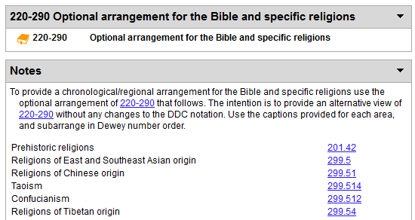
Alternative view of 220–290 (1)

Slide 27
Alternative view of 220–290 (2)
Develop notation to accompany optional alternative arrangement in one-to-one relationship with notation of standard arrangement
Divvy up notational territory
Give instructions to add from standard arrangement notation
Eliminate remaining options for giving preference to a religion other than Christianity, but retain permanently unassigned numbers at 284.12, 285.82, 286.12, 289.2, and 298

Slide 28
Enhancements to
history notes
in WebDewey

Slide 29
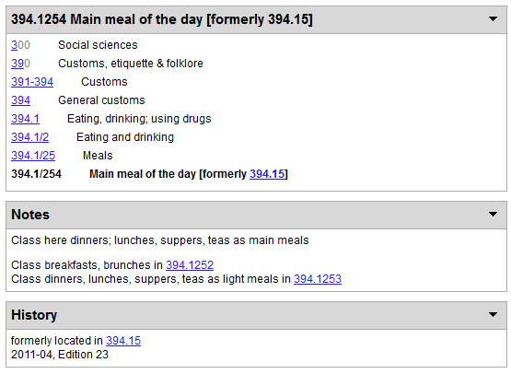
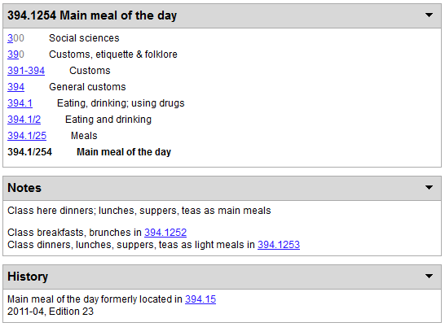
Compare: Main meal of the day

Slide 30
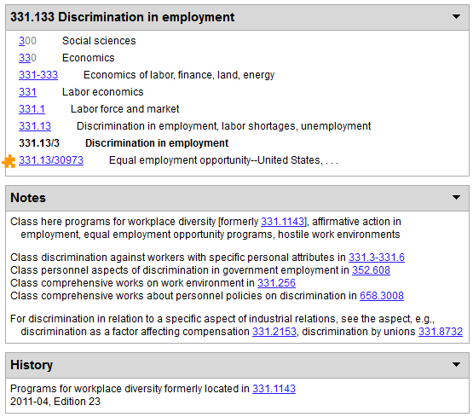
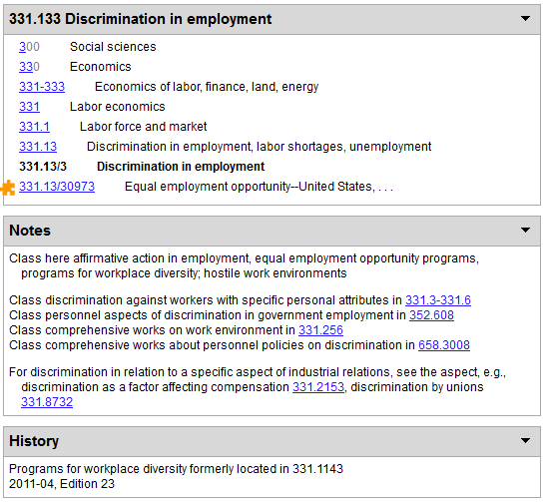
Compare: Discrimination in employment

Slide 31
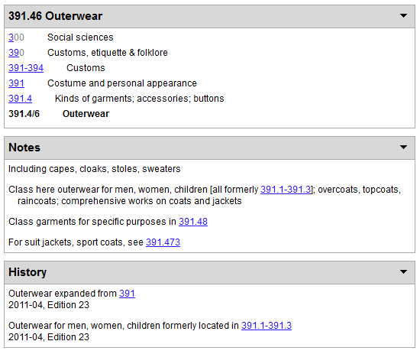
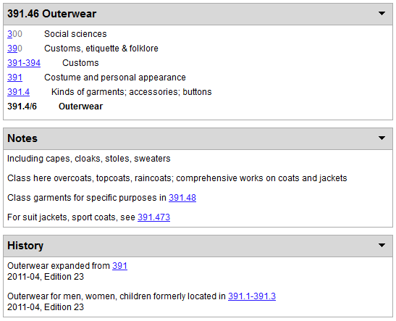
Compare: Outerwear

Slide 32
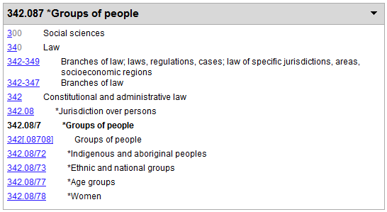
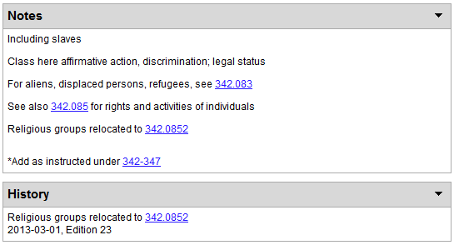
Before: Groups of people (constitutional and administrative law)

Slide 33
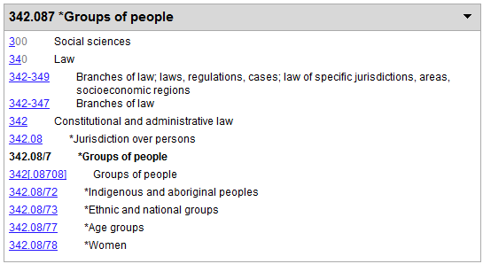
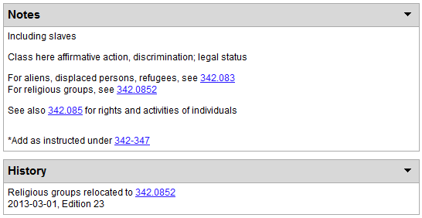
After: Groups of people (constitutional and administrative law)

Slide 34
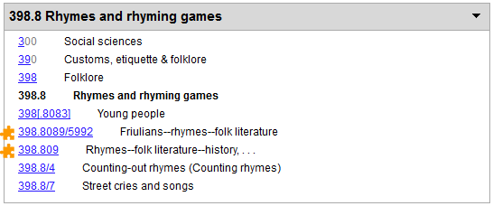
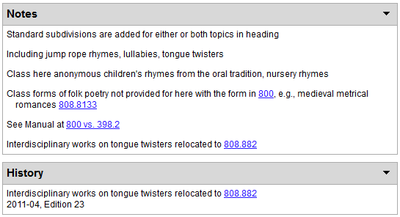
Before: Rhymes and rhyming games

Slide 35
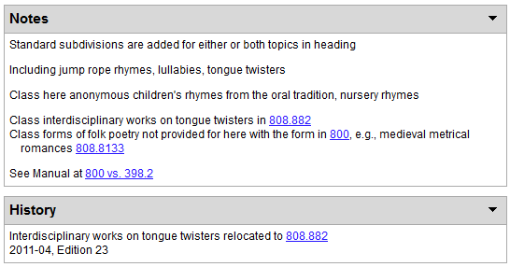
After: Rhymes and rhyming games

Slide 36
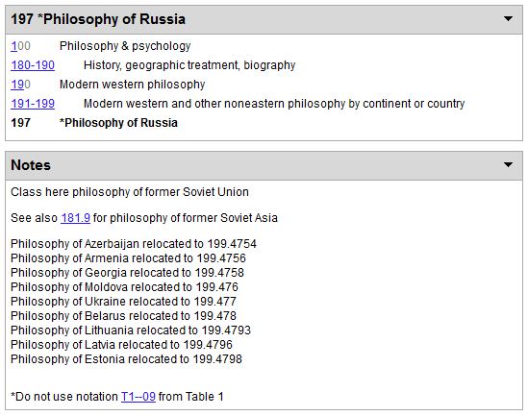
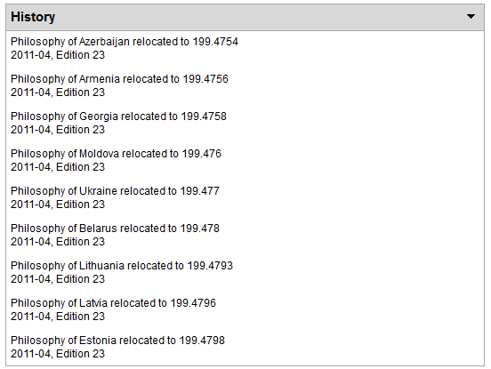
Before: Philosophy of Russia

Slide 37
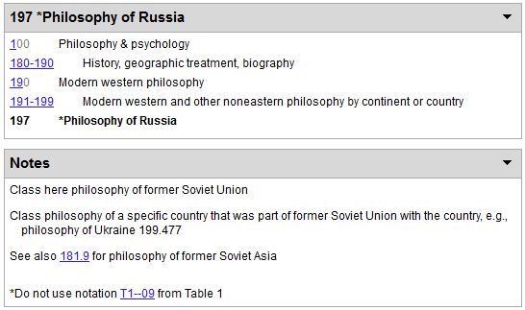
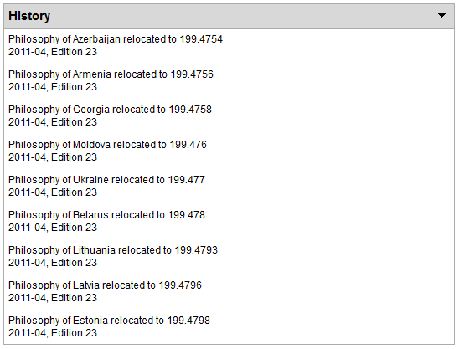
After: Philosophy of Russia

Slide 38
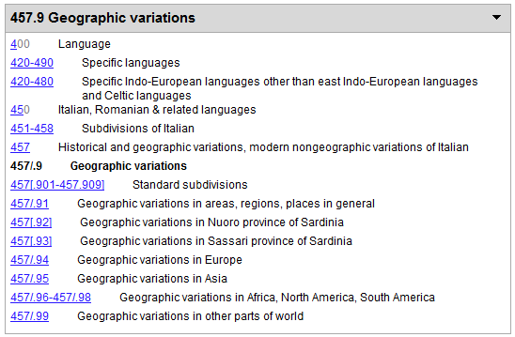
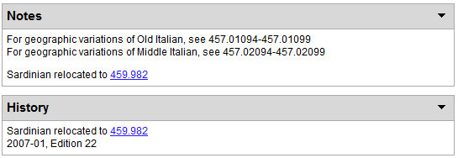
Before: Geographic variations (of Italian)

Slide 39
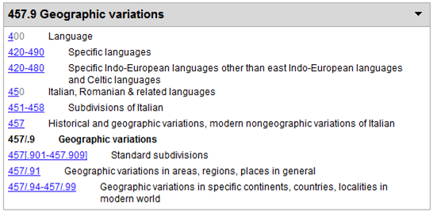
After: Geographic variations (of Italian)

Slide 40
segmentation

Slide 41
What comes after DDC 23?

Slide 42
Editions vs. versions
Caveat: Nothing here is settled; this is just what we’ve been thinking.
No new print editions as we have known them in the past
Edition as snapshot of set of records at a particular time doesn’t make much sense in electronic-only context
Versions for records for individual numbers makes more
Establish DDC 24 as baseline for new approach (?)

