Slide 1
Lost in classification ?
Teaching DDC : from Indexing to Managing Collections

Slide 2
Lost in classification ?
Bibliothèque de l’Heure Joyeuse (“Happy Hour Library”) ( 1924 )
1st public library in open stack: classification of the collections with DDC
Recommendations of the Ministry of the higher education ( 1988 ) :
adopting DDC and simplified Dewey numbers
Creation of the BnF (Decree 1994):
Choosing CDD for the open stack spaces and integrating DDC into the French national bibliography
French context
DDC in the various libraries

Slide 3
Lost in classification ?
Libraries’ automatisation :
Generalization of the OPAC: Making index browse easier, searching by subject headings.
Using normalized language RAMEAU (LAVAL, LCSH)
New ways for documentary research

Slide 4
Lost in classification ?
French translation of the DDC 21th edition(1998 )
Guide of the Dewey decimal classification (several editions)
WebDewey translates into French
Classify
Tools evolve and diversify

Slide 5
Lost in classification ?
New setting-up of collections:
Thematic organization of collections: departments at the BnF and in university libraries
Link of disciplines:
400/800; 300/900
Gathering notions : the shelves numbers are used to organize spatially collections and to discriminate between the contents
Practices are changing : to go beyond DDC ?

Slide 6
Lost in classification ?
Another use of the classification
Short Dewey numbers including related notions
Collections established in corpus with different modalities about shelving numbers
in literature, philosophy …
Put collections in space

Slide 7
Lost in classification ?
Classification plan : lists established by shelves numbers and titles.
Contains indications " classify here ", "including", " not use " …
Manuel of shelves numbers : reference manual worker. Described the organization, the rules of classification and access modes in a collection
Elaboration of new tools for the management of collections

Slide 8
Lost in classification ?
How to teach the cdd?
The man
The conceptual organization
Teaching at the university
Training for professionals

Slide 9
Lost in classification ?
Lists of terms to be classified
( Subject versus disciplinary Field):
Child / paediatrics, literature, school assistance
Dewey numbers constructions with the auxiliary tables
Dewey numbers to be translated
841.03208 ?
791.43617 ?
Some exercises out of context

Slide 10
Lost in classification ?
Sum-up
Exercises with elements of contents, bibliographical description allowing to index and to give a shelf number
Sum-up on binding itself
Bibliographic description

Slide 11
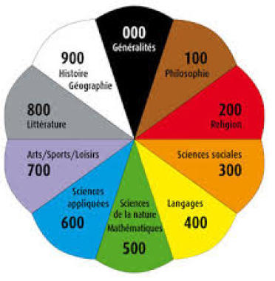
Lost in classification ?
Explain the classification of collections to the users
Poster in a school library

Slide 12
Lost in classification ?
Develop a classification plan :
National library of the Luxembourg
Number of titles
Volumetry, % in collection, linear meters
Number of copies

Slide 13
Lost in classification ?
« It is a practikal tool
Not a filosofical system »
Melvil Dewey
By way of conclusion

Slide 14
Lost in classification ?
Thank you for your attention !
bernadette.patte@univ-poitiers.fr
Any questions ?

