Slide 1
The Swedish WebDewey a mixed translation
Harriet Aagaard
The National Library of Sweden
EDUG meeting 22 May 2014

Slide 2
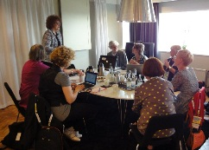
The Dewey project 2009 - 2011
Magdalena Svanberg, projectmanager
Projectgroup 6 persons
9.3 years of work (for one person)
Mixed translation - 40 %
SAB (the Swedish Classification System)
The Abridged edition
All superordinate classes to translated classes
All tables
Training
Mappings

Slide 3
The Swedish Dewey project - goals
Translate DDC to Swedish using the mixed model
Map Swedish subject headings to DDC
Update and revise the existing conversion table SAB-DDC
Develop tools for joint search and navigation of material with SAB codes and material with DDC numbers
Train librarians.
Started May 2009

Slide 4
Why a mixed translation?

Slide 5
40 %

Slide 6
Index: öl (beer)
Beer - Commercial processing

Slide 7
Index: beer

Slide 8
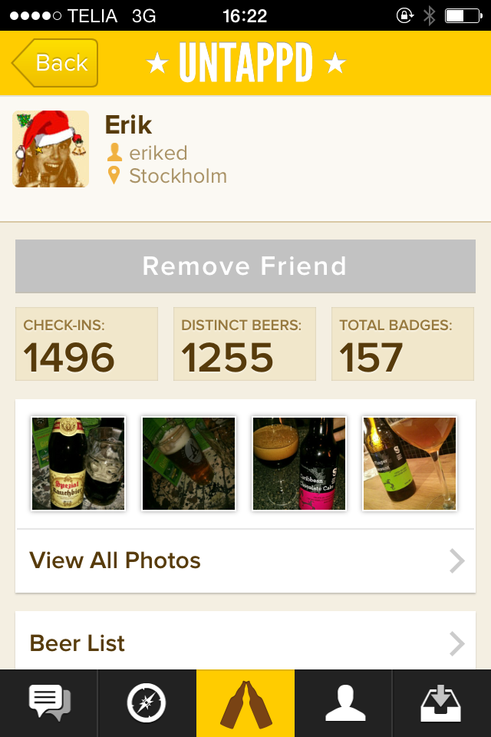
Missing
641.23
Interdisciplinary number
641.873
Aspect – home brewing

Slide 9
Solution: translation

Slide 10
?

Slide 11
Pros & Cons
+
Economy
Dewey in Sweden
Updates takes less time
-
Risk for bad classification
Classification takes more time
WebDeweySearch – possible to search in Swedish?
Linked data – in Swedish?
Subject access in the future webLibris
Updates takes more time
Learning more complicated

Slide 12
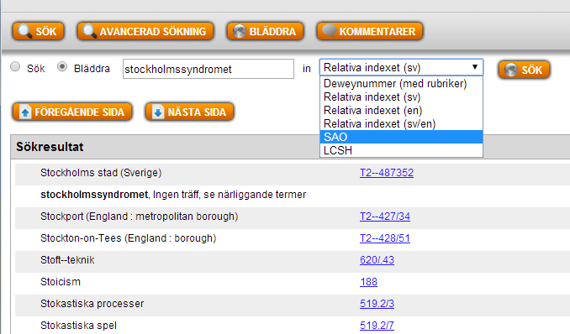
Searching the index
Search the Swedish index
Search the mappings to the Swedish Subject Headings
Search the English index
Risk of missing information & numbers
Classification takes more time

Slide 13
The plan for a mixed translation
Schema
Index, Tables
Manual

Slide 14
Do Swedish librarians understand
English?

Slide 15
A lot of instructions
In the Notes and in the Manual to
Read
& understand!

Slide 16
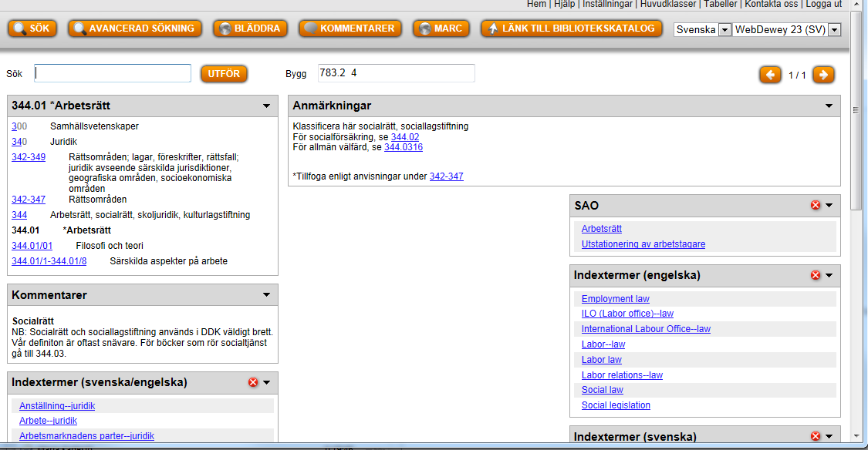
Comments
Social law
NB: Social law and social legislation is used broadly in DDC. Our definition is usually more narrow. For works on Socialtjänst (Social services) see 344.03

Slide 17
Stay with the English
Translation

Slide 18
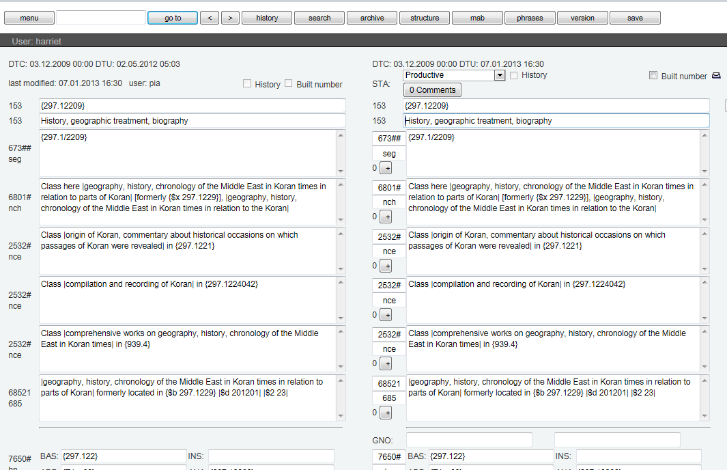

Slide 19
Backlog
1172 update pages ~ 11720 entries
1083 update pages before April 20, 2012
http://commons.wikimedia.org/wiki/File:Blue_Sad.jpg

Slide 20
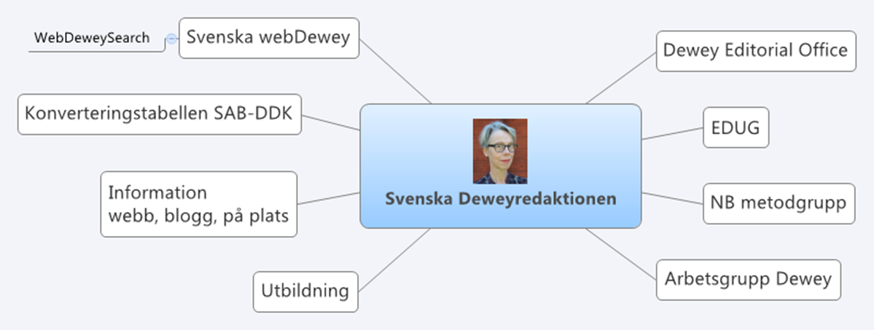

Slide 21
Goal – update to Number building

Slide 22
60 %

Slide 23
Subject acess
Linked data
DDC in Swedish!

Slide 24
Thank you!
harriet.aagaard@kb.se
dewey@kb.se
+4610-7093612

