Slide 1
Sharing classification data in Norway : cooperation and reuse
Ingebjørg Rype, National Library
Unni Knutsen, Oslo University Library

Slide 2
Overview
Use of Dewey in Norway
Recommendations for use of the Norwegian WebDewey
Cooperation in practice within the BIBSYS consortium
Why cooperation?
How to cooperate?

Slide 3
Use of Dewey in Norway
Used by all public and school libraries
Used by most academic and special libraries
Norwegian WebDewey
Full translation with some expansions
One size fits all?
Notes:
((2)In Norway Dewey is used by all public and school libraries, and by most academic and special libraries. Until the Norwegian WebDewey was launched in 2015, the public libraries and school libraries used the Norwegian customized edition. Many of the academic and special libraries used both the Norwegian and the complete DDC. The Norwegian edition was based on the literary warrant of Norwegian libraries, and was therefore abridged to meet the needs of the literary warrant. The National library, together with the Norwegian Committee on Classification and Indexing (now called …) spent a lot of time investigating the needs of a web edition. It was an agreement that we wanted an edition all Norwegian libraries could use. We tested, together with Sweden, how a mixed edition would work. The investigations came to the result that we would loose to much information if we [gikk for] a mixed edition. We would loose the information of including notes, we wanted the index terms to remain in Norwegian, and so on. Norway does not have national subject headings, which makes the Dewey index terms an important source for subject headings. The result of these considerations [?] was to translate DDC23 as a whole. We were concerned of the needs of the public- and small libraries. Would a complete version be too complicated? For a while we discussed the possibility of letting the Norwegian abbrevations remain, but it had meant too much work. We also discussed use of the abridged Dewey for those who wanted that, but came to the result that the numbers contain information which is useful for all libraries and for the end users, and that a solution is to differ between class number and shelf sign.

Slide 4
Who classifies?
Documents from/about Norway) (incl. Articles)
The National Library (partly tender based)
Some local cataloguing in the public library sector
Dissertations and other scholarly publications catalogued by academic and special libraries
The National Bibliography is therefore partly a cooperative effort
Foreign material
Academic and special libraries
Notes:
(3) Norwegian editions: The National library is responsible for classification to the National bibliography. The cataloguing and classifications work is [satt ut] to commercial supplers who do the work on behalf of NB. These metadatas are [kvalitetssikret] by the NB used by the public- and school libraries as well as by the National Library and in Alma, [felleskatalogen] for special- and academic librariese. This means that the academic libraries get the same class numbers as the public and school libraries on the Norwegian material.

Slide 5
The role of the National Library
Responsible for the implementation and dissemination of standards, e.g. WebDewey
Enables contact and collobaration between all relevant parties, including international forums
Advisory committee, EDK
Recommendations on applying the Norwegian WebDewey
Notes:
[5]The National Library is responsible for the administration of Dewey in Norway. It means licences, translations and updates, number building, training. Recommendations for the practical use of Dewey is worked out together with EDD. (The National Committee of subject data). EDD has memebers from all branches of the Norwegian library chain.: The National Library, public libraries, suppliers, system vendors and the library education.

Slide 6
Recommendation: Level of classification
The class numbers should be correct and complete
Better retrieval
Facilitates reuse
Notes:
[6]Recommendation: Classification. The class numbers should be correct and complete. A correct class number will give a better retrieval, and it is necessary if you want to reuse. Therefore it is important to follow standards, i..e. to follow the instruction in notes and manual. A complete class number is important for the same reasons.
use them by end users. Correct number: Follow notes and manual.

Slide 7
Recommendation: Reuse of class numbers
When copy cataloguing, reuse the class number if it is from an authoritative source, and from the newest Dewey edition
Authoritative sources:
LC Library of Congress
BL British Library
NB The (Norwegian) National Library
Other sources may also be authoritative, e.g. other national libraries
Notes:
[7] When copy cataloguing, reuse the class number if it is from an authoritative source and from the newest Dewey edition. Also reuse the class number if the book is translated and the original edition is classed by an authoitrative source. We had to make a decision what we consider as authoritative sources. Library of Congress, British library, Norwegian National Library. Other sources may also be considered as authorities, e.g. other [10] [9] When copy cataloguing, reuse the class number if it is from an authoritative source and from the newest Dewey edition. Also reuse the class number if the book is translated and the original edition is classed by an authoitrative source. We had to make a decision what we consider as authoritative sources. Library of Congress, British library, Norwegian National Library. Other sources may also be considered as authorities, e.g. other national libraries We have seen that the national libraries do not always classify complete, and we in some respects do not agree. It can also be difficult to see who the classification agency is. Would like to hear more about praxises here. We also have seen that BNB and LC have some differences.

Slide 8
Recommendation on use of MARC fields
082 $a: Class number from authoritative source or original provider of Dewey number
082 $zb (NORMARC)/083 $a(MARC 21): Any deviation from main Dewey number
09X: Numbers that are not correct or complete, e.g. abbreviated numbers or numbers according to local practice
Notes:
[8]We use 083 for other numbers, for retrieval. The BIBSYS case: Many different libraries class, used to different practices. [But not for wrong or abbreviated numbers!]

Slide 9
Recommendation: Recording of edition
$2 5/nor
$2 21
$2 23 and $2 23/nor
Notes:
[9] If you want to reuse a class number, it It is important to see what edition which is used. One example here is the changes of periods of Nordic history. Some libraries reclassifiy, some do not.

Slide 10
Recommendation: Class number vs. call number
Be aware of different functions:
Class number: tool for retrieval through the catalogue
Call number: tool for shelf access
This provision enables large and small libraries to use the full edition and reuse classification
Notes:
[10] We have chosen to emphasize the difference between the two: The class number is a tool for retrieval through the catalogue. The shelf sign is a tool for reuse on the shelf. And they do not need to be similar. This is a way to meet local needs, a library can put the books where they wnat onm the shelves, but they should follow the Dewey rules for classification. This is alsp a way of getting common practice.

Slide 11
Recommendation: Number building
Share the numbers you build in Norwegian WebDewey
Built numbers may be reused
Time saving in the long run
Notes:
[11] Share the numbers you build in Norwegian WebDewey. Through the training courses, we emphasized the number building. The courses lasted two days, with one day of number building,. It is a little complicated, and needs a lot of training. Why we think the the national number building is important, is that we think the classification work will be easier. We will have a lot of built numbesr, and you will see the [mønster], even if the number you are looking for is not built in WebDewey. It will also facilitate the retrieval in end user services. We will have much more index terms on different built topics.

Slide 12
Current situation and role of National Library
13420 built numbers in Norwegian WebDewey in a year (includes 1172 rejected numbers (8,6 %)
Numbers are checked and index terms added by the Norwegian Dewey editorial team
When in doubt as to whether a number is correctly assigned to a document, we check against the library’s catalogue or contact the library
The libraries receive feedback if the numbers are rejected explaining why
Contributed by
The National Library (including tenders ) 44 %
UBOmapper 34 %
University and special lbraries 18,5 % (16,8 % from The University of Oslo)
Other libraries 3,5 %
Notes:
[12] How many numbers? How many recected, and why? Obs: Godkjent av det norske teamet, sendes ikke OCLC

Slide 13
Distribution of built numbers (1)
Main class | Built numbers | Percentage of built numbers
000 | 220 | 1,6
100 | 150 | 1,1
200 | 300 | 2,2
300 | 4080 | 30,7
400 | 560 | 4,2
500 | 520 | 3,9
600 | 1100 | 8,2
700 | 1520 | 11,3
800 | 350 | 2,6
900 | 4620 | 34,2
In total | 13420 | 100

Slide 14
Distribution of built numbers (2)
636.2948 Reindeer –Animal husbandry
21 built numbers
338.76 Business enterprises by industry
170 built numbers
780-789 Music
540 numbers many of them from a reclassifying procect at Deichman, the Oslo public library

Slide 15
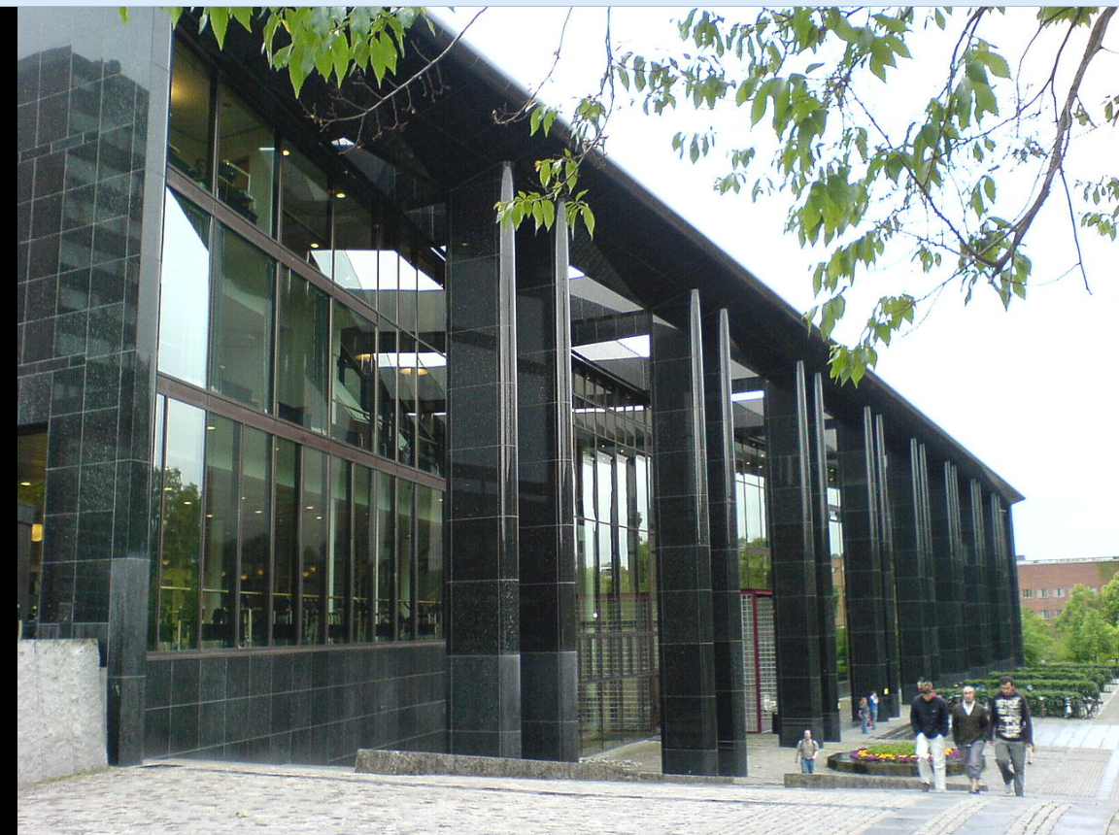
Cooperation seen from Oslo University Library

Slide 16
The BIBSYS consortium
Cooperation started in the 1970s
Approximately 100 academic and research libraries
Includes the National Library (and national bibliography)
Change of ILS in 2015 (Alma ExLibris)

Slide 17
Classification policy
Before Alma: classification = local data
After Alma: classification = preferably shared
Survey 2016: 36 libraries wanted to share their classification
Currently: 27 libraries with classification contact address, of those 15 with MARC institution code

Slide 18
Which rules apply?
Totally aligned with the national recommendations
Those who don’t share: MARC field 092
Those who do: MARC 21 fields 082 and/or 083
First library to classify adds their organization code
National Library is responsible for the national bibliographic records

Slide 19
University of Oslo
In order to start using the Norwegian WebDewey and reach a decision on reuse of classification data, we developed a strategy document
Decision: our goal is to share and to reuse classification
Decision partly based on two surveys conducted in 2015

Slide 20
Surveys – how is Dewey used?
1) Survey on classification practice, June 2015
Response rate: 86,2 %
2) Comparative study, June-December 2015
319 titles analyzed
Published in the report Er økt gjenbruk av klassifikasjonsdata mulig? [is increased reuse of classification data possible?] (February 2016)

Slide 21
Survey on classification practice
Use of sources
When you classify, do you consult classification data from other sources?
Answer | Number | Per cent
Always | 5 | 20 %
Often | 13 | 52 %
Sometimes | 7 | 28 %
Rarely | 0 | 0
Never | 0 | 0

Slide 22
Survey on classification practice
Usefulness
How useful do you find classification data from other sources?
Level of degree | Number | Per cent
Very high degree | 0 | 0 %
High degree | 4 | 16 %
Some degree | 18 | 72 %
Not very usable | 3 | 12 %
Not usable | 0 | 0

Slide 23
Survey on classification practice
Possible reuse in Alma
To what degree do you foresee reusing DDC-data from authoritative sources rather than classifying yourself?
Level of degree | Number | Per cent
Very high degree | 0 | 0
High degree | 6 | 24
Some degree | 9 | 36
Minor degree | 5 | 20
Not at all | 3 | 12
Do not know | 2 | 8

Slide 24
Comparative study
Approach:
Newly acquired books
Randomly selected
Compared DDC-numbers againt the English WebDewey (Norwegian under translation)
DDC numbers from UiO against LC, OCLC, National Library of Norway
Graded the level of compliance
Qualitative assessment of the classification numbers according to standard Dewey theory
Every class number assessed three times (by different people) to reduce subjectivity

Slide 25
Results
Approximately half of the titles were found in LC, and 80 % in OCLC Classify
The National Library covers Norwegian material well
Overall assessment of UiO classification : good quality (67,2 % retrieved in LC, 64,2 % retrieved in OCLC Classify)
UiO often has lower level of specificity than the other sources

Slide 26
Results
LC and OCLC Classify hold higher quality than UiO.
80,5 % of LC titles are considered «correct», 68,2 % of OCLC titles are «correct»
Both from a qualitative and quantitative point of view it makes sense to consult and reuse DDC numbers from LC and OCLC Classify

Slide 27
Comparison with National Library class numbers
At the time, the National Library classified according to the current, Norwegian abbreviated DDC
Comparison by assuming that NL classified according to full edition
Result: 68 % similarity

Slide 28
Recommendations from the UiO Dewey Committee
Reuse classification from authoritative sources as much as possible
Stop all local practices –local practices impede reuse of data
For the sake of user friendliness, consider having shorter call numbers
Complete move to Norwegian WebDewey

Slide 29
So where are we now?
Much more reuse from LC, BnB and other national libraries through import
Reuse of numbers also applies to translations into Norwegian
We would sometimes like to report obvious mistakes from authoritative sources! How?
How to cope when LC and BnB numbers differ?

Slide 30
Cooperation within the BIBSYS consortium
UiO classifies doctoral dissertations for the national bibliography
Communication with the National Library works both ways, we discuss matters and reach conclusions when disagreeing or when in doubt
Increasingly easier to contact other libraries

Slide 31
Number building
Some hesitation among the classifiers: number building is time consuming, is this a good investment?
We now see that we reuse our own built numbers
More classifiers understand that sharing built numbers is important and may save time in the long run
The responses from the National Library on built numbers increase the quality of our classification and corrects errors in the catalogue

Slide 32
Over time
Cooperation on classification will result in better quality of data
Cooperation on classification will increase our level of knowledge
Cooperation on classification is time consuming when one institution classifies and others simply reuse

Slide 33
Summing up
Cooperation on classification in Norway mainly involves the National Library, the vendor of bibliographic data to the public and school libraries and members of the BIBSYS consortium
We would like to be more actively involved with authoritative sources abroad
We would like to share more classification data, e.g. built numbers
How to best cooperate?

