Slide 1
EDUG Six years of cooperation
Karin Kleiber

Slide 2
Content
History
Structure
Members
Activities
Plans

Slide 3
EDUG history
Around 2000
French, Italian, German translations of DDC 21 and 22 existed, many other translations of other versions were in use in Europe
More and more Europen libraries adopted the DDC
Need to share experience and to cooperate

Slide 4
EDUG history
In 2007 EDUG was established to
promote professional interests of European DDC users
encourage the development of techniques, applications and documentation of translations
coordinate proposals of the DDC according to European interests

Slide 5
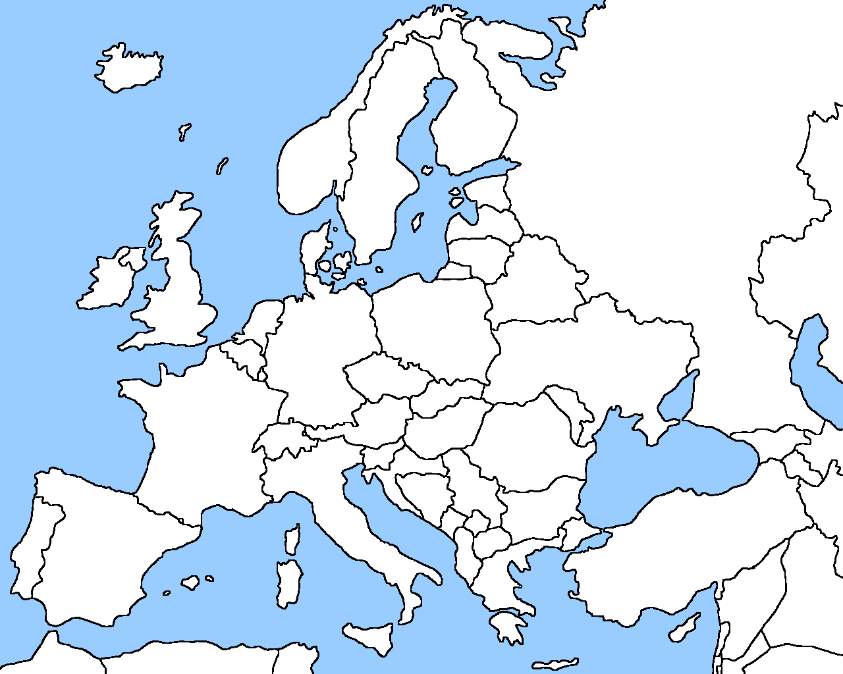
EDUG history

Slide 6
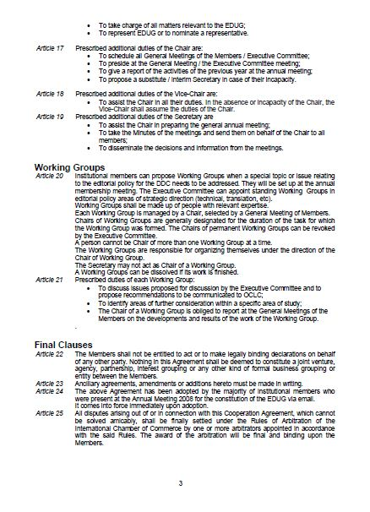
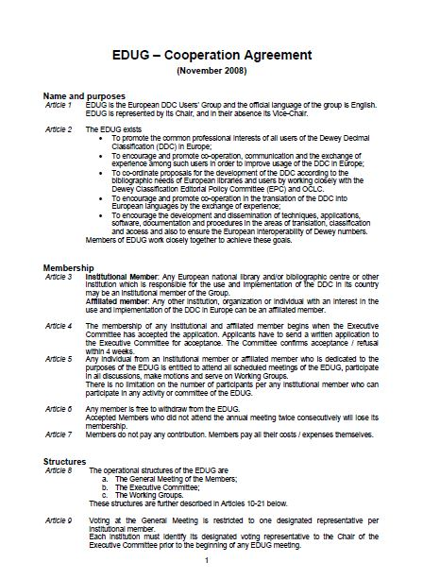
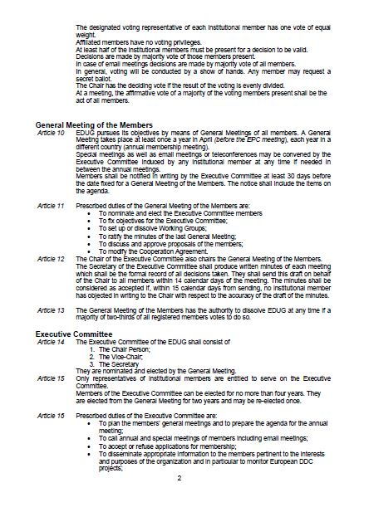
EDUG structure
EDUG is governed by a cooperation agreement (Bylaws)
a General Meeting of members is held at least once a year
an Executive Committee is elected every other year
Chair: Karin Kleiber (ÖNB)
Vice-Chair: Heidrun Alex (DNB)
Secretary: Caroline Kent (BL)

Slide 7
EDUG structure (continued)
Membership is free
Two categories of members:
Institutional members
Affiliated members

Slide 8
Institutional members 2013
Biblioteca nazionale centrale di Firenze
Bibliothèque nationale de France
Britisch Library
Deutsche Nationalbibliothek
National Library of Norway
National Library of Sweden
Oesterreichische Nationalbibliothek
Schweizerische Nationalbibliothek

Slide 9
Affiliated members 2013
Bibliotheks- und Archivwesen der Universität Wien (Austria)
KHT Library (Sweden)
Linköping University Library (Sweden)
Menntaskolinn vid Sund Library, Reykjavik (Iceland)
Oberoesterreichische Landesbibliothek (Austria)
OCLC EMEA B.V (Netherlands)
Scottish Library and Information Council (Great Britain)
Stockholm University Library (Sweden)
Umea University Library (Sweden)
Université de la Méditerranée (France)
University of Oslo Library (Norway)
Verbundzentrale des GBV, Göttingen (Germany)

Slide 10
Activities
Yearly symposia (in conjunction with the annual meetings)
2007 Bern
2008 Frankfurt
2009 Vienna
2010 Alexandria
2011 Stockholm
2012 Boston Spa
2013 Oslo

Slide 11
Activities (continued)
Working groups
340 (Law)
370 (Education)
930 (Archaeology) and
IT (technical issues)
worked on critical topics and submitted proposals/discussion papers to EPC

Slide 12
Activities (continued)
Input in DDC 23
340: updates for the European Union, criminal courts, juristic acts
370: improved framework for levels of education, kinds of schools, policy issues and primary education
930: expansion of geographic areas and historical periods

Slide 13
Activities (continued)
On the current EPC agenda
340: …..
370: …..
930: …..

Slide 14
Plans for 2013-2014
Support of the working groups
Support for the national DDC communities
Communication, promotion, development of DDC in Europe
General Meeting and symposium 2014

Slide 15
Plans for 2013-2014
Working groups
WG 340: European law issues
WG 370: Adult education, special topics
WG 930: Special notation to represent treatment of topics and places from archaeological viewpoint, Medieval period

Slide 16
EDUG homepage http://www.slainte.org.uk/edug/

Slide 17
Thank you
for your attention!
karin.kleiber@onb.ac.at

